Slide 1
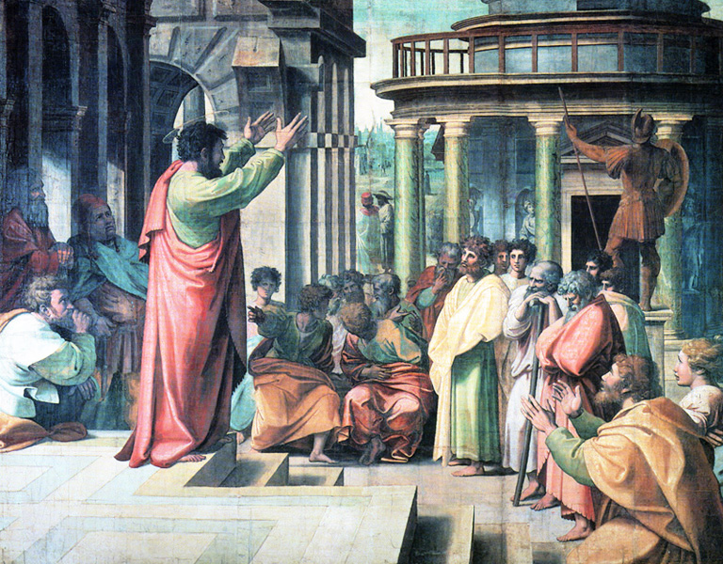
1 & 2 Corinthians
Paul’s most problematic church.
Paul wrote 4 letters to the Corinthians.
The 1st and 3rd letters were missing.
Thus, the 2nd letter is 1 Corinthians and
the 4th letter is 2 Corinthians.
1 Corinthians: What Paul thought was wrong with the people (How members ought to be)
2 Corinthians: What the people thought was wrong with Paul (How ministers ought to be)

Slide 2
FIRST EPISTLE TO
THE CORINTHIANS
(HIS MOST PROBLEMATIC CHURCH)
A letter from Paul to the Corinthians, correcting errors into which they had fallen.
PURPOSE: To address serious doctrinal & ethical problems.
Not confrontation but reconciliation.
THEME: Paul addresses and corrects numerous problems in the church at Corinth.
Paul’s first correspondence with the church in Corinth deals with the divisions and multiple problems this church was experiencing.
The members of the church were following after particular leaders.
In addition they were: involved in sexual immorality, taking their brothers / sisters to court, boasting about their wisdom and superior spiritual gifts and conducting themselves in a disorderly manner in worship services.
"To live like a Corinthian" is to live in gross immorality.

Slide 3
FIRST EPISTLE TO
THE CORINTHIANS
(HIS MOST PROBLEMATIC CHURCH)
            Paul responds with various answers:
            Jesus and His cross are God’s answers to the wisdom of this world.
      No other leader or philosophy can provide that.
Love between brothers and sisters should reign supreme in their relationships, 1Cor 6:1-3
The church is a body with many members and all gifts are important.
Your body is the temple of the Holy Spirit and will be resurrected.
Therefore, what you do with your body is important

Slide 4
FIRST EPISTLE TO
THE CORINTHIANS
(HIS MOST PROBLEMATIC CHURCH)
KEY VERSE: 1 Corinthians 3:11
“For no other foundation can anyone lay than that which is laid, which is Jesus Christ.”
Outline:
THE INTRODUCTION TO THE LETTER chap 1:1-9
THE REPLY TO THE REPORT FROM CHLOE chap 1:10-6:20
THE REPLY TO THE LETTER FROM CORINTH chap 7:1-16:4
CONCLUDING INFORMATION AND EXHORTATION chap 16:5-24

Slide 5
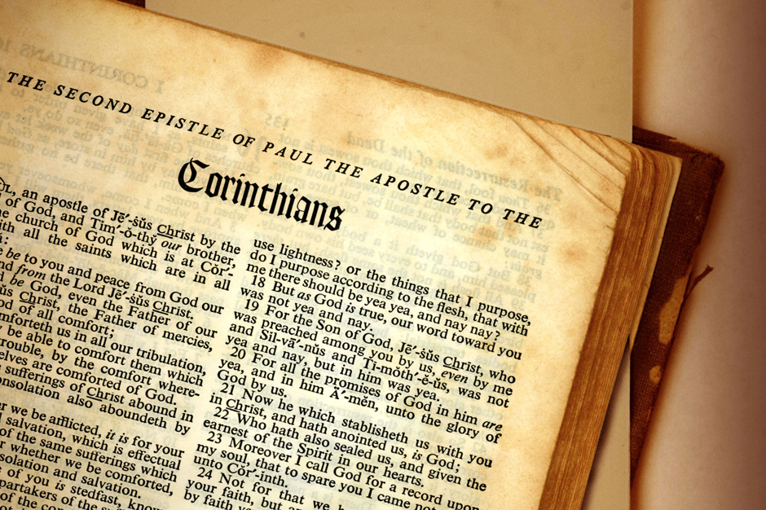
SECOND EPISTLE TO
THE CORINTHIANS
THEME: Paul passionately defends himself from false accusations by false teachers who have attacked his conduct, credibility, and credentials in the Corinthian church.
Paul confirms his disciples in their faith, and vindicates his own character.
In this second correspondence with the Corinthian church, Paul defends his apostleship against the false or “super” apostles who have infiltrated the church.

Slide 6
SECOND EPISTLE TO
THE CORINTHIANS
Paul’s apostleship (unlike that of the false apostles) is characterized by God’s power and not persuasive words; by boasting in his weakness so that God and not man would be glorified and by suffering on behalf of the gospel.
In a separate section of his letter, Paul asks the Corinthians for a generous offering to help those who are experiencing hardship in Jerusalem.
Paul was involved so deeply in all the issues that the letter is filled with emotion.

Slide 7
SECOND EPISTLE TO
THE CORINTHIANS
KEY VERSE: 2 Corinthians 3:5
“Not that we are sufficient of ourselves to think of anything as being from ourselves, but our sufficiency (competence) is from God.”
THE DEFENSE OF PAUL’S MINISTERIAL CONDUCT chap 1-7
THE DECLARATION OF THE PRINCIPLES OF GIVING chap 8-9
THE DEFENSE OF PAUL’S MINISTERIAL CREDENTIALS chap 10-13

Slide 8
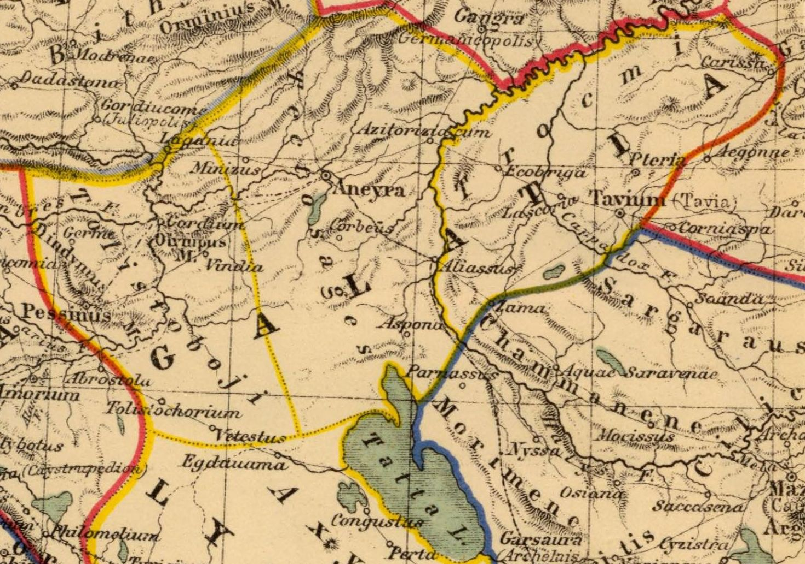
EPISTLE TO
THE GALATIANS
(WHAT THE GOSPEL IS NOT)
About Christian freedom.
THEME: The gospel of salvation by faith alone in Christ alone must be fully embraced, and anyone who teaches any other gospel is accursed.
Stern message: No commendation, praise or thanksgiving.
Martin Luther's favourite.
Paul maintains that we are justified by faith, and not by rites.
Notes:
Photo: Map galatia

Slide 9
EPISTLE TO
THE GALATIANS
(WHAT THE GOSPEL IS NOT)
Shortly after Paul returned from his first missionary journey (50 A.D.), he received word that a Jewish-Christian group had infiltrated the church in Galatia and was demanding that the Gentile brothers become Jews in order that they might be saved.
Paul wrote his strongest letter condemning the Jewish brothers and reprimanding the Galatian church for so quickly abandoning the faith that Paul had planted in them.
“O foolish Galatians,” he calls the church reminding them once again that no one is justified (made right with God) by the works of the law but rather by faith in Jesus Christ.
Notes:
Photo: Map galatia

Slide 10
EPISTLE TO
THE GALATIANS
(WHAT THE GOSPEL IS NOT)
KEY VERSE: Galatians 3:11
“But that no one is justified by the law in the sight of God is evident, for “the just shall live by faith.”
PAUL’S TEACHING ON THE GOSPEL chap 1-2
PAUL’S TEACHING ON THE COVENANTS chap 3-4
PAUL’S TEACHING ON THE CHRISTIAN’S WALK chap 5-6
Notes:
Photo: Map galatia

Slide 11
PRISON EPISTLES
EPHESIANS | PRESENTS THE CHURCH WHICH IS CHRIST'S BODY 2:16
COLOSSIANS | PRESENTS CHRIST AS HEAD OF THE BODY 1:18
PHILIPPIANS | CHRISTIAN LIVING
PHILEMON | CHRISTIAN LIVING IN PAGAN SOCIETY

Slide 12
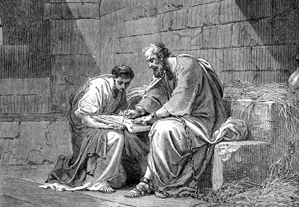
EPISTLE TO
THE EPHESIANS
THEME: The salvation and sanctification of the believer by the Triune God.
Paul did much more in prison than most in freedom.
Didn't pray to be released.
After Romans, this is the most carefully written presentation of Christian theology in NT.
Closely related to Colossians. (50% identical expressions)
Ephesians - the reconciliation of Christ and the church & the ministry of the Holy Spirit.
(Colossians - the deity of Christ)
A exposition by Paul on the power of divine grace.
Notes:
Photo: paul in prison writing his epistle to the ephesians

Slide 13
EPISTLE TO
THE EPHESIANS
PURPOSE: To strengthen the church & to make Christians more conscious of their oneness in Christ.
In his only correspondence with the church he founded in Ephesus, Paul elaborates on the so-called “mystery of God.”
This “mystery” is that before the foundation of the world, God would form the church from among Jews and Gentiles through Christ’s sacrifice on the cross.
Paul reminds the Ephesians that they have inherited many spiritual blessings as a result of being a part of this glorious church body. For this reason they are to walk in a manner worthy of this holy calling imitating God in His love.
In the final chapter, Paul reminds the Ephesians that they are in a spiritual battle between good and evil and that they must put on God’s full armour in order to have complete victory.
Notes:
Photo: paul in prison writing his epistle to the ephesians

Slide 14
EPHESIANS
Notes:
Photo: paul in prison writing his epistle to the ephesians

Slide 15
EPISTLE TO THE EPHESIANS
KEY VERSES: Ephesians 2:8
⁸ For by grace you have been saved through faith, and that not of yourselves; it is the gift of God, ⁹ not of works, lest anyone should boast. ¹⁰ For we are His workmanship, created in Christ Jesus for good works, which God prepared beforehand that we should walk in them.
Ephesians 2:16
and that He might reconcile them both to God in one body through the cross, thereby putting to death the enmity.
NOTICE:
Good works are denied as the basis for salvation, but good works are demanded as a result of salvation.
THE SALVATION WE HAVE IN CHRIST chap 1-3
THE SANCTIFICATION WE HAVE IN CHRIST chap 4-6
Notes:
Photo: paul in prison writing his epistle to the ephesians

Slide 16
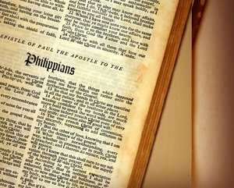
EPISTLE TO
THE PHILIPPIANS
The letter of joy.
One of Paul's most personal letters.
The 1st European congregation - closest to Paul.
Responded better than any other church.
Had fewest problems.
Grateful for the gospel.
He received the Macedonian call during his 2nd missionary journey.
Purpose:
a. To thank the Philippians for a gift they had sent him.
b. Exhortations to rejoice and to unity.

Slide 17
EPISTLE TO
THE PHILIPPIANS
THEME: The joy we have in knowing and serving Christ no matter what our circumstances may be.
The tone is one of joyous confidence in God at work.
Paul sets forth the beauty of Christian kindness.

Slide 18
EPISTLE TO THE PHILIPPIANS
Key verse: Phil 4:4
“Rejoice in the Lord always. Again I will say, rejoice!”
Popular verses:
Phil 1:21 “For to me, to live is Christ, and to die is gain.”
Phil 4.13 “I can do all things through Christ who strengthens me.”
PAUL’S CONDITION AND SITUATION chap 1:1-26
PAUL’S EXHORTATION AND COUNSEL chap 1:27-2:18
PAUL’S COMPANIONS AND HELPERS chap 2:19-30
PAUL’S WARNINGS AND ENCOURAGEMENTS chap 3:1-21
PAUL’S CONTENTMENT AND THANKSGIVING chap 4:1-23

Slide 19
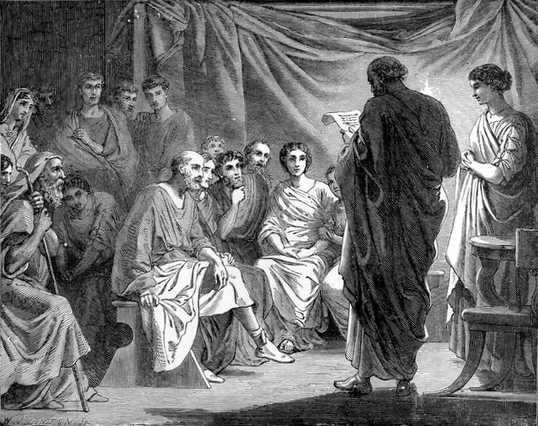
EPISTLE TO
THE COLOSSIANS
A significant deliverance for an insignificant church.
Identical expressions with Ephesians (50%)
Paul had never visited Colosse. Metropolis with many religions.
Many closing greetings.
Purpose: To deal with the doctrinal heresy.
THEME: Christ is a perfect saviour, who provides us with a perfect salvation, to which nothing needs to be added, and from which nothing must be taken away.
Paul warns his disciples against errors, and exhorts to certain duties.
In his letter to the Colossians, Paul is responding to heretical teaching that is making its rounds in the church.

Slide 20
EPISTLE TO
THE COLOSSIANS
This teaching debunks Jewish and mystical tendencies including: a worship with angels, a keeping of festivals and Jewish holy days, a secret wisdom and a mortification of the body.
What is Paul’s response to this falsehood?
Jesus Christ is God’s expressed image. He is firstborn over creation and the resurrection. He is over all principalities and human wisdom and He is head of the church.
Christ also fulfilled the law and therefore there is no longer a need to keep Jewish feasts and holy days.
Paul did not directly argue with the Colossians but built a positive case for the Christian truth.

Slide 21
EPISTLE TO THE COLOSSIANS
KEY VERSES:
Colossians 1:18
And He is the head of the body, the church, who is the beginning, the firstborn from the dead, that in all things He may have the pre-eminence.
Colossians 2:9-10
⁹ For in Him dwells all the fullness of the Godhead bodily; ¹⁰ and you are complete in Him, who is the head of all principality and power.
THE DOCTRINAL DISSERTATION chap 1-2
THE PRACTICAL APPLICATION chap 3-4

