Slide 1
PAUL’S EPISTLES
TO THE CHURCHES
Written to encourage, warn & instruct :
~ the churches he had founded
(1 & 2 Corinthians, Galatians, *Ephesians, *Philippians, 1 & 2 Thessalonians)
~ the churches he had not visited (Romans, *Colossians)
~ to individuals (1 & 2 Timothy, Titus, *Philemon)
* Prison epistles (letters)

Slide 2
PAUL’S EPISTLES
TO THE CHURCHES
Paul’s style:
a. identifies himself & his addressees
b. sends them greetings
c. thanksgiving & intercession for the readers
d. deals with doctrinal questions
e. deals with their application to life
f. greetings from his companions & to various people
g. benediction
He begins & ends with the unspeakable gift of God’s grace in Christ.

Slide 3
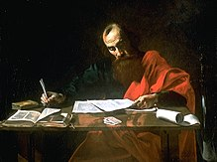
PAUL’S BACKGROUND
A Jew, of the tribe of Benjamin.
Grew up in religious family (Judaism).
Named after the 1st king of Israel - Saul.
Studied at Tarsus University (ranked no. 3)
Spoke Greek (lingua franca)
A Roman citizen; knew Roman law.
Thus, most suited to be a missionary for God.
After encounter with Christ, spent 3 years in Arabian suburbs & then 10 years in Tarsus before commencing ministry.
Notes:
Photo: depiction of paul writing his epistle to the romans

Slide 4
PAUL’S STRATEGY
Planted churches in the cities.
Revisited the churches.
Appointed local leaders.
Wrote (dictated) letters when he couldn’t visit them again.
Thank God that the NT churches were not perfect else there would be no letters.
Thank God that He used letters for divine revelation because they are personal (to us) and practical (related to life).
Paul’s letters averaged 1300 words. Romans was longest with 7000 words. (Letters of those days averaged 18-209 words)
Notes:
Photo: depiction of paul writing his epistle to the romans

Slide 5
Notes:
Photo: depiction of paul writing his epistle to the romans

Slide 6
EPISTLE TO
THE ROMANS
THEME: God’s plan of salvation explained and applied
An exposition by Paul on the doctrine of justification by Christ, 20 years into his ministry.
Theologically the most important of all Paul's epistles.
Most comprehensive & logical presentation of the gospel.
Romans is Paul’s most elaborate definition of the gospel written in anticipation of his visit to the Roman church on his way to Spain - what the gospel is.
Notes:
Photo: depiction of paul writing his epistle to the romans

Slide 7
EPISTLE TO THE ROMANS
PURPOSE: To preach the gospel where Christ has not been named.
Paul summarizes that both Gentiles and Jews cannot escape the judgement of sin, but that through Jesus Christ and His death, both are now justified by faith.
Paul also provides a long response to why Israelites did not embrace their Jewish messiah. (chaps 9-11, past, present & future)
2 Major Parts:
Theological (1:18-11:36)
Practical (12:1- 15:13)
Theology ought to result in practical life and practical life ought to be grounded in theology. Else, it's not a complete gospel.
Notes:
Photo: depiction of paul writing his epistle to the romans

Slide 8
EPISTLE TO THE ROMANS
KEY VERSES:
Romans 1:16
For I am not ashamed of the gospel of Christ, for it is the power of God to salvation for everyone who believes, for the Jew first and also for the Greek.
Romans 11:36
“For of Him and through Him and to Him are all things, to whom be glory forever. Amen.”
OUTLINE:
THE EXPOSITION OF THE GOSPEL chap 1-8
THE EXPLANATION OF ISRAEL’S TRANSFORMATION chap 9-11
THE EXHORTATION TO HOLY LIVING chap 12-16
Notes:
Photo: depiction of paul writing his epistle to the romans

Slide 9
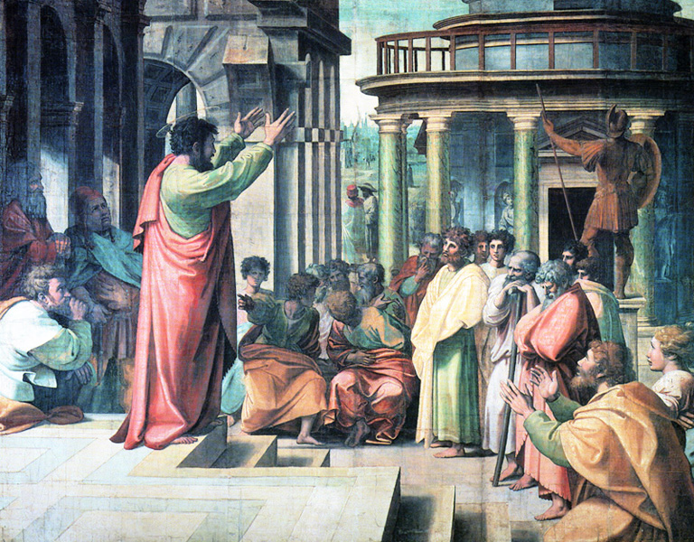
1 & 2 Corinthians
Paul’s most problematic church.
Paul wrote 4 letters to the Corinthians.
The 1st and 3rd letters were missing.
Thus, the 2nd letter is 1 Corinthians and
the 4th letter is 2 Corinthians.
1 Corinthians: What Paul thought was wrong with the people (How members ought to be)
2 Corinthians: What the people thought was wrong with Paul (How ministers ought to be)

Slide 10
FIRST EPISTLE TO
THE CORINTHIANS
(HIS MOST PROBLEMATIC CHURCH)
A letter from Paul to the Corinthians, correcting errors into which they had fallen.
PURPOSE: To address serious doctrinal & ethical problems.
Not confrontation but reconciliation.
THEME: Paul addresses and corrects numerous problems in the church at Corinth.
Paul’s first correspondence with the church in Corinth deals with the divisions and multiple problems this church was experiencing.
The members of the church were following after particular leaders.
In addition they were: involved in sexual immorality, taking their brothers / sisters to court, boasting about their wisdom and superior spiritual gifts and conducting themselves in a disorderly manner in worship services.
"To live like a Corinthian" is to live in gross immorality.

Slide 11
FIRST EPISTLE TO
THE CORINTHIANS
(HIS MOST PROBLEMATIC CHURCH)
            Paul responds with various answers:
            Jesus and His cross are God’s answers to the wisdom of this world.
      No other leader or philosophy can provide that.
Love between brothers and sisters should reign supreme in their relationships, 1Cor 6:1-3
The church is a body with many members and all gifts are important.
Your body is the temple of the Holy Spirit and will be resurrected.
Therefore, what you do with your body is important

Slide 12
FIRST EPISTLE TO
THE CORINTHIANS
(HIS MOST PROBLEMATIC CHURCH)
KEY VERSE: 1 Corinthians 3:11
“For no other foundation can anyone lay than that which is laid, which is Jesus Christ.”
Outline:
THE INTRODUCTION TO THE LETTER chap 1:1-9
THE REPLY TO THE REPORT FROM CHLOE chap 1:10-6:20
THE REPLY TO THE LETTER FROM CORINTH chap 7:1-16:4
CONCLUDING INFORMATION AND EXHORTATION chap 16:5-24

