Slide 1

GOSPEL OF MARK
JESUS AS THE SERVANT
THE POWERFUL SAVIOUR
THEME: Jesus is the dynamic and powerful
servant of God
The first and shortest (journalism) of the 4 gospels, written 25 years before gospel of Matthew
Based his gospel on the preaching of Peter.
A brief history of the life of Christ, supplying some incidents omitted by Matthew.
Notes:
Photo: servant king

Slide 2
GOSPEL OF MARK
JESUS AS THE SERVANT
THE POWERFUL SAVIOUR
Gospel of miracles (20). More about the actions than teachings of Jesus.
Romans didn’t care where one was from but what one could do. Thus, no genealogy. No OT quotes.
Used "immediately" 41 times.
KEY VERSE: Mark 10:45 For even the Son of Man did not come to be served, but to serve, and to give His life a ransom for many.”
Notes:
Photo: servant king

Slide 3
GOSPEL OF MARK
JESUS AS THE SERVANT
BUILDING UP:
30 months in the north (Galilee)
6 months in the south (Judea)
SLOWING DOWN:
Years, months, weeks, days, hours
THE POWERFUL SERVANT OF GOD INTRODUCED chap 1:1-13
THE POWERFUL SERVANT OF GOD MINISTERS IN GALILEE chap 1:14-9:50
THE POWERFUL SERVANT OF GOD RETURNS TO JUDEA chap 10:1-52
THE POWERFUL SERVANT OF GOD IN JERUSALEM chap 11:1-16:20
Notes:
Photo: servant king

Slide 4
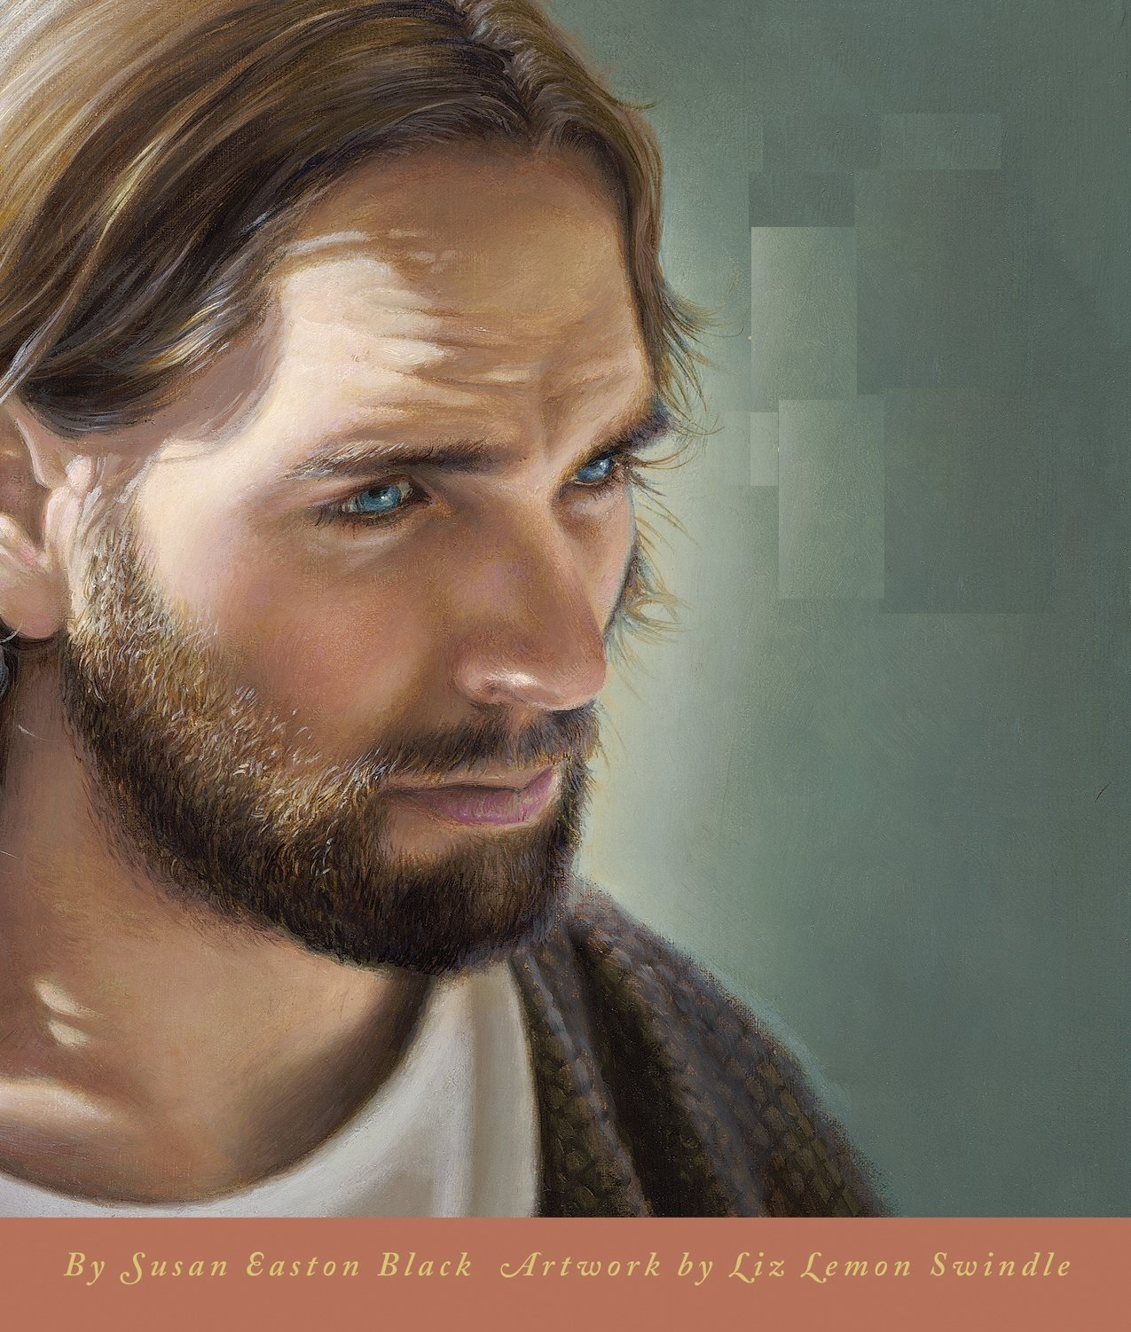
GOSPEL OF LUKE
JESUS AS THE SON OF MAN – THE PERFECT SAVIOUR
THEME: The perfect life of the perfect man brings a perfect salvation, and sets a perfect example for us to follow and imitate. (Greeks valued intellect, philosophy & perfection)
The first church historian.
The only gentile writer and a doctor (to tell us about virgin birth)
The history of the life of Christ, with special reference to His most important acts and detailed teachings. 18 more parables unique to Luke. Longest narrative.

Slide 5
GOSPEL OF LUKE
JESUS AS THE SON OF MAN – THE PERFECT SAVIOUR
Presents the birth, ministry, passion, death and resurrection of Jesus Christ as close parallels to the gospel of Matthew and Mark (Synoptic gospels).
Luke emphasized Jesus’ Jewish roots (the initial chapters take place in the temple) in order that Jesus Christ be presented as the Jewish messiah for a Gentile world.
Luke emphasized the poor, marginalized, women, outcasts and sinners as special recipients of God’s mercy. The humanity of Christ.
KEY VERSE: Luke 19:10 “For the Son of Man has come to seek and to save that which was lost.”

Slide 6
GOSPEL OF LUKE
JESUS AS THE SON OF MAN
THE EARLY LIFE OF THE PERFECT MAN chap 1:-4:13
THE MINISTRY OF THE PERFECT MAN chap 4:14-21:38
THE DEATH & RESURRECTION OF THE PERFECT MAN chap 22:1-24:53
SUMMARY:
A human gospel
A heavenly gospel
A happy gospel
OR SIMPLY:
The universal gospel

Slide 7
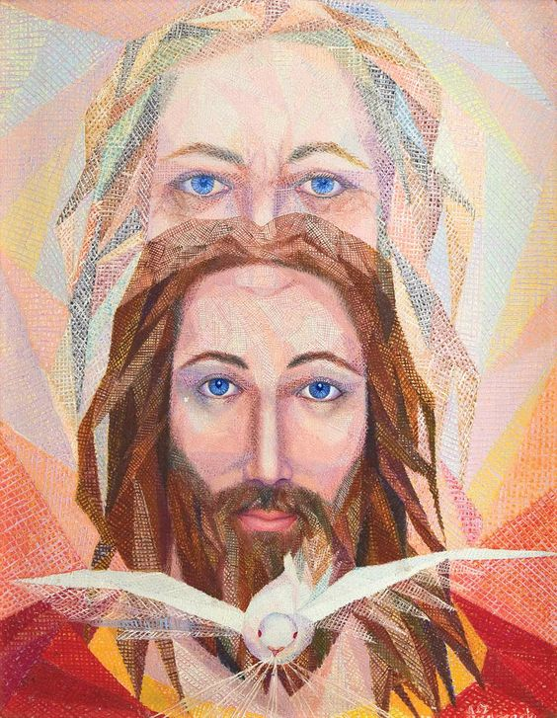
GOSPEL OF JOHN
JESUS AS THE SON OF GOD – THE PERSONAL SAVIOUR
THEME: Jesus is the Son of God incarnate in human flesh
The last written, AD 100 in Ephesus.
Purpose: John 20:30-31 “And truly Jesus did many other signs in the presence of His disciples, which are not written in this book; ³¹ but these are written that you may believe that Jesus is the Christ, the Son of God, and that believing you may have life in His name.”
The life of Christ, giving important discourses not related by the other evangelists.
Notes:
PHOTO: TRINITY

Slide 8
GOSPEL OF JOHN
JESUS AS THE SON OF GOD – THE PERSONAL SAVIOUR
Thoroughly grounded in Judaism and the Old Testament background.
No account of Jesus' birth or early years but begins with a statement of His pre-existence & divinity.
Concentrated heavily on the theological teachings of Jesus - light/darkness, belief/unbelief, love/hate, earthly/heavenly, relationship between the Father, the Son & the Holy Spirit, etc
Exhibition of God in Christ vs rejection of Christ by the Jews,
God's offer vs man's refusal,
God's love vs man's sins.
Notes:
PHOTO: TRINITY

Slide 9
GOSPEL OF JOHN
JESUS AS THE SON OF GOD
THE PROLOGUE chap 1:1-51
THE PUBLIC MINISTRY OF THE SON OF GOD chap 2:1-12:50
THE PRIVATE MINISTRY OF THE SON OF GOD chap 13:1-17:26
THE DEATH & RESURRECTION OF THE SON OF GOD chap 18:1-20:31
THE EPILOGUE chap 21:1-25
TRUTH IS NOT A PROPOSITION.
TRUTH IS A PERSON.
SOMEONE NOT SOMETHING.
Notes:
PHOTO: TRINITY

Slide 10
HISTORICAL BOOK

Slide 11
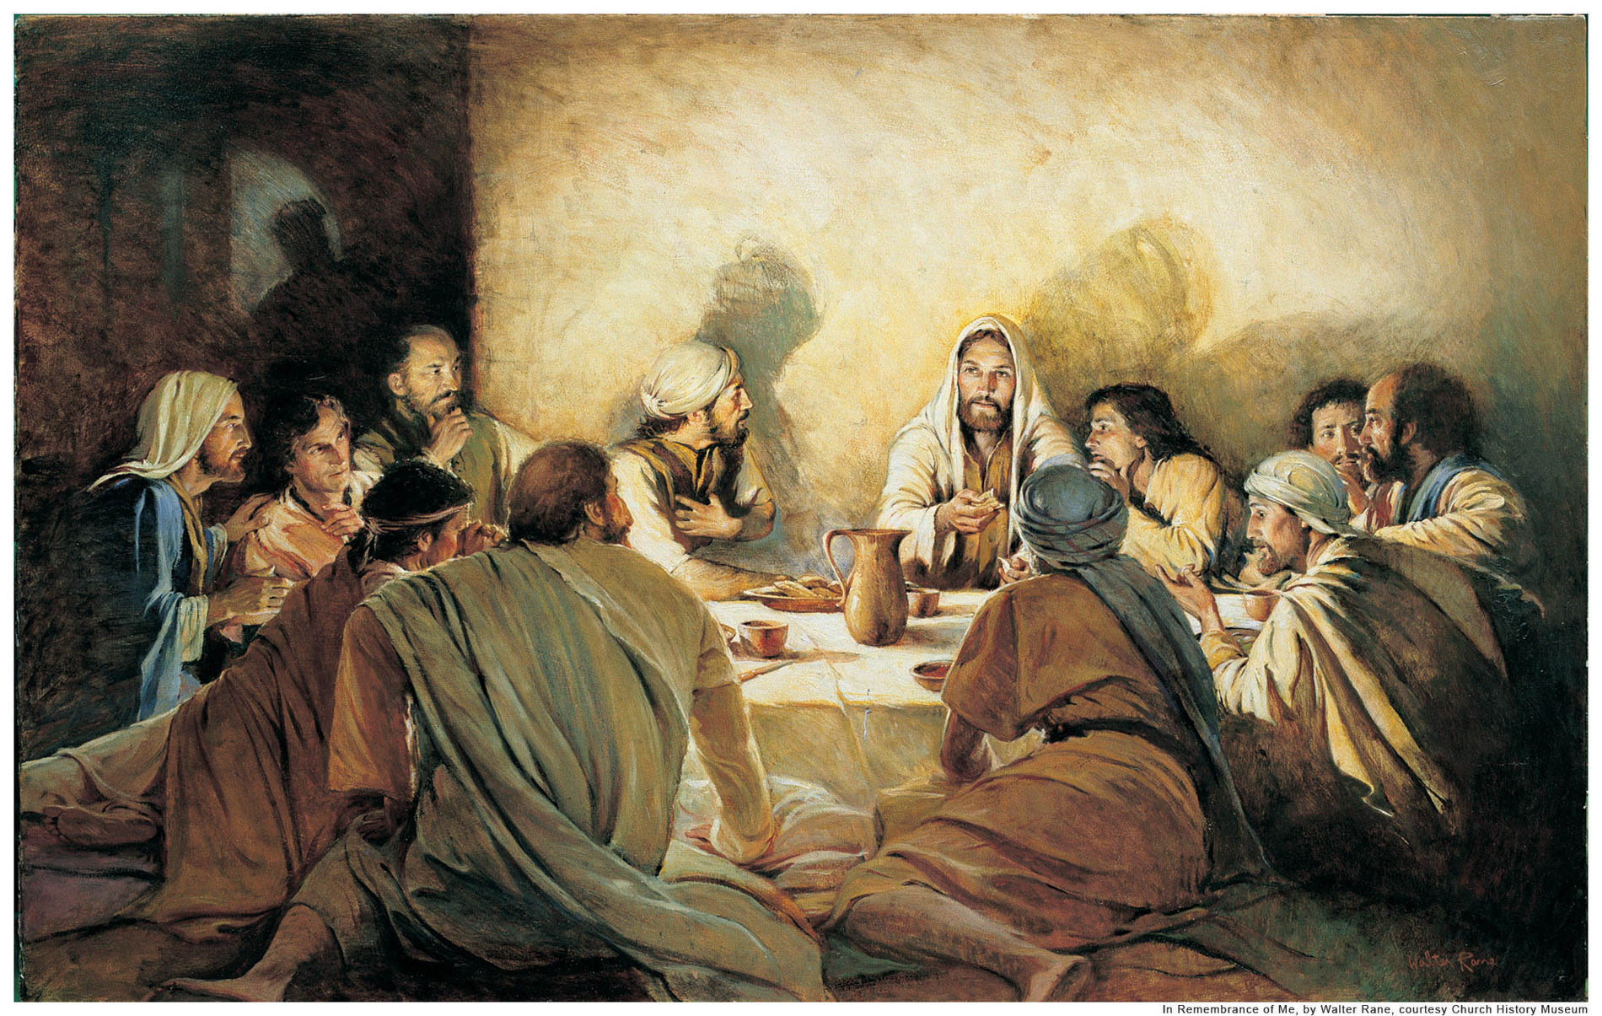
ACTS OF
THE APOSTLES
(OF THE HOLY SPIRIT)
AUTHOR: Luke, the beloved physician. Written over 38 years
PURPOSE: To inform & confirm the faith of believers, as well as to win converts to "The Way" (9:2 “He sent them to preach the kingdom of God and to heal the sick.”)
THEME: The beginning and the witness of the first century church as it spread the gospel of Jesus Christ throughout the world.
Acts begins where Luke ends with the ascension of Jesus into heaven.
Notes:
Photo: apostles

Slide 12
ACTS OF
THE APOSTLES
(OF THE HOLY SPIRIT)
The history of the labour of the apostles and of the foundation of the Christian Church.
Entire book is an expansion & fulfilment of the promise of 1:8.
Narrates the beginning of the Christian church on the Day of Pentecost and the expansion of the church through the apostle’s Peter (Jerusalem), Philip (Samaria) and Paul (Gentile world).
The last 8 chapters deal with Paul’s trials before Jewish leaders and Roman magistrates, and Paul’s voyage to Rome to stand trial before Caesar.
Notes:
Photo: apostles

Slide 13
ACTS OF
THE APOSTLES
(OF THE HOLY SPIRIT)
KEY VERSE: Acts 1:8
“But you shall receive power when the Holy Spirit has come upon you; and you shall be witnesses to Me in Jerusalem, and in all Judea and Samaria, and to the end of the earth.”
OUTLINE:
THE WITNESS TO CHRIST IN JERUSALEM, JUDEA AND SAMARIA chap 1-12
THE WITNESS TO CHRIST IN THE UTTERMOST PARTS OF THE EARTH chap 13-28
Notes:
Photo: apostles

