Slide 1

NEW TESTAMENT

Slide 2
The Old enfolds the New.
The New unfolds the Old.
The New is in the Old concealed.
The Old is in the New revealed.
The Old and the New Testaments
The OT was the bible for the NT writers.
OT quoted more than 300 times in NT.

Slide 3
Without the NT, the OT is…
Promise without fulfillment
Problem without solution
Riddle without answer
Shadow without substance
Pregnancy without delivery

Slide 4
What is the gospel?
The good news about what God has done through Jesus Christ to save us.
The essence is of Christ’s life, death & resurrection.
Fills us with hope, peace & joy.
4 narratives but 1 gospel.

Slide 5
THE FOUR NARRATIVES (news bulletin)
Matthew, Mark, Luke (synoptic) & John tell us about the life of Jesus.
Not complete biographies.
They say very little of His family's background & youth and nothing of His physical appearance.
Concentrated almost totally on the 3 years of His ministry - Jesus' person, His teachings, His death & resurrection.
Each author had a slightly different purpose & audience in mind but together to give us a full picture of Jesus.

Slide 6
Why 4 narratives?
The importance of the person focused, i.e. Jesus & His teachings
Specific audience targeted

Slide 7
GOSPELS | WRITTEN FOR | CHRIST AS | RECOMMENDED FOR
MATTHEW | Jews (What Jesus said) | King of the Jews (Promised Saviour) | Believers
MARK | Romans (What Jesus did) (Shortest) | Servant of God (Powerful Saviour) | New believers
LUKE | Greeks (What Jesus said) (Longest) | Son of man (Perfect Saviour) | New believers
JOHN | World (Who Jesus was) | Son of God (Personal Saviour) | Believers
Unity in Diversity

Slide 8
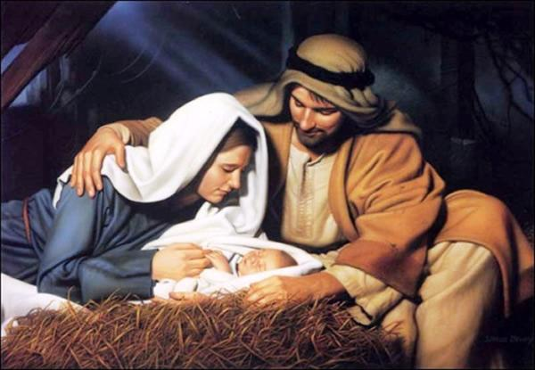
GOSPEL OF MATTHEW
JESUS AS THE KING OF THE JEWS
THE PROMISED SAVIOUR
THEME: Jesus is the King of the Jews promised in the Davidic covenant
The bridge between the Old and New Testaments.
A brief history of the life of Christ.
Presents the birth, ministry, passion, death and resurrection of Jesus Christ.
This gospel is characterized by the high level of Old Testament citations which seek to prove that Jesus fulfills the long-awaited expectations of a Jewish messiah.
To this end, the initial sentence gives us a clue to the contents of the gospel:
The genealogy of Jesus the Messiah (or the Christ), the son of Abraham, the son of David (Mat 1:1).
5 sermons ~ 5 books of the Pentateuch (Law)
Communicated in words & deeds (5 sets)
Notes:
PHOTO: birth of christ

Slide 9
GOSPEL OF MATTHEW
(JESUS AS THE KING OF THE JEWS)
Key verses :
And all the multitudes were amazed and said, “Could this be the Son of David?” ~ Matthew 12:23
¹⁹ Go therefore and make disciples of all the nations, baptizing them in the name of the Father and of the Son and of the Holy Spirit, ²⁰ teaching them to observe all things that I have commanded you; and lo, I am with you always, even to the end of the age.” Amen ~ Matt 28:19-20
“that it might be fulfilled, which was spoken by the prophets”
29 direct quotations from Old Testament
121 indirect references
Quoted Isaiah, Jeremiah, Hosea & Micah
THE BIRTH AND THE PREPARATION OF THE KING, chap 1:1- 4:11
THE GREAT GALILEAN MINISTRY OF THE KING, chap 4:12-18:35
THE KING RETURNS TO JERUSALEM, chap 19:1- 20:34
THE FINAL WEEK OF THE KING IN JERUSALEM, chap 21:1-28:20

