Slide 1


Slide 2

Video
- World End -
We Were Warned

Slide 3

1 Peter 4:7-11 But the end of all things is at hand; therefore
be serious and watchful in your prayers. And above all things have fervent love for one another, for “love will cover
a multitude of sins.” Be hospitable to one another without grumbling. As each one has received a gift, minister it
to one another, as good stewards of the manifold grace of God.
If anyone speaks, let him speak as the oracles of God.
If anyone ministers, let him do it as with the ability
which God supplies, that in all things God may be
glorified through Jesus Christ, to whom belong the glory
and the dominion forever and ever. Amen.

Slide 4

1 Peter 4:1-6 - Context
Therefore, since Christ suffered for us in the flesh, arm yourselves also with the same mind, for he who has suffered in the flesh has ceased from sin, that he no longer should live the rest of his time in the flesh for the lusts of men, but for the will of God. For we have spent enough of our past lifetime in doing the will of the Gentiles—when we walked in lewdness, lusts, drunkenness, revelries, drinking parties, and abominable idolatries. In regard to these, they think it strange that
you do not run with them in the same flood of dissipation, speaking evil of you. They will give an account to Him who is ready to judge the living and the dead …

Slide 5

Introduction
We are living in the end-times
Many signs of the coming
Rapture of the Church

Slide 6
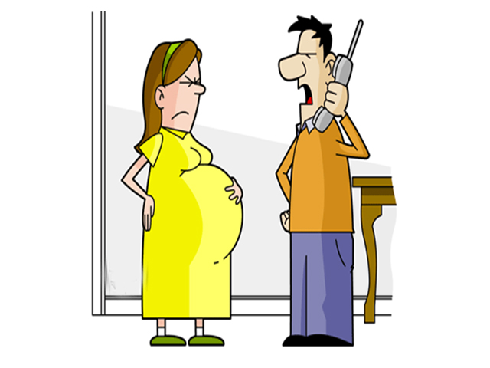

Slide 7

7
Ways
How We Shall
Live

Slide 8

I. Be clear-minded and self-controlled so that we can pray.
1 Peter 4:7 (NKJV)
But the end of all things is at hand; therefore be serious and watchful
in your prayers.
1 Peter 4:7 (NIV)
The end of all things is near. Therefore be alert and of sober mind so that
you may pray.

Slide 9

1. The first thing we must always do is connect to God in prayer.
1 Thessalonians 5:17
pray without ceasing …

Slide 10
2. To have a good connect with God i.e.
pray effectively, we must be clear-minded.
1 John 5:14-15
Now this is the confidence that
we have in Him, that if we ask anything according to His will,
He hears us. And if we know that
He hears us, whatever we ask,
we know that we have the petitions that we have asked of Him.

Slide 11

2. To have a good connect
with God i.e. pray effectively, we must be clear-minded.
John 15:7 If you abide in Me, and
My words abide in you, you will ask what you desire, and it shall be done for you.

Slide 12
2. To have a good connect
with God i.e. pray effectively, we must be clear-minded.
James 1:8 he is a double-minded man, unstable in all his ways.

Slide 13

3. To have a good connect with God
i.e. pray effectively, we must have
self-control.
2 Timothy 1:7 (NKJV) For God has not given us a spirit of fear, but of power and of love and of a sound mind.
2 Timothy 1:7 (NIV) For the Spirit God gave us does not make us timid, but gives us power, love and self-discipline.

Slide 14

II. Love each other deeply because love covers
a multitude of sins.
1 Peter 4:8
And above all things have fervent love for one another, for
“love will cover a multitude of sins.”

Slide 15

1. Love needs to cover a multitude of sins because
we are all on the journey to grow into Christlikeness.
Romans 3:23
for all have sinned and fall short of the glory of God …

Slide 16

2. In this journey towards Christlikeness, we are still sorting out the baggage that hinders.
Hebrews 12:1
… let us throw off everything that hinders …

Slide 17

3. In this journey towards Christlikeness,
we are still sorting out the sin that
entangles.
Hebrews 12:1
… the sin that so easily entangles …

Slide 18

4. By our love for one another, we testify to the world that
we are disciples of Christ.
John 13:34-35 A new command
I give you: Love one another.
As I have loved you, so you must love one another. By this everyone will know that you are my disciples,
if you love one another.

Slide 19

III. Be hospitable to one another without grumbling.
1 Peter 4:9
Be hospitable to one another without grumbling.
Philippians 2:14
Do ALL THINGS without grumbling and complaining—because it will be a shining testimony to those people who live in a dark, crooked and perverse world!

Slide 20
III. Be hospitable to one another without grumbling.
Matthew 25:35, 38-40
for I was hungry and you gave Me food; I was thirsty and you gave Me drink; I was a stranger and you took Me in … to the extent, you did it to one of the least of these My brethren, you have done it unto me.’

Slide 21

IV. Serve one another with
your gifting.
1 Peter 4:10
As each one has received a gift, minister it to one another, as good stewards of the manifold grace of God.

Slide 22
IV. Serve one another with your gifting.
Romans 12:4-8
For as we have many members in one body, but all
the members do not have the same function, so we, being many, are one body in Christ, and individually members of
one another. Having then gifts differing according to
the grace that is given to us, let us use them: if prophecy,
let us prophesy in proportion to our faith; or ministry, let us use
it in our ministering; he who teaches, in teaching; he who exhorts, in exhortation; he who gives, with liberality; he who leads, with diligence; he who shows mercy, with cheerfulness.

Slide 23
IV. Serve one another with your gifting.
Romans 12:9-13
Let love be without hypocrisy. Abhor what is evil. Cling to what is good. Be kindly affectionate to one another with brotherly love, in honour giving preference to one another; not lagging
in diligence, fervent in spirit, serving the Lord; rejoicing
in hope, patient in tribulation, continuing steadfastly in prayer; distributing to the needs of the saints, given to hospitality.

Slide 24

V. When we speak, do so as one speaking the very Words of God.
1 Peter 4:11a If anyone speaks, let him speak as the oracles of God.

Slide 25

1. The mouth speaks from
the overflow of the heart.
Matthew 12:34b (AMP)
For out of the fullness (the overflow, the superabundance)
of the heart the mouth speaks.

Slide 26

2. We must therefore guard our hearts.
Proverbs 4:23 (NIV)
Above all else, guard your heart,
for everything you do flows from it.
Proverbs 18:21
Death and life are in the power of
the tongue, and those who love it
will eat its fruit.

Slide 27
3A. Fill our hearts richly
with the Word of God.
Colossians 3:16a (NASB)
Let the word of Christ richly dwell
within you …

Slide 28
3B. We will then be filled
with wisdom.
Colossians 3:16b (NASB)
… with all wisdom teaching and
admonishing …

Slide 29
3C. We will then be filled
with the Love of God overflowing into thanksgiving, praise and worship.
Colossians 3:16c (NASB)
… another with psalms and hymns and spiritual songs, singing with thankfulness in your hearts to God.

Slide 30
3C. We will then be filled
with the Love of God overflowing into thanksgiving, praise and worship.
Romans 5:5
Now hope does not disappoint, because
the love of God has been poured out
in our hearts by the Holy Spirit who
was given to us.

Slide 31
4. God will confirm His Word
and counsel through you.
Isaiah 44:26a
Who confirms the word of His servant, and performs the counsel of His messengers …

Slide 32

VI. When we serve, we should do it with the strength that God provides.
1 Peter 4:11b
… If anyone ministers, let him do it as with the ability which God supplies …

Slide 33

1. We must always serve with total dependency on the Holy Spirit.
Zechariah 4:6
So he answered and said to me: “This is the word of the Lord to Zerubbabel:
‘Not by might nor by power, but by
My Spirit,’ says the Lord of hosts.
Philippians 3:3 For we are the circumcision, who worship God in
the Spirit, rejoice in Christ Jesus, and have no confidence in the flesh …

Slide 34

2. As we serve God to bless others,
He will enable us with His grace.
2 Corinthians 9:8
And God is able to make all grace abound toward you, that you, always having all sufficiency in all things,
may have an abundance for every
good work.

Slide 35

2. As we serve God to bless others, He will enable
us with His grace.
Philippians 4:13
I can do all things through Christ who strengthens me.

Slide 36

VII. In everything, do so that God may be glorified.
1 Peter 4:11c
… that in all things God may be glorified through Jesus Christ, to whom belong the glory and the dominion forever and ever. Amen.

Slide 37
VII. In everything, do so that God may be glorified.
1 Corinthians 10:31
Therefore, whether you eat or drink, or whatever you do, do all to the glory of God.
Romans 1:21
because, although they knew God,
they did not glorify Him as God, nor were thankful, but became futile in their thoughts, and their foolish hearts were darkened.

Slide 38

CONCLUSION
Luke 12:45-48 But if that servant says in his heart,
‘My master is delaying his coming,’ and begins to beat the male and female servants, and to eat and
drink and be drunk, the master of that servant will come on a day when he is not looking for him, and
at an hour when he is not aware, and will cut him
in two and appoint him his portion with the unbelievers.

Slide 39
CONCLUSION
Luke 12:45-48 And that servant who knew his master’s will, and did not prepare himself or do according to his will, shall be beaten with many stripes. But he who did not know, yet committed things deserving of stripes, shall be beaten with few. For everyone to whom much is given, from him much will be required; and to whom much has been committed, of him they will ask the more.

Slide 40
CONCLUSION
1 John 3:18 (NIV) Dear children, let us not love with words or speech [tongue] but with actions and in truth.
Titus 1:16a (NIV) They claim to know God, but by
their actions they deny him.

Slide 41
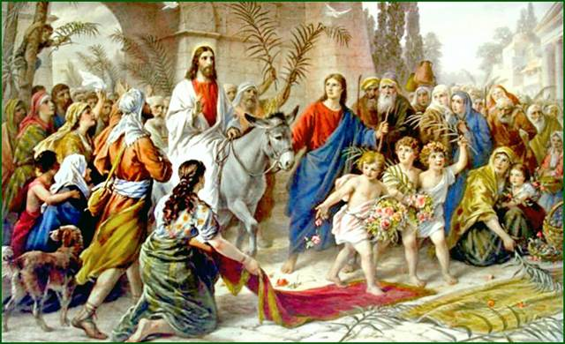
The Monday after Palm Sunday

