Slide 2
Questions:
1. Once saved, always saved?
2. Can we be assured of our salvation?
3. What happens to the backslidden?
4. What happens if I die in my backslidden stage?
5. What happens to those who were born again, served in the church but later on, left the church and denied the Lord?

Slide 3
Introduction
A Truth and a Principle must be based on the weight of Scriptures.
Psalm 119:160 The entirety of Your word is truth, and every one of Your righteous judgments endures forever.

Slide 4
Salvation belongs to the LORD Three Broad Truths:
I. We must have assurance of Salvation.
II. How we live and what we do will result in rewards or losses
III. Apostasy - we lose our salvation

Slide 5
I. Assurance of Salvation
John 1:12 But as many as received Him, to them He gave the right to become children of God, to those who believe in His name …
John 3:16 For God so loved the world that He gave His only begotten Son, that whoever believes in Him should not perish but have everlasting life.
John 5:24 Most assuredly, I say to you, he who hears My word and believes in Him who sent Me has everlasting life, and shall not come into judgment, but has passed from death into life.

Slide 6
I. Assurance of Salvation
1 John 5:11-13
11 And this is the testimony: that God has given us eternal life, and this life is in His Son. 12 He who has the Son has life; he who does not have the Son of God does not have life. 13 These things I have written to you who believe in the name of the Son of God, that you may know that you have eternal life, and that you may continue to believe in the name of the Son of God.

Slide 7
II. How we live and what we do will result in rewards or losses; both in this life and the life to come.
1. This covers:
A. Our Journey in Discipleship to become more like Christ.
Romans 8:29 For whom He foreknew, He also predestined to be conformed to the image of His Son, that He might be the firstborn among many brethren.

Slide 8
1. This covers:
A. Our Journey in Discipleship to become more like Christ.
The Wheel Illustration - The Navigators

Slide 9
II. How we live and what we do will result in rewards or losses; both in this life and the life to come.
1. This covers:
B. How we serve God?
Ephesians 2:10 For we are His workmanship, created in Christ Jesus for good works, which God prepared beforehand that we should walk
in them.

Slide 10
II. How we live and what we do will result in rewards or losses; both in this life and the life to come.
Malachi 3:18 Then you shall again discern between the righteous and the wicked, between one who serves God and one who does not serve Him.

Slide 11
II. How we live and what we do will result in rewards or losses; both in this life and the life to come.
Ecclesiastes 12:13-14
13 Let us hear the conclusion of the whole matter: Fear God and keep His commandments, for this is man’s all. 14 For God will bring every work into judgment, including every secret thing, whether good or evil.
2 Corinthians 5:10 For we must all appear before the judgment seat of Christ, that each one may receive the things done in the body, according to what he has done, whether good or bad.

Slide 12
II. How we live and what we do will result in rewards or losses; both in this life and the life to come.
1 Corinthians 3:11-15
11 For no other foundation can anyone lay than that which is laid, which is Jesus Christ. 12 Now if anyone builds on this foundation with gold, silver, precious stones, wood, hay, straw, 13 each one’s work will become clear; for the Day will declare it, because it will be revealed by fire; and the fire will test each one’s work, of what sort it is. 14 If anyone’s work which he has built on it endures, he will receive a reward. 15 If anyone’s work is burned, he will suffer loss; but he himself will be saved, yet so as through fire.

Slide 13
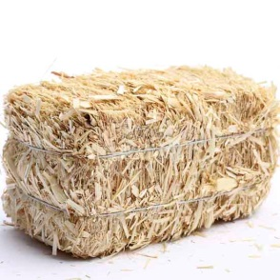
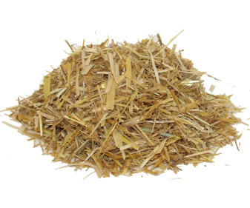
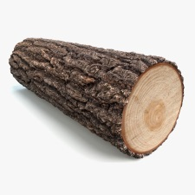
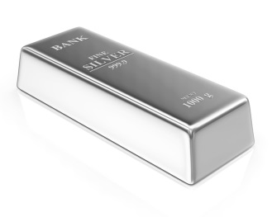
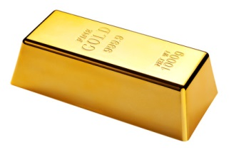
II. How we live and what we do will result in rewards or losses; both in this life and the life to come.
2A. We build on the foundation of Christ i.e. we are already saved
2B. How we live and serve God are depicted in 6-picture languages:
Wood
Hay
Straw
Precious Stones
Gold
Silver

Slide 14
II. How we live and what we do will result in rewards or losses; both in this life and the life to come.
2C. They will all be tested by fire.
1 Corinthians 3:13 each one’s work will become clear; for the Day will declare it, because it will be revealed by fire; and the fire will test each one’s work, of what sort it is.

Slide 15
II. How we live and what we do will result in rewards or losses; both in this life and the life to come.
2D. Fire will burn up wood, hay and straw i.e. the believer will suffer loss.
2E. Fire will purify good, silver and precious stones i.e. the believers will receive rewards.
1 Corinthians 3:14-15
14 If anyone’s work which he has built on it endures, he will receive a reward. 15 If anyone’s work is burned, he will suffer loss; but he himself will be saved, yet so as through fire.

Slide 16
II. How we live and what we do will result in rewards or losses; both in this life and the life to come.
2F. How we end this life matters?
We must finish well.
Ezekiel 18:26-28
26 When a righteous man turns away from his righteousness, commits iniquity, and dies in it, it is because of the iniquity which he has done that he dies. 27 Again, when a wicked man turns away from the wickedness which he committed, and does what is lawful and right, he preserves himself alive. 28 Because he considers and turns away from all the transgressions which he committed, he shall surely live; he shall not die.

Slide 17
2F. How we end this life matters?
We must finish well.
Ezekiel 18:30-32
30 “Therefore I will judge you, O house of Israel, every one according to his ways,” says the Lord God. “Repent, and turn from all your transgressions, so that iniquity will not be your ruin. 31 Cast away from you all the transgressions which you have committed, and get yourselves a new heart and a new spirit. For why should you die, O house of Israel? 32 For I have no pleasure in the death of one who dies,” says the Lord God. “Therefore turn and live!”

Slide 18
II. How we live and what we do will result in rewards or losses; both in this life and the life to come.
3A. The Message of the Gospel of the Kingdom of God has inherent power to save, deliver and heal.
Romans 1:16
For I am not ashamed of the gospel of Christ, for it is the power of God to salvation for everyone who believes, for the Jew first and also for the Greek.

Slide 19
3A. The Message of the Gospel of the Kingdom of God has inherent power to save, deliver and heal.
Matthew 7:22-23
22 Many will say to Me in that day, ‘Lord, Lord, have we not prophesied in Your name, cast out demons in Your name, and done many wonders in Your name?’ 23 And then I will declare to them, ‘I never knew you; depart from Me, you who practice lawlessness!’

Slide 20
II. How we live and what we do will result in rewards or losses; both in this life and the life to come.
3B. The Message ought to be in the Messenger who delivers the Message.
Message
Messenger

Slide 21
II. How we live and what we do will result in rewards or losses; both in this life and the life to come.
3C. When the Messenger himself falls away from the Message, the Message will still save, deliver and heal but the Messenger himself will face the consequences accordingly.
Message
Messenger

Slide 22
III. Apostasy
When a believer in his sound mind, deliberately, intentionally, explicitly reject the Lord up to his last breath, he will lose his salvation.

Slide 23
III. Apostasy - When a believer in his sound mind, deliberately, intentionally, explicitly reject the Lord up to his last breath, he will lose his salvation.
2 Peter 2:20-22
20 For if, after they have escaped the pollutions of the world through the knowledge of the Lord and Savior Jesus Christ, they are again entangled in them and overcome, the latter end is worse for them than the beginning. 21 For it would have been better for them not to have known the way of righteousness, than having known it, to turn from the holy commandment delivered to them. 22 But it has happened to them according to the true proverb: “A dog returns to his own vomit,” and, “a sow, having washed, to her wallowing in the mire.”

Slide 24
III. Apostasy - When a believer in his sound mind, deliberately, intentionally, explicitly reject the Lord up to his last breath, he will lose his salvation.
Hebrews 10:26-27; 29
26 For if we sin willfully after we have received the knowledge of the truth, there no longer remains a sacrifice for sins, 27 but a certain fearful expectation of judgment, and fiery indignation which will devour the adversaries.
29 Of how much worse punishment, do you suppose, will he be thought worthy who has trampled the Son of God underfoot, counted the blood of the covenant by which he was sanctified a common thing, and insulted the Spirit of grace?

Slide 25
III. Apostasy - When a believer in his sound mind, deliberately, intentionally, explicitly reject the Lord up to his last breath, he will lose his salvation.
Hebrews 6:4-6
4 For it is impossible for those who were once enlightened, and have tasted the heavenly gift, and have become partakers of the Holy Spirit, 5 and have tasted the good word of God and the powers of the age to come, 6 if they fall away, to renew them again to repentance, since they crucify again for themselves the Son of God, and put Him to an open shame.

Slide 26
Bottom Line: Application # 1 Praying for Salvation of Loved Ones
2 Corinthians 4:3-4, 6
3 But even if our gospel is veiled, it is veiled to those who are perishing, 4 whose minds the god of this age has blinded, who do not believe, lest the light of the gospel of the glory of Christ, who is the image of God, should shine on them. 6 For it is the God who commanded light to shine out of darkness, who has shone in our hearts to give the light of the knowledge of the glory of God in the face of Jesus Christ.

Slide 27
Bottom Line: Application # 1 Praying for Salvation of Loved Ones
1 John 3:8 … For this purpose the Son of God was manifested, that He might destroy the works of the devil.
Luke 4:18 The Spirit of the Lord is upon Me, because He has anointed Me to preach the gospel to the poor; He has sent Me to heal the broken-hearted, to proclaim liberty to the captives and recovery of sight to the blind, to set at liberty those who are oppressed …

Slide 28
Bottom Line: Application # 1 Praying for Salvation of Loved Ones
Acts 26:18 to open their eyes, in order to turn them from darkness to light, and from the power of Satan to God, that they may receive forgiveness of sins and an inheritance among those who are sanctified by faith in Me …

Slide 29
Bottom Line: Application # 1 Praying for Salvation of Loved Ones
A Methodology for Evangelism
Luke 10:5-7, 9
5 But whatever house you enter, first say, ‘Peace to this house.’ 6 And if a son of peace is there, your peace will rest on it; if not, it will return to you. 7 And remain in the same house, eating and drinking such things as they give, for the laborer is worthy of his wages. Do not go from
house to house. 9 And heal the sick there, and say
to them, ‘The kingdom of God has come near to you.’

Slide 30
Bottom Line: Application # 1 Praying for Salvation of Loved Ones
Luke 10 - A Methodology for Evangelism
A. Find a man of peace.
B. Fellowship with them - eat and drink.
C. Fulfill their felt needs - heal the sick; pray for them, etc.
D. Share the Gospel of the Kingdom of God.

Slide 31
Bottom-Line: Application #2 Aim NOT to Fall-Stumble
2 Peter 1:10 Therefore, brethren, be even more diligent to make your call and election sure, for if you do these things you will never stumble …

Slide 32
Bottom-Line: Application #2 Aim NOT to Fall-Stumble
2 Peter 1:5-9
5 But also for this very reason, giving all diligence, add to your faith virtue, to virtue knowledge, 6 to knowledge self-control, to self-control perseverance, to perseverance godliness, 7 to godliness brotherly kindness, and to brotherly kindness love. 8 For if these things are yours and abound, you will be neither barren nor unfruitful in the knowledge of our Lord Jesus Christ. 9 For he who lacks these things is short-sighted, even to blindness, and has forgotten that he was cleansed from his old sins.

Slide 33
Bottom-Line: Application #2 Aim NOT to Fall-Stumble
Jude 20-21, 24
20 But you, beloved, building yourselves up on your most holy faith, praying in the Holy Spirit, 21 keep yourselves in the love of God, looking for the mercy of our Lord Jesus Christ unto eternal life.
24 Now to Him who is able to keep you from stumbling, and to present you faultless before the presence of His glory with exceeding joy …

