Slide 2
We need to posture our lives to continually experience the Mercy, Grace and Favour from God.

Slide 3
We need to posture our lives to continually experience the Mercy, Grace and Favour from God.
1. Always Blessed to be a Blessing to others!
2. Because it is NOT automatic.
WHY?
Deuteronomy 30:19 I call heaven and earth as witnesses today against you, that I have set before you life and death, blessing and cursing; therefore choose life, that both you and your descendants may live …
Choices & Consequences

Slide 4
We need to posture our lives to continually experience the Mercy, Grace and Favour from God.
Titus 1:4 To Titus, a true son in our common faith: Grace, mercy, and peace from God the Father and the Lord Jesus Christ our Saviour.
2 John 3 Grace, mercy, and peace will be with you from God the Father and from the Lord Jesus Christ, the Son of the Father, in truth and love.
Jeremiah 9:23-24

Slide 5
We need to posture our lives to continually experience the Mercy, Grace and Favour from God.
1 Timothy 1:2 To Timothy, a true son in the faith: Grace, mercy, and peace from God our Father and Jesus Christ our Lord.
2 Timothy 1:2 To Timothy, a beloved son: Grace, mercy, and peace from God the Father and Christ Jesus our Lord.
Peace = Eirene-Shalom = Favour = Wholesome Well-being
HOW?

Slide 6
We need to posture our lives to continually experience the Mercy, Grace and Favour from God.
I. Plead for Mercy.
II. Pursue the specific Grace for our need.
III. Position our lives to obtain Favour.

Slide 7
We need to posture our lives to continually experience the Mercy, Grace and Favour from God.
I. Plead for Mercy.
II. Pursue the specific Grace for our need.
III. Position our lives to obtain Favour.

Slide 8
1. Definition
A. Mercy is not getting what we deserve.
Romans 6:23 For the wages of sin is death, but the gift of God is eternal life in Christ Jesus our Lord.
Separated from God, we reap everything the devil hurls at us:
continually accused, condemned, lied to, deceived, stolen, hurt, wounded, in bondage, destroyed, killed, death!

Slide 9
1. Definition
B. Mercy is not reaping the negative consequences of what we have previously sown wrongly.
Galatians 6:7-8
7 Do not be deceived, God is not mocked; for whatever a man sows, that he will also reap. 8 For he who sows to his flesh will of the flesh reap corruption, but he who sows to the Spirit will of the Spirit reap everlasting life.
Reflect from time born to date,
bring every wrong-failure-mistake under the Blood!

Slide 10
B. Mercy is not reaping the negative consequences of what we have previously sown wrongly.
1 Timothy 5:24 Some men’s sins (failures) are clearly evident, preceding them to judgment, but those of some men follow later.
Gibeonites - Joshua 9 - 2 Samuel 21
Joshua failed re succession
BilHy-GLd
Parenting - 7 year cycles - HI-elder-son/daughter

Slide 11
B. Mercy is not reaping the negative consequences of what we have previously sown wrongly.
1 John 5:16-17
16 If anyone sees his brother sinning a sin which does not lead to death, he will ask, and He will give him life for those who commit sin not leading to death. There is sin leading to death. I do not say that he should pray about that. 17 All unrighteousness is sin, and there is sin not leading to death.

Slide 12
B. Mercy is not reaping the negative consequences of what we have previously sown wrongly.
1 John 5:16 There is sin leading to death.
Leviticus 10
Nadab & Abibu - offered strange fire
Numbers 16 Korah & his clan - Rebellion
Joshua 6-7 Achan who took the accursed things
1 Samuel 3-4 Eli’s two sons who sinned against the Lord
2 Samuel 6 Uzzah - touched the Ark
Acts 5 Ananias & Sapphira - lied to the Holy Spirit
1 Corinthians 11 Those who abuse the Lord’s Supper

Slide 13
2. Appropriate the Blood of Jesus for:
A. Forgiveness;
1 John 1:9 If we confess our sins, He is faithful and just to forgive us our sins and to cleanse us from all unrighteousness.

Slide 14
2. Appropriate the Blood of Jesus for:
B. Cleansing;
2 Corinthians 7:1 Therefore, having these promises, beloved, let us cleanse ourselves from all filthiness of the flesh and spirit, perfecting holiness in the fear of God.

Slide 15
2. Appropriate the Blood of Jesus for:
C. Covering.
Ephesians 4:27 Nor give place-doorway-foothold-ground to the devil.
Psalm 32:1 Blessed is he whose transgression is forgiven, whose sin is covered.
1 Peter 5:8 Be sober, be vigilant; because your adversary the devil walks about like a roaring lion, seeking whom he may devour.
Courts of Heaven

Slide 16
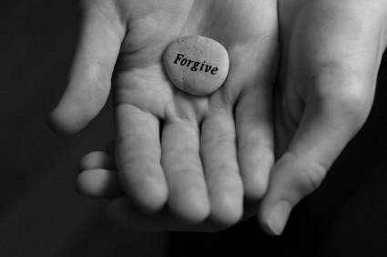
Question: Doesn’t appropriating the Blood automatically provide forgiveness, cleansing and covering?
NO!
1 John 1:9 If we confess our sins, He is faithful and just to forgive us our sins and to cleanse us from all unrighteousness.
Forgiveness restores Fellowship - Right Standing with God -

Slide 17
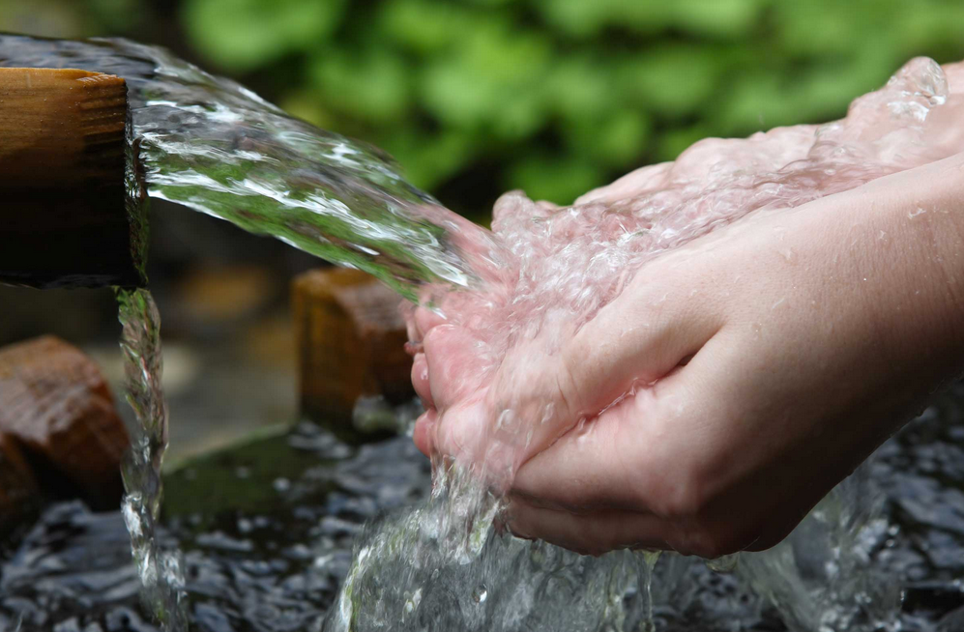
Question: Doesn’t appropriating the Blood automatically provide forgiveness, cleansing and covering?
NO!
2 Corinthians 7:1 Therefore, having these promises, beloved, let us cleanse ourselves from all filthiness of the flesh and spirit, perfecting holiness in the fear of God.
All sins defile us. We must cleanse ourselves!
Hebrews 12:14 Pursue peace with all people, and holiness, without which no one will see the Lord.

Slide 18
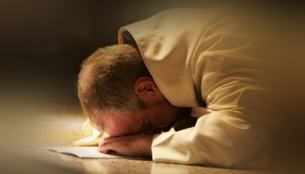
Question: Doesn’t appropriating the Blood automatically provide forgiveness, cleansing and covering?
NO!
Hebrews 4:16 Let us therefore come boldly to the throne of grace, that we may obtain mercy and find grace to help in time of need.
Go to God and intentionally obtain mercy to cover our wrongs!

Slide 19
3. The Lord’s mercies are current, present, available.
Lamentation 3:22-23 22 Through the Lord’s mercies we are not consumed, because His compassions fail not. 23 They are new every morning; great is Your faithfulness.

Slide 20
3. The Lord’s mercies are current, present, available.
Psalm 51:1 Have mercy upon me, O God, according to Your lovingkindness; according to the multitude of Your tender mercies, blot out my transgressions.
Psalm 69:16 Hear me, O Lord, for Your lovingkindness is good; turn to me according to the multitude of Your tender mercies.
Psalm 106:45 And for their sake He remembered His covenant, and relented according to the multitude of His mercies.

Slide 21
4. Mercy triumphs over judgment.
James 2:13 For judgment is without mercy to the one who has shown no mercy. Mercy triumphs over judgment.

Slide 22
We need to posture our lives to continually experience the Mercy, Grace and Favour from God.
I. Plead for Mercy.
II. Pursue the specific Grace for our need.
III. Position our lives to obtain Favour.

Slide 23
II. Pursue the specific Grace for our need.
Hebrews 4:16 Let us therefore come boldly to the throne of grace, that we may obtain mercy and find grace to help in time of need.
James 4:6

Slide 24
II. Pursue the specific Grace for our need.
Luke 11:11-13
11 If a son asks for bread from any father among you, will he give him a stone? Or if he asks for a fish, will he give him a serpent instead of a fish? 12 Or if he asks for an egg, will he offer him a scorpion? 13 If you then, being evil, know how to give good gifts to your children, how much more will your heavenly Father give the Holy Spirit to those who ask Him!”

Slide 25
II. Pursue the specific Grace for our need.
James 1:17 Every good gift and every perfect gift is from above, and comes down from the Father of lights, with whom there is no variation or shadow of turning.

Slide 26
II. Pursue the specific Grace for our need.
Hebrews 11:6 But without
it is impossible to please Him, for he who comes to God must believe that He is, and that He is a rewarder of those who diligently seek Him.

Slide 27
II. Pursue the specific Grace for our need.
1 Peter 2:2-3 2 as newborn babes, desire the pure milk of the word, that you may grow thereby, 3 if indeed you have tasted-experienced that the Lord is gracious.
When we continually stand on the Word and experience God coming through for us, we grow Faith Convictions!

Slide 28
II. Pursue the specific Grace for our need.
Needs in One Lives
Needs
Sickness
Safety
Anxieties & Worries
Fears
Emptiness & Void
Bondage
Loneliness
Specific Grace that we need
Provision
Healing
Protection
Strength
Peace
Love of God
Deliverance
Presence of God

Slide 29
We need to posture our lives to continually experience the Mercy, Grace and Favour from God.
I. Plead for Mercy.
II. Pursue the specific Grace for our need.
III. Position our lives to obtain Favour.

Slide 30
1. We must increasingly know:
A. Our Primary Calling: connected to our basic responsibilities in life.
B. Our Missional Calling: God’s assignment for us to influence and impact lives.
C. We need the Favour of God to fulfil especially our Missional Calling.
E.g. Joseph, Esther, Daniel, Jesus
+ They grew in Favour!

Slide 31
2. We must increasingly recognize the Favour of God in our lives:
Ability to mobilize resources to accomplish our destiny plans and calling
Position us in places of influence
Special advantages and
preferential treatment
Goodwill, acceptance and benefits flowing
Higher levels of success and service
Designed to help us to help others extend the Kingdom of God
Open doors
Winsomeness
Promotion
Platforms
Connections

Slide 32
III. Position our lives to obtain Favour.
Psalm 84:11 [ESV] For the Lord God is a sun and shield; the Lord bestows favour and honour. No good thing does he withhold from those who walk uprightly.
Psalm 5:12 For You, O Lord, will bless the righteous; with favour You will surround him as with a shield.

Slide 33
3. Be aware of what blocks God’s Favour in our lives.
Rebellion against the ways and instruction of God
Sympathy with the world vs Kingdom Values
Disobedience
Sins
Pride
Out of alignment with God’s purpose and call

Slide 34
4. Do whatever is necessary to restore God’s Favour in our lives.
Psalm 119:58-60
58 I entreated Your favour with my whole heart; be merciful to me according to Your word. 59 I thought about my ways, and turned my feet to Your testimonies. 60 I made haste, and did not delay to keep Your commandments.

Slide 35
4. Do whatever is necessary to restore God’s Favour in our lives.
Revelation 3:20 Behold, I stand at the door and knock. If anyone hears
My voice and opens the door, I will come in to him and dine with him, and he with Me.

Slide 36
4. Do whatever is necessary to restore God’s Favour in our lives.
Isaiah 57:15 For thus says the High and Lofty One who inhabits eternity, whose name is Holy: “I dwell in the high and holy place, with him who has a contrite and humble spirit, to revive the spirit of the humble, and to revive the heart of the contrite ones.

Slide 37
4. Do whatever is necessary to restore God’s Favour in our lives.
Psalm 51:17 The sacrifices of God are a broken spirit, a broken and a contrite heart—these, O God, You will not despise.

Slide 38
We need to posture our lives to continually experience the Mercy, Grace and Favour from God.
I. Plead for Mercy.
II. Pursue the specific Grace for our need.
III. Position our lives to obtain Favour.

Slide 39
BOTTOM-LINE
Know the Redemptive Purpose of God
Mercy, Grace and Favour is always for the above purpose
Blessed to be a Blessing

