Slide 2
Understand the Warfare - 5 Basic Fronts:
I. Schemes of the evil one.
II. Giving Space - Ground to the evil one to work against us.
III. Demonic Strongholds in our lives.
IV. Shakings in the demonic world around us.
V. Failing to Surrender to the Lordship of Christ.
War is won. Soccer - Coach.
Battle - personal - various fronts.

Slide 3
Understand the Warfare - 5 Basic Fronts:
I. Schemes of the evil one.
II. Giving Space - Ground to the evil one to work against us.
III. Demonic Strongholds in our lives.
IV. Shakings in the demonic world around us.
V. Failing to Surrender to the Lordship of Christ.

Slide 4
I. Schemes of the evil one.
2 Corinthians 2:11 lest Satan should take advantage of us; for we are not ignorant of his devices - schemes.

Slide 5
I. Schemes of the evil one.
1. As accuser.
Revelation 12:10 Then I heard a loud voice saying in heaven, “Now salvation, and strength, and the kingdom of our God, and the power of His Christ have come, for the accuser of our brethren, who accused them before our God day and night, has been cast down.
Matthew 5:25 - 1 John 1:9

Slide 6
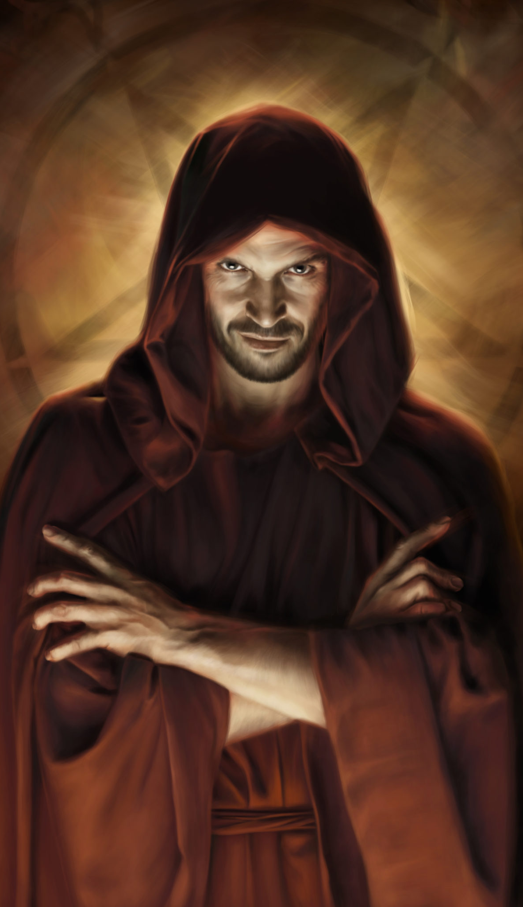
I. Schemes of the evil one.
2. As deceiver.
Revelation 12:9 So the great dragon was cast out, that serpent of old, called the Devil and Satan, who deceives the whole world; he was cast to the earth, and his angels were cast out with him.
John 8:32 - Jeremiah 9:24

Slide 7
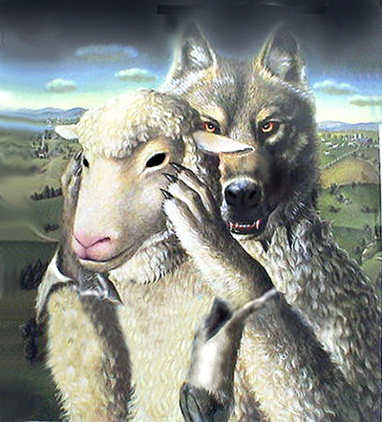
I. Schemes of the evil one.
3. As liar and murderer.
John 8:44 ... he was a murderer from the beginning, and does not stand in the truth, because there is no truth in him. When he speaks a lie, he speaks from his own resources, for he is a liar and the father of it.
Ds - death thots

Slide 8
I. Schemes of the evil one.
4. As condemner.
Romans 8:33-34
₃₃ Who shall bring a charge against God’s elect? It is God who justifies. ₃₄ Who is he who condemns? It is Christ who died, and furthermore is also risen, who is even at the right hand of God,
who also makes intercession for us.
UGBs-Pursue G-Free-No-C r/s

Slide 9
I. Schemes of the evil one.
5. As devourer looking for ground in our lives to oppress us.
1 Peter 5:8 Be sober, be vigilant; because your adversary the devil walks about like a roaring lion, seeking whom he may devour.

Slide 10
I. Schemes of the evil one.
1. As accuser.
2. As deceiver.
3. As liar and murderer.
4. As condemner.
5. As devourer.
John 10:10a The thief does not come except to steal, and to kill, and to destroy.

Slide 11
Understand the Warfare - 5 Basic Fronts:
I. Schemes of the evil one.
II. Giving Space - Ground to the evil one to work against us.
III. Demonic Strongholds in our lives.
IV. Shakings in the demonic world around us.
V. Failing to Surrender to the Lordship of Christ.

Slide 12
II. Giving Space - Ground to the evil one to work against us.
Ephesians 4:27 nor give place-ground-foothold-doorway to the devil.

Slide 13
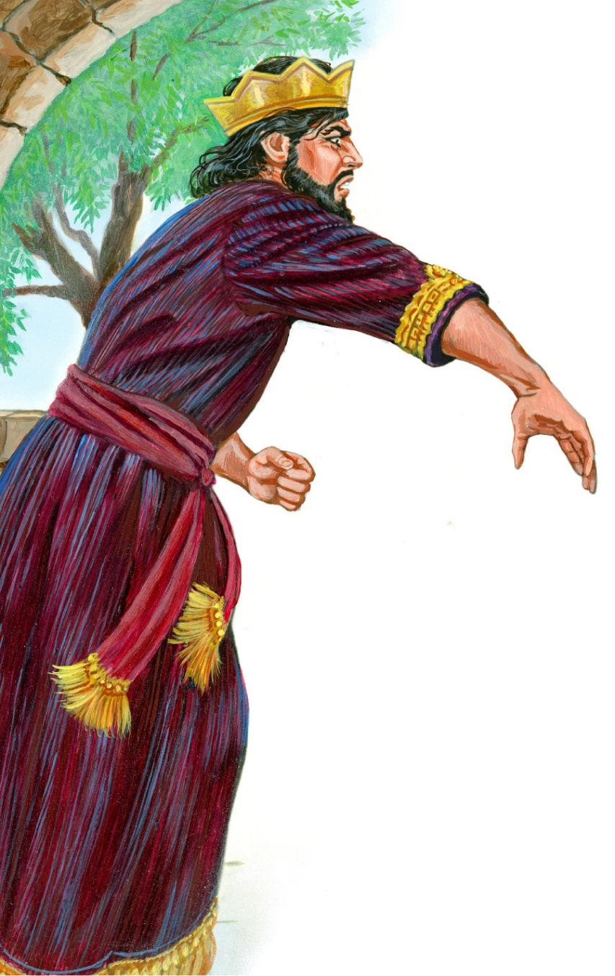
II. Giving Space - Ground to the evil one to work against us.
The Example of Saul - Space for Enemies to Harass
1 Samuel 18:8, 10a
₈ Then Saul was very angry, and the saying displeased him; and he said, “They have ascribed to David ten thousands, and to me they have ascribed only thousands. Now what more can he have but the kingdom?”
₁₀ And it happened on the next day that the distressing spirit from God came upon Saul ..

Slide 14
II. Giving Space - Ground to the evil one to work against us.
The Example of Saul - Space for Enemies to Harass
Ephesians 4:26-27 ₂₆ “Be angry, and do not sin”: do not let the sun go down on your wrath, ₂₇ nor give place-ground-foothold to the devil.

Slide 15
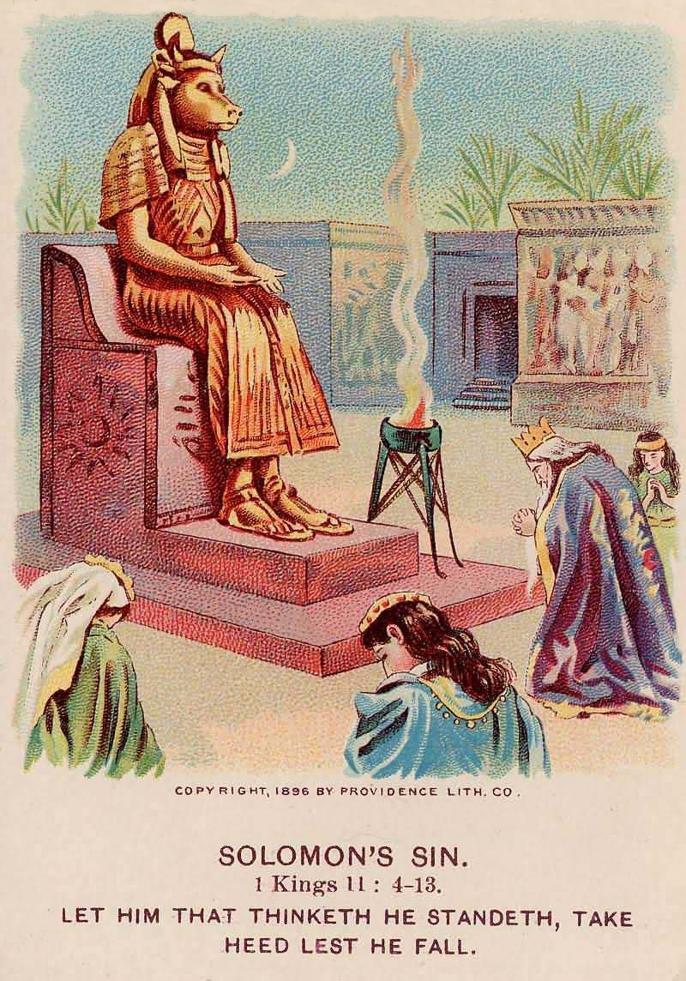
II. Giving Space - Ground to the evil one to work against us.
The Example of Solomon - Space for Enemies to Harass - 1 Kings 11:4-6
₄ For it was so, when Solomon was old, that his wives turned his heart after other gods; and his heart was not loyal to the Lord his God, as was the heart of his father David. ₅ For Solomon went after Ashtoreth the goddess of the Sidonians, and after Milcom the abomination of the Ammonites. ₆ Solomon did evil in the sight of the Lord, and did not fully follow the Lord, as did his father David.

Slide 16
II. Giving Space - Ground to the evil one to work against us.
The Example of Solomon - Space for Enemies to Harass
1 Kings 11:14 Now the Lord raised up an adversary against Solomon, Hadad the Edomite; he was a descendant of the king in Edom.
AB’s bro - prop in K, biz, law-suits, etc.

Slide 17
II. Giving Space - Ground to the evil one to work against us.
The Example of Solomon - Space for Enemies to Harass
1 Kings 11:23, 25-26
₂₃ And God raised up another adversary against him, Rezon the son of Eliadah, who had fled from his lord, Hadadezer king of Zobah.
₂₅ He was an adversary of Israel all the days of Solomon (besides the trouble that Hadad caused); and he abhorred Israel, and reigned over Syria. ₂₆ Then Solomon’s servant, Jeroboam the son of Nebat, an Ephraimite from Zereda, whose mother’s name was Zeruah, a widow, also rebelled against the king.

Slide 18
II. Giving Space - Ground to the evil one to work against us.
Proverbs 16:7 When a man’s ways please the Lord, He makes even his enemies to be at peace with him.

Slide 19
II. Giving Space - Ground to the evil one to work against us.
Ephesians 4:30 [For Believers]
And do not grieve the Holy Spirit of God, by whom you were sealed for the day of redemption.

Slide 20
When do we grieve the Holy Spirit?
Ephesians 4:25-32 - 5:5:
Give Ground to the Evil One
Corrupt Words
Steal
Coarse Jesting
Malice
Idolater
Selfish
Lazy
Lie
Stingy
Filthiness
Anger
Not Walking in Love
Unkind
Covetous
Unclean
Bitterness
Unforgiving
Wrath
Sexual Sins
Foolish Talking
Evil Speaking
Clamor
Fornication

Slide 21
II. Giving Space - Ground to the evil one to work against us.
John 14:30 I will no longer talk much with you, for the ruler of this world is coming, and he has nothing in Me.
How? Journey in S-Disciplines
Baggage-declutter
RTF for Breakthroughs

Slide 22
Understand the Warfare - 5 Basic Fronts:
I. Schemes of the evil one.
II. Giving Space - Ground to the evil one to work against us.
III. Demonic Strongholds in our lives.
IV. Shakings in the demonic world around us.
V. Failing to Surrender to the Lordship of Christ.

Slide 23
III. Demonic Strongholds in our lives.
1. Definition of Strongholds:
They are mind-sets, thought-patterns, ideas, attitudes and beliefs that are Contrary to the True Knowledge of God.
2 Corinthians 10:5 … strongholds … casting down arguments (logizomi) and every high thing (hypsoma) that exalts itself against the knowledge of God …

Slide 24
III. Demonic Strongholds in our lives.
2. Understanding strongholds.
A. Arguments / Imaginations - “logizomi”
James 3:15 Such “wisdom” does not come down from heaven but is earthly / natural, unspiritual, of the devil.
Good Christian vs Godly Christian
Religion vs Relationship
Thinking Patterns of the world vs Word & Spirit Revelation
Earthly Wisdom vs Heavenly Wisdom

Slide 25
2. Understanding strongholds.
B. Every pretension / every high thing - “hypsoma”
2 Corinthians 4:4 The god of this age has blinded the minds of unbelievers, so that they cannot see the light of the gospel of the glory of Christ, who is the image of God.
Acts 26:18 to open their eyes, in order to turn them from darkness to light, and from the power of Satan to God …
Romans 12:2a And do not be conformed to this world …

Slide 26
3. How are strongholds established?
A. Consequences of Generational Iniquities.
Exodus 20:5 You shall not bow down to them or worship them; for I, the LORD your God, am a jealous God, punishing the children for the sin of the fathers to the third and fourth generation of those who hate me …

Slide 27
3. How are strongholds established?
A. Consequences of Generational Iniquities.
Galatians 3:13-14 ₁₃ Christ has redeemed us from the curse of the law, having become a curse for us (for it is written, “Cursed is everyone who hangs on a tree”), ₁₄ that the blessing of Abraham might come upon the Gentiles in Christ Jesus, that we might receive the promise of the Spirit through faith.
John 3:16

Slide 28
3. How are strongholds established?
A. Consequences of Generational Iniquities.
e.g. 1 - Certain Sickness & Diseases
e.g. 2 - Sexual & Marital Problems
e.g. 3 - Financial Problems
e.g. 4 - Character Flaws [constant anger]
e.g. 5 - Addictions [to substance / negative behaviour]

Slide 29
3. How are strongholds established?
B. The fractured-wounded soul.
1 Thessalonians 5:23 May God himself, the God of peace, sanctify you through and through. May your whole spirit, soul and body be kept blameless at the coming of our Lord Jesus Christ.
we may hurt others to the degree of our unhealed wounded-ness

Slide 30
3. How are strongholds established?
B. The fractured-wounded soul.
Our past:
(1) Unhealed hurts
(2) Unresolved issues
(3) Unmet needs

Slide 31
3. How are strongholds established?
C. All personal habitual sins.
Galatians 5:19-21
₁₉ Now the works of the flesh are evident, which are: adultery, fornication, uncleanness, lewdness, ₂₀ idolatry, sorcery, hatred, contentions, jealousies, outbursts of wrath, selfish ambitions, dissensions, heresies, ₂₁ envy, murders, drunkenness, revelries, and the like …
Hebrews 12:15 See to it that no one misses the grace of God and that no bitter root grows up to cause trouble and defile many.

Slide 32
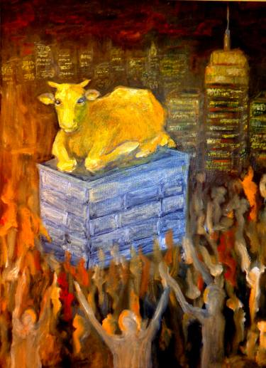
3. How are strongholds established?
D. All sins directly involving the evil one.
Exodus 20:4-5
₄ You shall not make for yourself a carved image - any likeness of anything that is in heaven above, or that is in the earth beneath, or that is in the water under the earth; ₅ you shall not bow down to them nor serve them …

Slide 33
3. How are strongholds established?
D. All sins directly involving the evil one.
Deuteronomy 18:10-11
₁₀ Let no one be found among you who sacrifices his son or daughter in the fire, who practices divination or sorcery, interprets omens, engages in witchcraft, ₁₁ or casts Spells, or who is a medium or spiritist or who consults the dead.
Woman - 3rd eye - Indian meditation

Slide 34
3. How are strongholds established?
D. All sins directly involving the evil one.
Isaiah 47:13-14
₁₃ … Let your astrologers come forward, those stargazers who make predictions month by month … ₁₄ Surely they are like stubble; the fire will burn them up. They cannot even save themselves from the power of the flame …

Slide 35
Understand the Warfare - 5 Basic Fronts:
I. Schemes of the evil one.
II. Giving Space - Ground to the evil one to work against us.
III. Demonic Strongholds in our lives.
IV. Shakings in the demonic world around us.
V. Failing to Surrender to the Lordship of Christ.

Slide 36
IV. Shakings in the demonic world around us.
Matthew 12:43-45
₄₃ When an unclean spirit goes out of a man, he goes through dry places, seeking rest, and finds none. ₄₄ Then he says, ‘I will return to my house from which I came.’ And when he comes, he finds it empty, swept, and put in order. ₄₅ Then he goes and takes with him seven other spirits more wicked than himself, and they enter and dwell there; and the last state of that man is worse than the first. So shall it also be with this wicked generation.”

Slide 37
IV. Shakings in the demonic world around us.
Matthew 12:43 When an unclean spirit goes out of a man, he goes through dry places, seeking rest, (harmony in environment) ...

Slide 38
IV. Shakings in the demonic world around us.
This happens in about 2 Basic Situations:
1. When the believer makes a significant decision towards God e.g.
To Grow Spiritually
To Deal with Sins
To Make Changes in life towards Godliness
Stop flirting with Pornography
Determine to be a True Worshipper

Slide 39
IV. Shakings in the demonic world around us.
This happens in about 2 Basic Situations:
2. When the believer brings the Kingdom of God into lives and situations e.g.
Mark 16:15 And He said to them, “Go into all the world and preach the gospel to every creature.

Slide 40
2. When the believer brings the Kingdom of God into lives and situations e.g.
Mark 16:17-18
₁₇ And these signs will follow those who believe: In My name they will cast out demons; they will speak with new tongues; ₁₈ they will take up serpents; and if they drink anything deadly, it will by no means hurt them; they will lay hands on the sick, and they will recover.”

Slide 41
2. When the believer brings the Kingdom of God into lives and situations e.g.
Matthew 11:12 And from the days of John the Baptist until now the kingdom of heaven suffers violence, and the violent take it by force.

Slide 42
2. When the believer brings the Kingdom of God into lives and situations e.g.
Responding to LGBT Activists
Bringing Sight to the Spiritual Blind
Mission Trips
Contending with Demonic Forces in Family
Setting Free those in Bondage
Reaching out to a Key Person in a Family / Tribe - Acts 28 Paul - viper - Publius
Preaching the Gospel to Pre-believers
Casting out Demons
Sharing the Gospel
Ministering to the Broken-hearted

Slide 43
2. When the believer brings the Kingdom of God into lives and situations e.g.
Acts 26:18 to open their eyes, in order to turn them from darkness to light, and from the power of Satan to God, that they may receive forgiveness of sins and an inheritance among those who are sanctified by faith in Me.

Slide 44
IV. Shakings in the demonic world around us.
This happens in about 2 Basic Situations:
1. When the believer makes a significant decision towards God (and godliness).
2. When the believer brings the Kingdom of God into lives and situations.

Slide 45
Understand the Warfare - 5 Basic Fronts:
I. Schemes of the evil one.
II. Giving Space - Ground to the evil one to work against us.
III. Demonic Strongholds in our lives.
IV. Shakings in the demonic world around us.
V. Failing to Surrender to the Lordship of Christ.

Slide 46
Understand the Warfare - 5 Basic Fronts:
V. Failing to Surrender to the Lordship of Christ.
Matthew 12:44-45
₄₄ Then he (unclean spirit) says, ‘I will return to my house from which I came.’ And when he comes, he finds it empty, swept, and put in order. ₄₅ Then he goes and takes with him seven other spirits more wicked than himself, and they enter and dwell there; and the last state of that man is worse than the first. So shall it also be with this wicked generation.”

Slide 47
V. Failing to Surrender to the Lordship of Christ.
Empty = The house is empty
Not occupied
Not under possession
Not under ownership
It is either under the Lord or under the spirit of the world/wicked one
James 3:15 This wisdom does not descend from above, but is earthly, sensual (soulical), demonic.
1 John 5:19b the whole world lies under the sway of the wicked one.
When we are not under the Lordship of Christ, we are under the sway of the evil one.

Slide 48
V. Failing to Surrender to the Lordship of Christ.
Surrender to the Lordship of Christ involves:
1. Submission
Romans 12:1 I beseech you therefore, brethren, by the mercies of God, that you present your bodies a living sacrifice, holy, acceptable to God, which is your reasonable service.
Loyal to
Aligned with
Under authority
Yield
Led by
Submit
Directed by
Governed by
Sync with God

Slide 49
Surrender to the Lordship of Christ involves:
2. Servitude
Luke 6:46-48
₄₆ But why do you call Me ‘Lord, Lord,’ and not do the things which I say? ₄₇ Whoever comes to Me, and hears My sayings and does them, I will show you whom he is like: ₄₈ He is like a man building a house, who dug deep and laid the foundation on the rock. And when the flood arose, the stream beat vehemently against that house, and could not shake it, for it was founded on the rock.

Slide 50
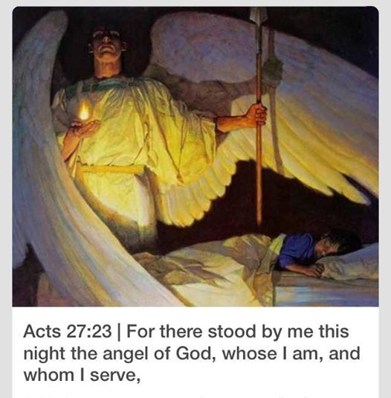
Surrender to the Lordship of Christ involves:
2. Servitude
Acts 27:23 For there stood by me this night an angel of the God to whom I belong and whom I serve.
1 Kings 17:1b As the Lord God of Israel lives, before whom I stand.
Psalm 110:1
1 Corinthians 15:25

Slide 51
BOTTOM-LINE
Revelation 12:11 And they overcame him [the evil one]:
by the blood of the Lamb
by the word of their testimony
and they did not love their lives to the death. (surrender)

