Slide 2
The Word of God is:
The Sword of the Spirit Ephesians 6:17
AND
The Double-Edged Sword Psalm 149:6 Hebrews 4:12 Revelation 2:12

Slide 3
Double-Edged Sword in our hands
equals to
Building a Strong Word-Life
Working Knowledge of the Double-edged Sword
Wielding the Sword of the Spirit
Word-Empowered Believer

Slide 4
I. Why build a strong word-life?

Slide 5
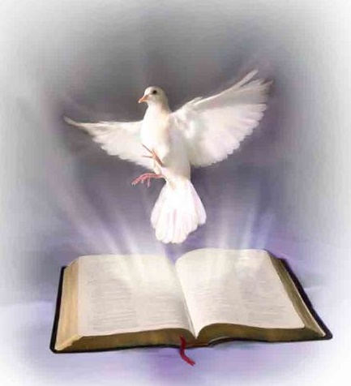
I. Why build a strong word-life?
1. Because it is spiritual life to us.
John 6:68 But Simon Peter answered Him, “Lord, to whom shall we go? You have the words of eternal life.
John 6:63 It is the Spirit who gives life … The words that I speak to you are spirit, and they are life.

Slide 6
I. Why build a strong word-life?
2. Because it gives direction in life.
John 1:1, 4
1 In the beginning was the Word, and the Word was with God, and the Word was God. 4 In Him was life, and the life was the light of men.
Psalm 119:105 Your word is a lamp to my feet and a light to my path.

Slide 7
I. Why build a strong word-life?
3. Because it is life and health to us.
Proverbs 4:20-22
20 My son, give attention to my words; incline your ear to my sayings. 21 Do not let them depart from your eyes; keep them in the midst of your heart; 22 for they are life to those who find them, and health to all their flesh.

Slide 8
I. Why build a strong word-life?
4. Because God always fulfil His Word.
Psalm 138:2 I will worship toward Your holy temple, and praise Your name for Your lovingkindness and Your truth; for You have magnified Your word above all Your name.
Notes:
Obedience more important than asking for prayers in Jesus’ Name.
Healing begins with sanctification of the heart.
Eg: Forgiveness and repentance to remove legal ground to the evil one.
R/s with God
r/s with self/
r/s with others

Slide 9
II. Develop a working knowledge
of the Word of God.

Slide 10
II. Develop a working knowledge of the Word of God.
1. Revelation from regularly partaking the Word.
2. Meditation to get the Word in us.
3. Confession - Application to experience the Word.

Slide 11
II. Develop a working knowledge of the Word of God.
1. Revelation from regularly partaking the Word.
2. Meditation to get the Word in us.
3. Confession - Application to experience the Word.

Slide 12
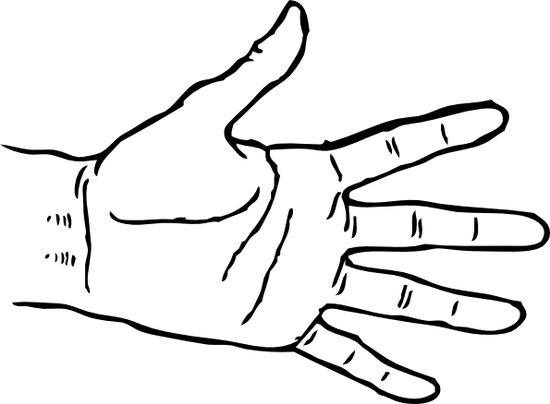
A. We must regularly partake the Word.
Meditate
Remember
Study
Read
Hear

Slide 13
A. We must regularly partake the Word.
Sunday Morning Corporate Worship Service
Listening to Audio Sermons
Audio CDs and DVDs
Articles
Books
Conferences
Podcast
Attending a CG Meeting
Seminars
Devotional Blogs
Magazines

Slide 14
B. We must posture to partake the Word.
Proverbs 4:20-23
20 My son, give attention to my words; incline your ear to my sayings. 21 Do not let them depart from your eyes; keep them in the midst of your heart; 22 for they are life to those who find them, and health to all their flesh. 23 Keep your heart with all diligence, for out of it spring the issues of life.

Slide 15
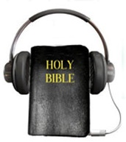
C. We posture to receive revelation and faith.
Romans 10:17 So then faith comes by hearing, and hearing by the word of God.

Slide 16
II. Develop a working knowledge of the Word of God.
1. Revelation from regularly partaking the Word.
2. Meditation to get the Word in us.
3. Confession - Application to experience the Word.

Slide 17
A. To Meditate means :-
Contemplate
Sit on it
Reflect
Think Deeply
Ponder
Muse Over
Active Use of Heart and Mind
Consider over and over again

Slide 18
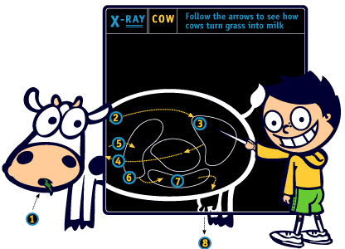
B. Meditate like the cow chewing

Slide 19
II. Develop a working knowledge of the Word of God.
1. Revelation from regularly partaking the Word.
2. Meditation to get the Word in us.
3. Confession - Application to experience the Word.

Slide 20
3. Confession - Application to experience the Word
A. To Confess is to speak forth the Word.
Proverbs 18:21 Death and life are in the power of the tongue, and those who love it will eat its fruit.
Numbers 14:28 Say to them, ‘As I live,’ says the Lord, ‘just as you have spoken in My hearing, so I will do to you:

Slide 21
3. Confession - Application to experience the Word
A. To Confess is to speak forth the Word.
Speaking forth the word is a range of verbal activities:
Pray
Thanksgiving
Spiritual Songs
Worship
Read
Sing
Mutter
Shout
Declare
Praise
Proclaim
Whisper

Slide 22
3. Confession - Application to experience the Word
B. This is known as developing the Spirit of Faith.
2 Corinthians 4:13 And since we have the same spirit of faith, according to what is written, “I believed and therefore I spoke,” we also believe and therefore speak …

Slide 23
III. We must experience the Word to develop Faith Convictions.

Slide 24
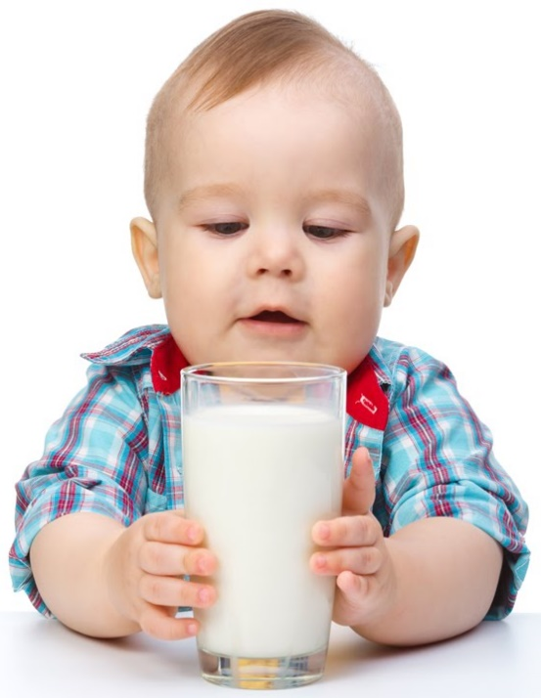
III. We must experience the Word to develop Faith Convictions.
1 Peter 2:2-3 2 as newborn babes, desire the pure milk of the word, that you may grow thereby, 3 if indeed you have tasted- experienced that the Lord is gracious.
When we continually stand on the Word and experience God coming through for us, we grow Faith Convictions!

Slide 25
III. We must experience the Word to develop Faith Convictions.
 | Issues in Life | Faith Convictions
e.g. #1 | Regarding needs | Knowing and experiencing God as Provider.
e.g. #2 | Regarding sickness | Knowing and experiencing God as Healer.
e.g. #3 | Regarding dangers to life | Knowing and experiencing God as Protector.
e.g. #4 | Regarding Stress, Anxieties and Fears (SAF) | Knowing and experiencing the Peace of God.

Slide 26
Examples of Faith Convictions
Sense of being deeply loved by God
Can always come to God 24-7-365
A Guilt-Free, No Condemnation r/s with God
Nothing happens by chance
Always protected
Never suffer lack
Etc.

Slide 27
III. We must experience the Word to develop Faith Convictions.
Natural Man
Carnal Believer
Spiritual Believer
100
0
50
Born again
Overcomer Zone

Slide 28
IV. Desired Outcomes of wielding [believe and speak] the Word:
1. For Salvation.
Romans 10:9-10
9 that if you confess with your mouth the Lord Jesus and believe in your heart that God has raised Him from the dead, you will be saved. 10 For with the heart one believes unto righteousness, and with the mouth confession is made unto salvation.

Slide 29
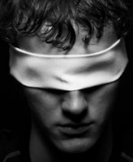
Praying for Salvation of Loved Ones
2 Corinthians 4:3-4, 6
3 But even if our gospel is veiled, it is veiled to those who are perishing, 4 whose minds the god of this age has blinded, who do not believe, lest the light of the gospel of the glory of Christ, who is the image of God, should shine on them. 6 For it is the God who commanded light to shine out of darkness, who has shone in our hearts to give the light of the knowledge of the glory of God in the face of Jesus Christ.
Matthew 12:29 Or how can one enter a strong man’s house and plunder his goods, unless he first binds the strong man? And then he will plunder his house.

Slide 30
IV. Desired Outcomes of wielding [believe and speak] the Word:
2. For wisdom to make my way prosperous.
Joshua 1:8 Do not let this Book of the Law depart from your mouth; meditate on it day and night, so that you may be careful to do everything written in it. They you will be prosperous and successful.
Psalm 1:1-3
1 Blessed is the man … 2 [whose] delight is in the law
of the LORD, and in His law he meditates day and night.
3 He shall be like a tree planted by the rivers of water,
that brings forth its fruit in its season, whose leaf also
shall not wither; and whatever he does shall prosper.

Slide 31
IV. Desired Outcomes of wielding [believe and speak] the Word:
2. For wisdom to make my way prosperous.
I am deeply loved
I am completely forgiven
I have divine wisdom
God’s favour surrounds me always
He works all things for good for me

Slide 32
IV. Desired Outcomes of wielding [believe and speak] the Word:
3. The Word is key to answered prayer.
John 15:7 If you abide in Me, and My words abide in you, you will ask what you desire, and it shall be done for you.

Slide 33
IV. Desired Outcomes of wielding [believe and speak] the Word:
3. The Word is key to answered prayer.
Pray the Word:
Philippians 4:19 - Provision
2 Corinthians 9:8 - all grace received
2 Corinthians 9:10 - seed and bread
Ephesians 3:14-21 - Power of Father’s Love
Psalm 91 - Protection
Colossians 1:9-11 - Destiny
2 Peter 1:2-11 - Victory Always

Slide 34
IV. Desired Outcomes of wielding [believe and speak] the Word:
4. To be a king as called by the Lord with His delegated authority.
Revelation 1:5-6
5 and from Jesus Christ, the faithful witness, the firstborn from the dead, and the ruler over the kings of the earth. To Him who loved us and washed us from our sins in His own blood, 6 and has made us kings and priests to His God and Father, to Him be glory and dominion forever and ever. Amen.

Slide 35
IV. Desired Outcomes of wielding [believe and speak] the Word:
4. To be a king as called by the Lord with His delegated authority.
Ecclesiastes 8:4 Where the word of a king is, there is power; and who may say to him, “What are you doing?”
Revelation 5:10 And have made us kings and priests to our God; and we shall reign on the earth.

Slide 36
IV. Desired Outcomes of wielding [believe and speak] the Word:
4. To be a king as called by the Lord with His delegated authority.
As kings, we speak to the mountain [demons, sickness, situations, etc.]
Speaking to the mountain is NOT speaking to God.
A. Speaking to God is prayer as a Priest.
B. Speaking to the mountain is our commanding and rebuking the mountain as a King.

Slide 37
IV. Desired Outcomes of wielding [believe and speak] the Word:
4. To be a king as called by the Lord with His delegated authority.
i. Cast out demons
ii. Rebuke sickness and diseases
iii. Take authority over the environment of our situations

Slide 38
IV. Desired Outcomes of wielding [believe and speak] the Word:
4. To be a king as called by the Lord with His delegated authority.
i. Cast out demons
ii. Rebuke sickness and diseases
iii. Take authority over the environment of our situations

Slide 39
IV. Desired Outcomes of wielding [believe and speak] the Word:
4. To be a king as called by the Lord with His delegated authority.
i. Cast out demons
Luke 10:19 Behold, I give you the authority to trample on serpents and scorpions, and over all the power of the enemy, and nothing shall by any means hurt you.

Slide 40
IV. Desired Outcomes of wielding [believe and speak] the Word:
4. To be a king as called by the Lord with His delegated authority.
i. Cast out demons
Luke 4:35-36 But Jesus rebuked him, saying, “Be quiet, and come out of him!” And when the demon had thrown him in their midst, it came out of him and did not hurt him. Then they were all amazed and spoke among themselves, saying, “What a word this is! For with authority and power He commands the unclean spirits, and they come out.”

Slide 41
IV. Desired Outcomes of wielding [believe and speak] the Word:
4. To be a king as called by the Lord with His delegated authority.
i. Cast out demons
In Jesus name, I come against you unclean, filthy and lustful spirit! Get out of my life! You have no more hold over me! I am cleansed and covered by the blood of Jesus! Away from my life! GO! In Jesus’ name.

Slide 42
IV. Desired Outcomes of wielding [believe and speak] the Word:
4. To be a king as called by the Lord with His delegated authority.
i. Cast out demons
ii. Rebuke sickness and diseases
iii. Take authority over the environment of our situations

Slide 43
IV. Desired Outcomes of wielding [believe and speak] the Word:
4. To be a king as called by the Lord with His delegated authority.
ii. Rebuke sickness and diseases
Luke 4:39 So He stood over her and rebuked the fever, and it left her.
And immediately she arose and served them.

Slide 44
IV. Desired Outcomes of wielding [believe and speak] the Word:
4. To be a king as called by the Lord with His delegated authority.
ii. Rebuke sickness and diseases
In Jesus name, I come against you - (pain, cancer cells, ache, flu, virus, germs, bacteria, spirit of infirmity, death & dumb spirit ..) Get out of the body! You have no more hold over this body! This body is now cleansed and covered by the blood of Jesus! You are nullified, GO! In Jesus’ name.

Slide 45
IV. Desired Outcomes of wielding [believe and speak] the Word:
4. To be a king as called by the Lord with His delegated authority.
i. Cast out demons
ii. Rebuke sickness and diseases
iii. Take authority over the environment of our situations

Slide 46
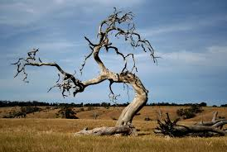
IV. Desired Outcomes of wielding [believe and speak] the Word:
4. To be a king as called by the Lord with His delegated authority.
iii. Take authority over the environment of our situations
Matthew 21:19 And seeing a fig tree by the road, He came to it and found nothing on it but leaves, and said to it, “Let no fruit grow on you ever again.” Immediately the fig tree withered away.
Mark 11:21 And Peter, remembering, said to Him, “Rabbi, look! The fig tree which You cursed has withered away.”

Slide 47
IV. Desired Outcomes of wielding [believe and speak] the Word:
4. To be a king as called by the Lord with His delegated authority.
iii. Take authority over the environment of our situations
Mark 4:39 Then He arose and rebuked the wind, and said to the sea, “Peace, be still!” And the wind ceased and there was a great calm.

Slide 48
IV. Desired Outcomes of wielding [believe and speak] the Word:
4. To be a king as called by the Lord with His delegated authority.
iii. Take authority over the environment of our situations
In Jesus name, I speak to you rain clouds, go away from this place! There shall be no rain on this grounds in Jesus’ name!

Slide 49
Bottom Line
Psalm 103:20 Bless the Lord, you His angels, who excel in strength, who do His word, heeding the voice of His word.

Slide 50
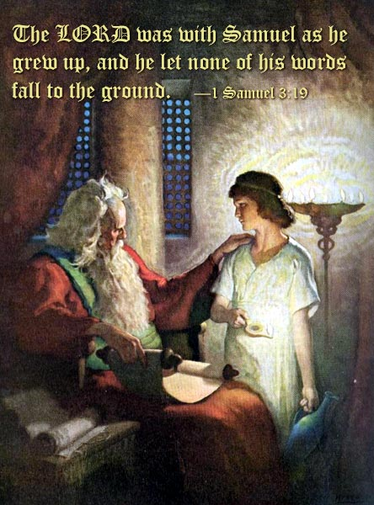
Bottom Line
1 Samuel 3:19 The LORD was with Samuel as he grew up, and he let none of his words fall to the ground.

Slide 51
Bottom Line
Isaiah 61:3 “…that they may be called trees of righteousness, the planting of the LORD, that He may be glorified.”

