Slide 1
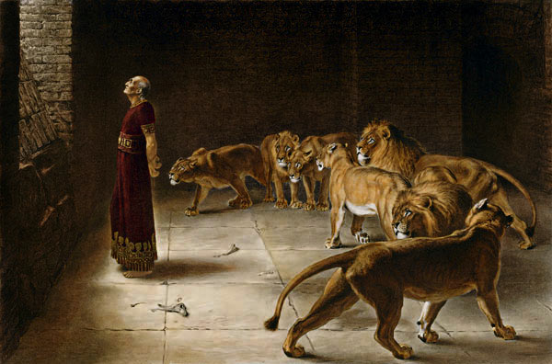
DANIEL
(God is my judge)
God’s kingdom and godless kingdoms.
A narrative of some of the occurrences of the captivity, and a series of prophecies concerning Christ.
3 famous stories:
Shadrach, Meshach & Abed-Nego in the fiery furnace.
The handwriting on the wall at Belshazzar’s feast.
Daniel in the den of lions.
A mystery of dreams, visions & their interpretations.
Daniel was among the people in 1st deportation to Babylon in 605 BC. He became a high-ranking advisor to Nebuchadnezzar.
Greatest prophetic utterance of the sovereignty of God, yet he was humble.
Notes:
Photo: Daniel in the lion’s den

Slide 2
DANIEL
1st part: Daniel and his friends (faithful living in evil times, ch 1-6)
The people of Babylon tried to make them forget the real God and to serve false gods.
They even tried to kill Daniel and his friends because they would not serve the false gods.
But Daniel and his friends were loyal to the real God.
Daniel became prime minister of Babylon.
2nd part: Daniel's dreams (forward looking in evil times, ch 7-12)
These were strange dreams about the future. Sometimes Daniel was awake when he had his dreams.
Some things that Daniel saw in his dreams have now happened.
Other things that God told Daniel in his dreams have not happened yet.
Eschatology – The 70-weeks of Daniel; The setting up of the Messianic Kingdom etc
God’s kingdom will conquer & outlast all godless kingdoms.
The church must live faithfully look forward with hope.
God is in control of the future. God will do what He has promised.
Notes:
Photo: Daniel in the lion’s den

Slide 3
THE 12 MINOR PROPHETS
Reflected circumstances before, during & following the great Babylonian captivity.
(Haggai, Zechariah & Malachi: post-exile)

Slide 4
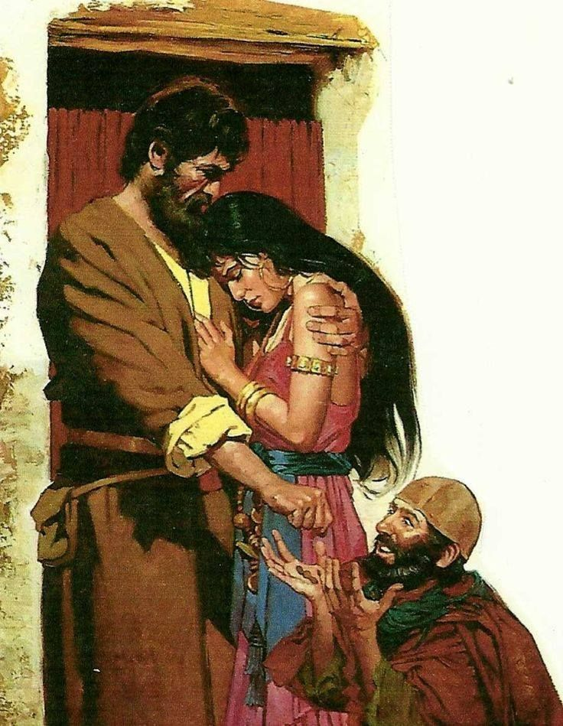
HOSEA
“The Lord is Salvation”
A faithful God & a faithless people.
Theme: God’s love for His wayward people.
‘Jeremiah’ of the northern kingdom.
Prophet of grace.
Contemporary of Amos.
Prophecies relating to Christ and the latter days.
God told Hosea to marry a wife, Gomer, who was not loyal. Bore him 3 children & still a harlot.
But Hosea still loved her.
And he still wanted her to be his wife.
Notes:
Photo: hosea & wife

Slide 5
HOSEA
Hosea's troubles with his wife were like God's troubles with Israel.
The people in Israel were not loyal to God but Baal (husband of the soil) worship. Still, God loved them.
But they were very evil.
They worshipped God as if He were a Baal.
Hosea called the people back to God but his warning was ignored.
So, God would punish them for their evil deeds.
But afterwards, the people would trust in God again.
They would confess their evil deeds to God.
God would forgive them.
And He would love them again.
Insight into the hurt of God over human faithlessness, His suffering over human rebellion.
Faithful Hosea and faithless wife, chaps 1-3
Faithful God and faithless people, chaps 4-14
Notes:
Photo: hosea & wife

Slide 6
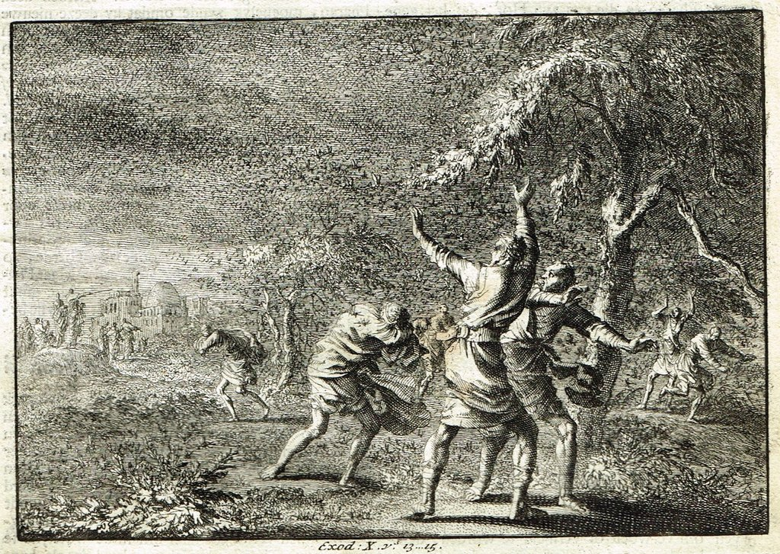
JOEL
Considered to be the most polished literary work among the prophetic writings.
Careful & well-developed imagery of, e.g. the locust plague (Chaps 1 & 2).
Purpose:
To warn against approaching judgment,
to call the people to repentance &
to give God's people hope of the coming day of salvation that will follow the judgment.
Notes:
Photo: locust plague

Slide 7
JOEL
The Book of Joel describes some terrible events.
Joel called these events 'the Day of God'.
A terrible army would attack Jerusalem.
They would destroy everything. Nobody could escape from this army.
So, the people must confess their evil deeds to God.
Even when these terrible things happen, they must ask God to save them.
Then, God will be kind to his people. He will hear their prayers.
He will cause this terrible army to leave. He will provide food for his people.
And He will send His Spirit on all people - universal outpouring of the Holy Spirit, Joel 2:28-29
Thus, often called "The prophet of the Pentecost"
God will also punish the nations that attack Jerusalem (Joel 3:1-16).
But God will protect His own people always.
Notes:
Photo: locust plague

Slide 8
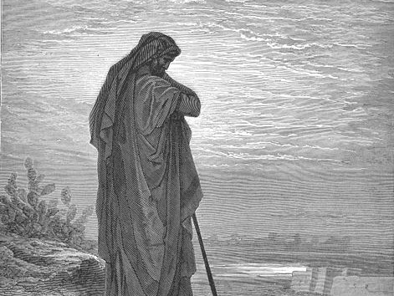
AMOS
(burden bearer)
Prophet of justice & righteousness. Concern for social justice.
After exile, Israel shall be exalted above the gentiles.
Key verse:
For thus says the Lord to the house of Israel:
“Seek Me and live; Amos 5:4
  The Lord roars, chap 1-9:10
  The Lord restores, chap 9:11-15
Notes:
Photo: amos

Slide 9
AMOS
(burden bearer)
In Joel: The people were plagued by locusts.
In Amos: The people were prospering. Chosen to expose false spirituality in the 10 northern tribes though he was from Judah.
Witnessed against those who subordinated human need & dignity to the pursuit of wealth & pleasure.
Warned against civil religion that equates national success with the favour of God.
Amos looked after sheep. But God sent Amos with a message to his nation. 1 Cor 1:27
Prediction that Israel and other neighbouring nations will be punished by conquerors from the north, and of the fulfillment of the Messiah's kingdom.
Notes:
Photo: amos

Slide 10
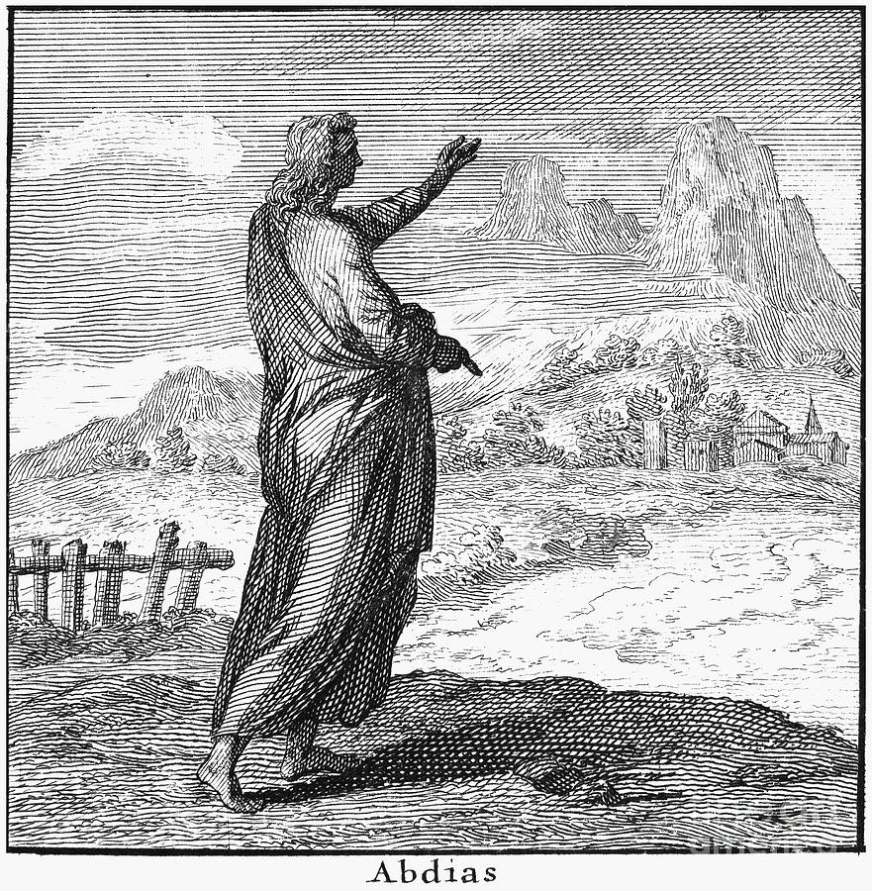
OBADIAH
(THE LORD'S SERVANT)
Vengeance & Victory
Theme: Edom will fall & Judah will rise
The kingdom of God will ultimately triumph.
God’s vengeance on Esau, vv1-16
God’s victory for Jacob, vv17-21
He is worthy of Judah’s trust.
Great message for suffering Christians.

Slide 11
OBADIAH
(THE LORD'S SERVANT)
A message of doom about the country called Edom.
Descendants of Esau. Thus, relatives of the people from Israel.
But they refused to help when the people from Israel suffered.
So, God would punish the people from Edom for this evil deed.
God would destroy their country.
The Lord is sovereign over all nations, not just the God of Israel.

Slide 12
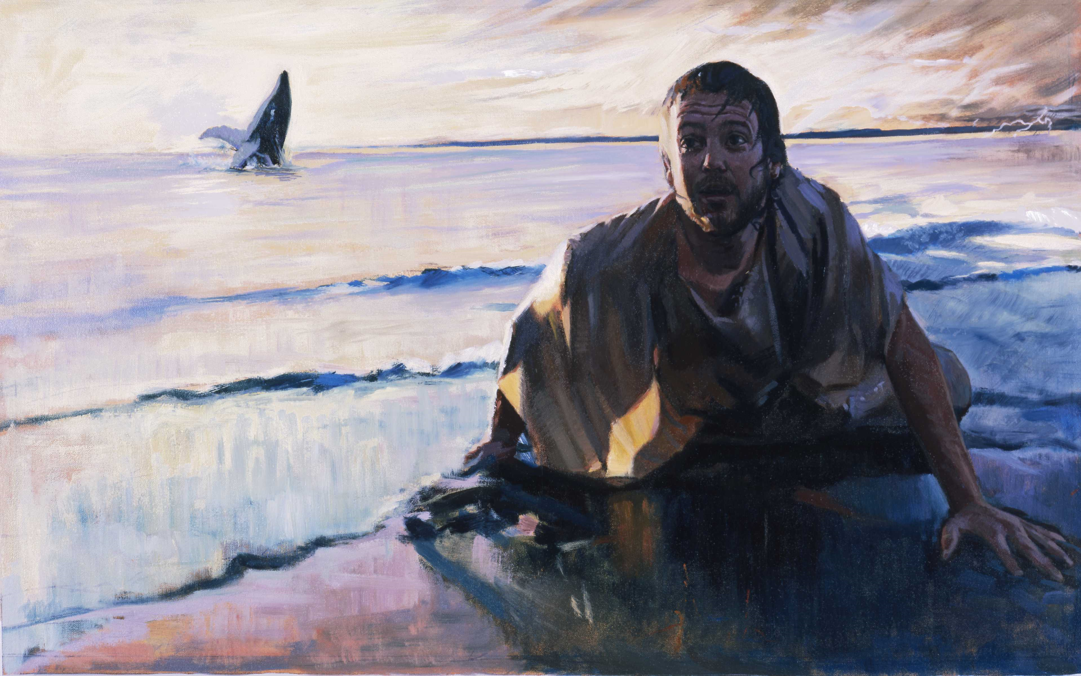
JONAH
The great sea, the great city & the great God.
Theme: The God of the Jews & the gentiles.
A missionary book
God’s call to extend His mercy to the nations.
Key verse:
…for I know that You are a gracious and merciful God, slow to anger and abundant in lovingkindness, One who relents from doing harm…Jon 4:2
The prejudice prophet.
The first foreign missionary.
12 miracles in 48 verses – power of God.
Notes:
Photo: Jonah & fish

Slide 13
JONAH
Chapter | Outline 1 | Outline 2
1 | I won’t go | Running from God
2 | I will go | Running to God
3 | I am here | Running for God
4 | I wish I hadn’t come | Running against God
Should I not spare Nineveh ?
As He showed mercy to undeserving world, so must we.

Slide 14
Jonah & Jesus
Similarities
Servant of God.
Sent to gentiles.
Cast into the depth.
Delivered from the depth (3D/3N)
Resurrection led to salvation of many.
Contrast
Jonah | Jesus, greater than Jonah (Matt 12:41)
Went unwillingly | Went willingly
Sent to one city | Sent to the whole world
Thousands repented | Millions repented

Slide 15
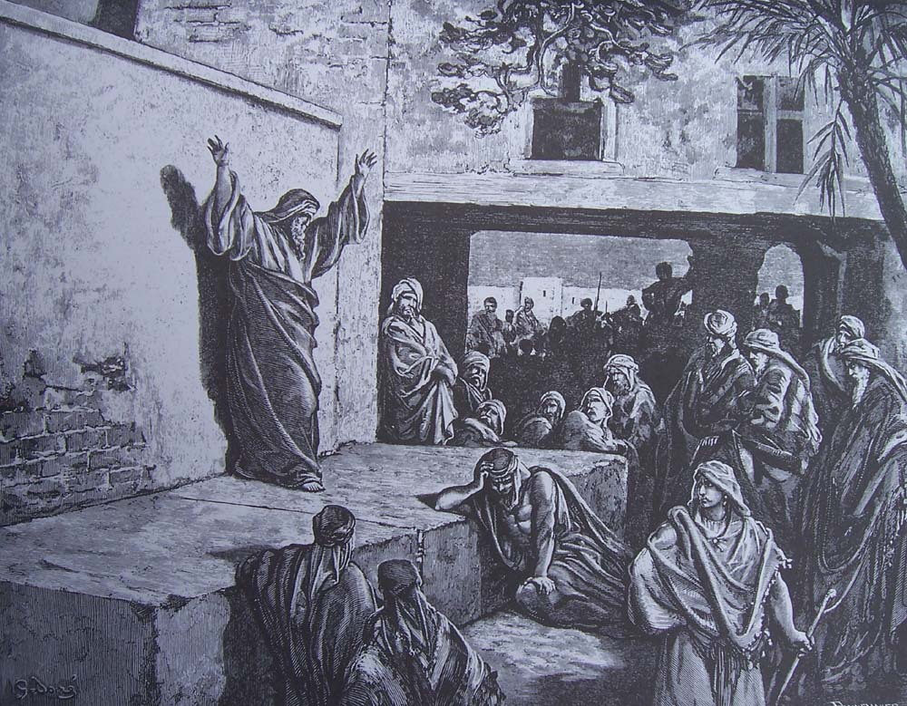
MICAH
(WHO IS LIKE GOD?)
Punishment & Pardon
The blue collar prophet – spokesman for the common people.
Message: Israel should repent.
He has shown you, O man, what is good; And what does the Lord require of you But to do justly, To love mercy,
And to walk humbly with your God? ~ 6:8
Who is a God like You, Pardoning iniquity and passing over the transgression of the remnant of His heritage? He does not retain His anger forever, Because He delights in mercy. ~ 7:18
Key verses:
“But you, Bethlehem Ephrathah, Though you are little among the thousands of Judah, Yet out of you shall come forth to Me
The One to be Ruler in Israel, Whose goings forth are from of old,
From everlasting.” ~ 5:2

Slide 16
MICAH
(WHO IS LIKE GOD?)
Contemporary of Isaiah.
His intercession deferred judgment by 120 years.
He had Amos' passion for justice & Hosea's heart of love.
Predictions relating to the Babylonian captivity, the establishment of a theocratic kingdom in Jerusalem, and the birth of the Messiah in Bethlehem.
Micah warned the people in Israel and Judah.
God would punish them for their evil deeds.
The people had cruel schemes. They were thieves.
And they listened to false prophets whose words were lies.
God did not want terrible things to happen. God wants to teach people.
And He wants the nations to be at peace.
God promised to send a leader for Israel.
This leader would be from Bethlehem.
We now know that this leader is Jesus, Micah 5:2

Slide 17
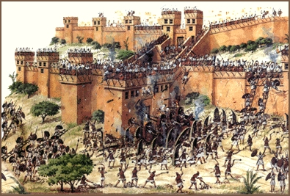
NAHUM
“compassion” / “consolation”
Theme: The enemies of God’s people will be destroyed.
Points to God, the divine warrior.
Foreshadowing Jesus, the conquering king.
Message: Rejoice & continue in hope.
A full restoration for Israel.
Key verse:
The Lord is good,
A stronghold in the day of trouble;
And He knows those who trust in Him. ~ 1:7
The Judge 1:1-8
The Verdict 1:9-2:13
The Sentence 3:1-19
Notes:
Photo: the fall of nineveh

Slide 18
NAHUM
Prediction of the downfall of Assyria (the bloody city).
Purpose: To declare God's moral government of the world, to provide comfort to all those, especially God's people , who suffered abuse at the hands of this vicious world power.
A message based on God's justice.
He wrote about a country which was an evil enemy of Israel, called Nineveh.
The people from Nineveh were also cruel to the people in other countries.
But God cares about the people who trust Him.
So, God would send the enemies of Nineveh to destroy Nineveh.
God would end Nineveh's cruelty.
But God would help His own people, Israel.
And Israel would become a great nation again.
Notes:
Photo: the fall of nineveh

Slide 19
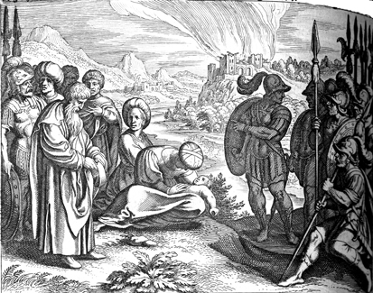
HABAKKUK
(WRESTLER / EMBRACER)
Human complaints & divine responses.
Book of ‘Whys’ (much neglected)
The optimist
The prophet of persistent faith.
Theme: Faith - Trusting God with the mystery of providence.
Key verses:
“Behold the proud,
His soul is not upright in him;
But the just shall live by his faith. ~ 2:4
Though the fig tree may not blossom,
Nor fruit be on the vines;
Though the labour of the olive may fail,
And the fields yield no food;
Though the flock may be cut off from the fold,
And there be no herd in the stalls—
¹⁸ Yet I will rejoice in the Lord,
I will joy in the God of my salvation~3:17-18
Notes:
Photo: Habakkuk & soldiers

Slide 20
HABAKKUK
(WRESTLER / EMBRACER)
Minor prophet with major message.
Last of the minor prophets to preach in Judah before Babylonian invasion.
A prediction of the doom of the Chaldeans.
Unique among the prophets because he spoke to God.
Habakkuk complained twice to God.
Habakkuk asked God why good people must suffer.
And, Habakkuk asked why cruel people seem to succeed.
Firstly, Habakkuk complained that the rulers of his country were wicked.
God replied that soldiers from Babylon would attack these wicked rulers.
Notes:
Photo: Habakkuk & soldiers

Slide 21
HABAKKUK
(WRESTLER / EMBRACER)
But Habakkuk complained to God again.
Habakkuk said that God allowed cruel people to attack good people.
God replied that He would punish cruel people.
But this does not always happen immediately.
But God told Habakkuk to write this down, because God will definitely punish evil people.
So, good people must trust God.
The time will come when God will rule the whole world.
The story of a believer's conflict of faith & the ultimate triumph of faith.
A personal experience which ends, not with a wail but a song (3:17-19); not with an enquiry but with an affirmation.
Notes:
Photo: Habakkuk & soldiers

Slide 22
HABAKKUK
The wrestler has turned into a worshipper.
Book opens in gloom but closes in glory.
Begins with a question but closes with exclamation!
Conclusion:
The just shall live by faith and the wicked shall not go unpunished.
Notes:
Photo: Habakkuk & soldiers

Slide 23
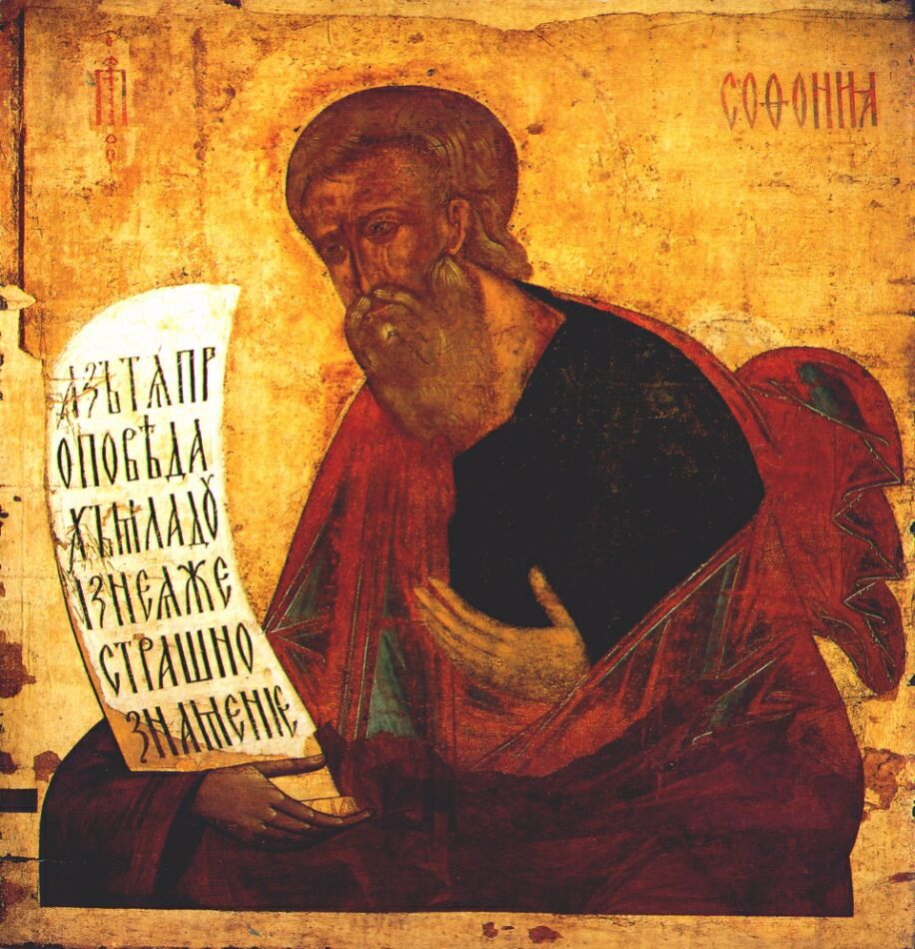
ZEPHANIAH
(Jehovah has hidden him)
The orator.
Prophet of all nations.
Theme: Day of desolation / deliverance
Message:
Judah should fear for her part in the judgment of the nations but should rejoice in the promise of restoration & possession of the nations.
Key verse:
Seek the Lord, all you meek of the earth,
Who have upheld His justice.
Seek righteousness, seek humility.
It may be that you will be hidden
In the day of the Lord’s anger. ~ 2:3

Slide 24
ZEPHANIAH
A Judean prophet, contemporary of Jeremiah, Nahum & Habakkuk.
A prediction of the overthrow of Judah for its idolatry and wickedness.
Zephaniah explained that God would punish many countries because of their evil deeds.
God would also punish the evil people in Jerusalem.
So, the people should pray to God.
They must confess their evil deeds to God.
And they must be humble.
When these terrible punishments happen, God will protect the people who trust Him.
God will rescue them. He loves them.
And He will make them glad.

Slide 25
ZEPHANIAH
The Day of the Lord (double-edged)
Deliverance for the faithful.
Judgment for the unrepentant.
Outline:
Looking within: The sin of Judah, 1-2:3
Looking around: The sentence against the nations, 2:4-3:8
Looking ahead: The salvation of the remnant, 3:9-20

Slide 26
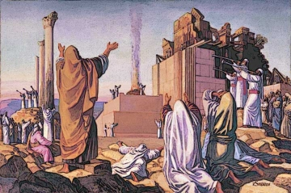
HAGGAI
(FESTIVE)
The people’s work & God’s work.
Prophet of divine shaking (post-exilic)
Theme: Seek first the kingdom of God and all other things will be added to you.
Purpose: To encourage the reconstruction of the temple.
The people’s work, chap 1
God’s work, chap 2
Notes:
Photo: rebuilding the temple

Slide 27
HAGGAI
Haggai, Zechariah & Malachi prophesied after the exile.
Came on scene 18 years after return of exiles from Babylon.
Prophecies concerning the rebuilding of the temple, provided the impetus to resume & to finish the work.
He lived at the same time as Zechariah.
Then, some people from Israel had returned from Babylon.
They rebuilt their own houses in Jerusalem.
Haggai explained why they were poor. He said that God was not blessing them.
Haggai told them that they should also rebuild God's temple (the house of God).
The new temple was small.
But God told Haggai that it would be greater than the old temple.
And now, God would bless the people because they had rebuilt the temple.
Notes:
Photo: rebuilding the temple

Slide 28
HAGGAI
KEY VERSES:
“You have sown much, and bring in little;
You eat, but do not have enough;
You drink, but you are not filled with drink;
You clothe yourselves, but no one is warm;
And he who earns wages,
Earns wages to put into a bag with holes.” ~ 1:6
Go up to the mountains and bring wood and build the temple, that I may take pleasure in it and be glorified,” says the Lord. ~ 1:8
Notes:
Photo: rebuilding the temple

Slide 29
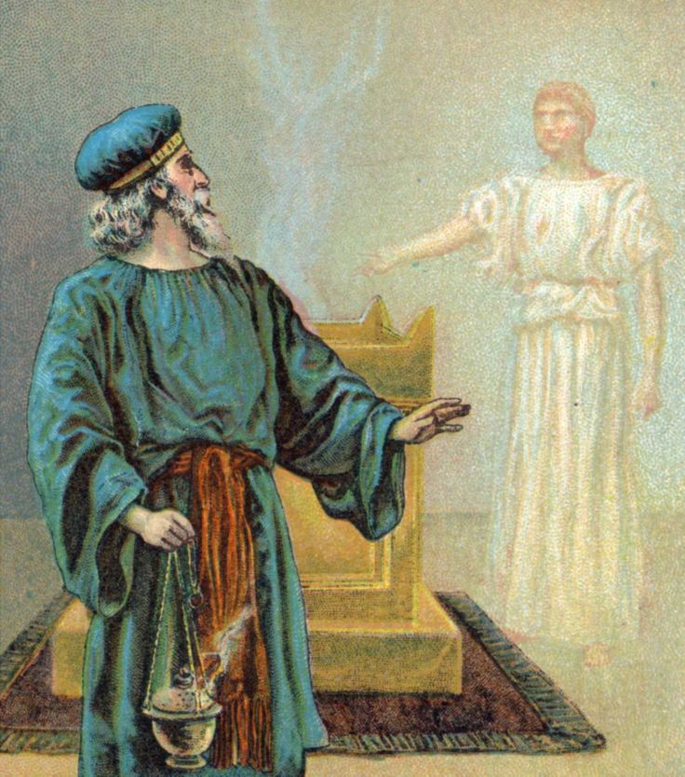
ZECHARIAH
(THE LORD REMEMBERS)
Prophet of hope & truth (mystical – 8 night visions).
Apocalyptic, symbolic language.
Theme:
Return to God for blessings.
Message:
Israel (church) to return to God in repentance &
God will return to Israel (church) in restoration (messianic).
Key verses:
Therefore say to them, ‘Thus says the Lord of hosts: “Return to Me,” says the Lord of hosts, “and I will return to you,” says the Lord of hosts.~1:3
And it shall come to pass that everyone who is left of all the nations which came against Jerusalem shall go up from year to year to worship the King, the Lord of hosts, and to keep the Feast of Tabernacles.~14:16
Israel’s return, chaps 1-8
God’s return, chaps 9-14

Slide 30
ZECHARIAH
Visionary & apocalyptic
Prophecies relating to the rebuilding of the temple and the Messiah.
Zechariah lived at the same time as Haggai.
1st part: Visions of Zechariah as a young man.
God showed Zechariah many strange pictures to encourage the people in Jerusalem. These pictures explained good things that God would do in the future.
2nd part: Messages delivered or written when he had grown old.
Zechariah wrote about some things that would happen during his own life.
And we now know that Zechariah wrote some things about Jesus.
Jesus is both a priest and a king.
Zechariah describes Jesus' death in Zechariah 12:10.
“And I will pour on the house of David and on the inhabitants of Jerusalem the Spirit of grace and supplication; then they will look on Me whom they pierced. Yes, they will mourn for Him as one mourns for his only son, and grieve for Him as one grieves for a firstborn.

Slide 31
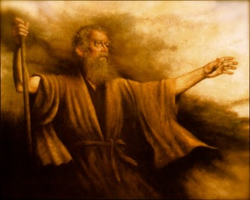
MALACHI
(MY MESSENGER)
When people sin against love.
Prophet of the restoration.
Minor prophet with a major message.
Closing & connecting book.
Book of continual rebuke.
55 verses (47 spoken by God)
Unlike other prophets, Malachi ended with a warning instead of a hope.
Then 400 years of silence.
Theme: Divine love spurned but persistent.
God’s sovereign love, 1:1-5
The priests sinned against His love, 1:6-2:9
The people sinned against His love, 2:10-4:6
God’s answer: Not a program but a Person. Not just a message but a Messenger.

Slide 32
MALACHI
(MY MESSENGER)
Key verse:
“Behold, I send My messenger (John the Baptist),
And he will prepare the way before Me. And the Lord, whom you seek, will suddenly come to His temple,
Even the Messenger (Jesus Christ) of the covenant,
In whom you delight. Behold, He is coming,”
Says the Lord of hosts.~3:1
6 questions for God:
‘In what way have You loved us?’~1:2
‘In what way have we despised Your name?’~1:6
Why do we deal treacherously with one another
‘By profaning the covenant of the fathers?’~2:10
‘In what way shall we return?’… ‘In what way have we robbed You?’~3:7-8
‘What have we spoken against You?’~3:13
Last verse:
OT(law): “Lest I come and strike the earth with a curse.”~4:6
NT: “The grace of our Lord Jesus Christ be with you all. Amen.” ~Rev 22:21

Slide 33
MALACHI
(MY MESSENGER)
Mission of reformation.
Prophecies relating to the calling of the Gentiles and the coming of Christ.
Malachi said that God accused the people.
They were doing many wrong things.
They did not give the best gifts to God.
The priests did not teach well.
The men divorced their wives without a proper reason.
But God Himself would come to His temple.
But before this, God would send His special servant.
This servant would teach the correct way to serve God.
Then, the people would be ready for God's arrival.
This was good news for the people who respected God.
But this was terrible news for the people who refused to obey God.
Malachi's book was written after all the other books in the Old Testament.
400 years later, Jesus came.

