Slide 1
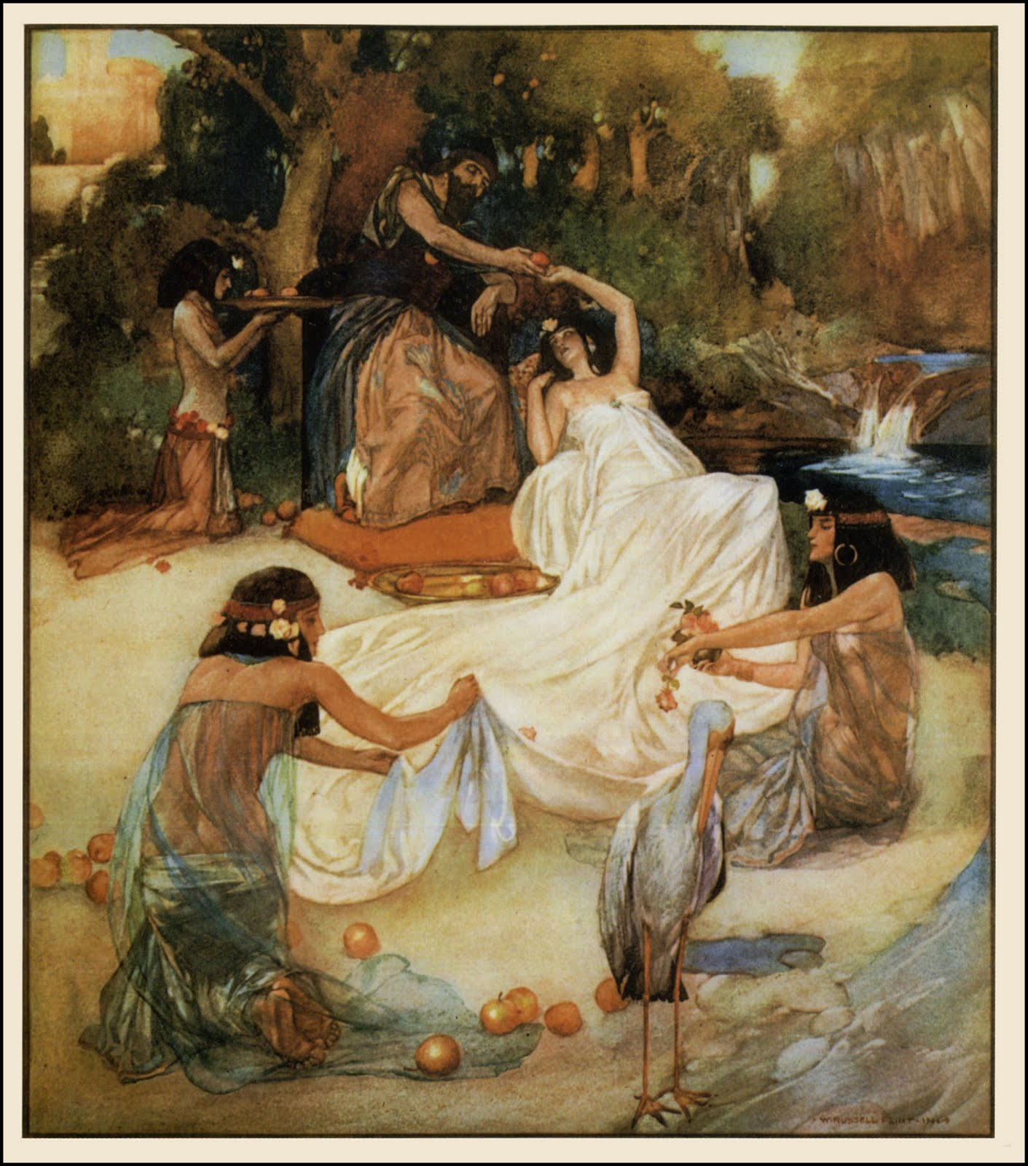
SOLOMON'S SONG
(THE SONG OF SONGS)
theme
“LOVE AND MARRIAGE”
Notes:
Photo: man & woman in marriage

Slide 2
SOLOMON'S SONG
(THE SONG OF SONGS)
The greatest song. No adjective in Hebrew.
The 5th & final book of poetry.
God's manual for marriage.
God's love for Israel.
Christ's love for the church and individual believer.
An allegory relating to the church.
No mention of God (like Esther). No mention of sin.
Notes:
Photo: man & woman in marriage

Slide 3
SOLOMON'S SONG
(THE SONG OF SONGS)
A passionate love poem that presents the ideal love that should exist between a man and a woman in marriage.
The song celebrates intimacy, sexual desire and the marital love of man to woman and woman to man.
Jews below age 30 cannot read book because of romantic sensual issues.
At the same time, the song serves as a metaphor for the covenant love that exists between God and his people.
Indeed, marriage is the appropriate picture that describes our relationship with God.
Lots of wisdom for others but not much for himself.
Notes:
Photo: man & woman in marriage

Slide 4
ECCLESIASTES | SOS
Vanity of vanities | Song of songs
Life of wandering | Rest from wandering
Life under the sun | Life in the Son

Slide 5
BOOKS OF
PROPHECY
Men raised by God in a period when neither priests nor kings were worthy channels through which God's expression might flow.
They spoke of events in the distant future & local events in the immediate future.

Slide 6
PROPHETS
Isaiah | Greatest
Jeremiah | Courageous
Ezekiel | Mystical
Jonah | Successful

Slide 7
Isaiah | Points to the Son | Declared the salvation of the Father
Jeremiah | Points to the Father | Declared the judgment of the Father
Ezekiel | Points to the Spirit | Declared the mystery and the majesty of the Father

Slide 8
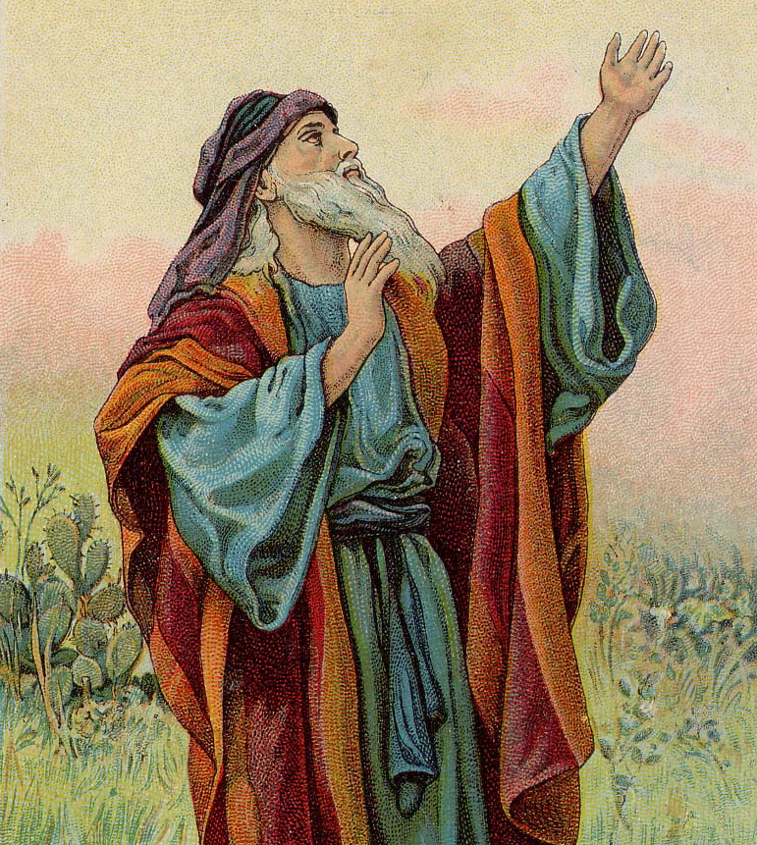
ISAIAH
(YAHWEH IS SALVATION OR GOD SAVES)
The prince of prophets.
Evangelist of the Old Testament.
The mini Bible
Chaps 1-39 : law & judgement (OT); the Disease
Chaps 40-66: hope, grace &salvation (NT); the Cure
The gospel before the gospel. Book of salvation.
Themes of justice and redemption.
Most quoted in the New Testament.
Christ-centric. His virgin birth, character, life, death, resurrection, second coming...
Notes:
Photo: isaiah

Slide 9
ISAIAH
(YAHWEH IS SALVATION OR GOD SAVES)
Isaiah lived before Ezekiel and Jeremiah.
Northern kingdom was already in Assyrian captivity.
God appointed Isaiah to warn the people in Judah. He gave them another chance.
The people were evil. So, they should ask God to forgive them.
Isaiah described the future of many countries (Isaiah 13-24).
But especially, he warned his own people in Judah and Israel (Isaiah 28-31).
Notes:
Photo: isaiah

Slide 10
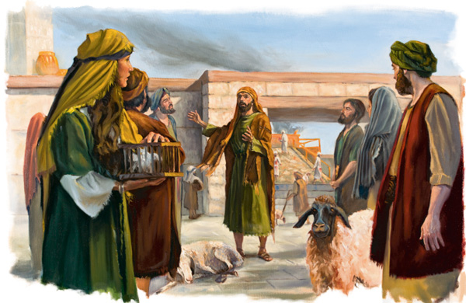
JEREMIAH
(THE WEEPING / PERSISTENT / COURAGEOUS PROPHET)
A type of Jesus, Matt 16:14
A difficult ministry. None converted after 40 years.
Broken-hearted prophet with heart-breaking message.
Prophecies announcing the captivity of Judah, its sufferings, and the final overthrow of its enemies.
God chose Jeremiah as a prophet when Jeremiah was a young man (Jer 1).
Jeremiah lived at the same time as the last kings of Judah.
Notes:
Photo: jeremiah talking to people on the prophecies

Slide 11
JEREMIAH
(THE WEEPING / PERSISTENT / COURAGEOUS PROPHET)
Jeremiah warned the people that God would punish them (Jer 4). They must return to God. Otherwise, they would suffer terrible troubles (Jer 14-16).
Oversaw winding down of backslidden nation.
God wanted the people to trust him. But they refused (Jer 18).
So, God told Jeremiah that the people must serve their enemies for 70 years (Jer 25).
Thereafter, people from Israel would return to their land (Jer 30-33).
Jeremiah also wrote about the future of other nations (Jer 46-51).
And Jeremiah knew that God would send Jesus (Jer 23:1-8, Jer 31:31-37, and Jer 33)
The new covenant, Jer 31:33 But this is the covenant that I will make with the house of Israel after those days, says the Lord: I will put My law in their minds, and write it on their hearts; and I will be their God, and they shall be My people.
Notes:
Photo: jeremiah talking to people on the prophecies

Slide 12
Jeremiah 31:31-33 New King James Version (NKJV)
A New Covenant
³¹ “Behold, the days are coming, says the Lord, when I will make a new covenant with the house of Israel and with the house of Judah—
³² not according to the covenant that I made with their fathers in the day that I took them by the hand to lead them out of the land of Egypt, My covenant which they broke, though I was a husband to them, says the Lord.
³³ But this is the covenant that I will make with the house of Israel after those days, says the Lord: I will put My law in their minds, and write it on their hearts; and I will be their God, and they shall be My people.
Notes:
Photo: jeremiah talking to people on the prophecies

Slide 13
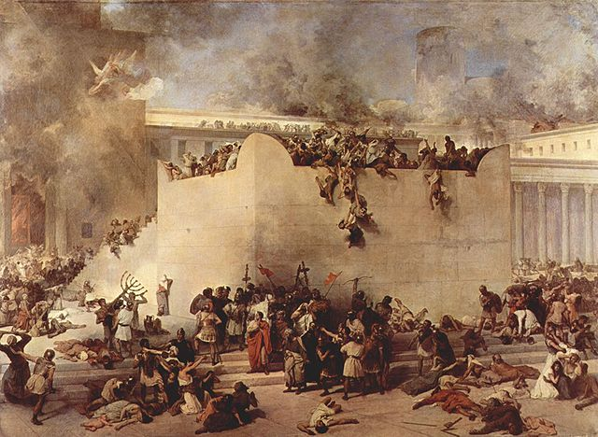
LAMENTATIONS
The utterance of Jeremiah's sorrow upon the capture of Jerusalem and the destruction of the temple.
The wailing wall of the Bible.
Lamentations is a book of very sad poems.
Jeremiah wrote the Book of Lamentations after soldiers from Babylon destroyed Jerusalem.
A tough message by a tender man. Sin always brings sorrow.
“Through the Lord’s mercies we are not consumed,
Because His compassions fail not.
They are new every morning;
Great is Your faithfulness.” Lam 3:22-23
Notes:
Photo: fall of jerusalem

Slide 14
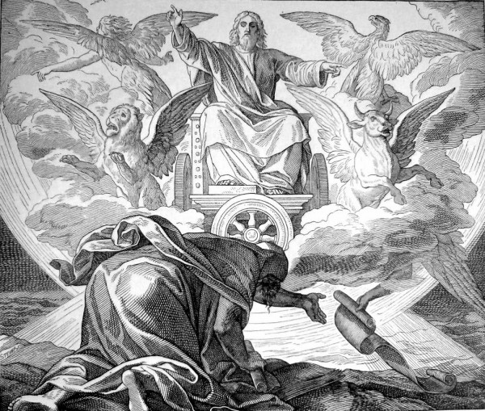
EZEKIEL
(GOD WILL STRENGTHEN)
Messages of warning and comfort to the Jews in their captivity.
Abrupt, unbending, forcible language.
Absence of tears & lamentations.
Prolongation of the voice of Jeremiah. He ‘acted’ out the prophecies.
Ezekiel, a priest-in-training, lived at the same time as the last kings of Judah.
As exile (2nd deportation, 597 BC) deprived Ezekiel of his priestly ministry, God gave him the prophetic ministry.
Written outside of Israel (like Daniel & John)
Notes:
Photo: visions, thrones, chariots

Slide 15
EZEKIEL
(GOD WILL STRENGTHEN)
Objective: To waken spiritual thoughts & feelings, to bring the people back to God.
God showed Ezekiel events that would happen in the future.
God told Ezekiel to warn the people about these events (Ezekiel 33).
God would punish Judah because its people did not obey God's law. Their enemies would surround Jerusalem, which was Judah's capital city (Ezekiel chapters 4-5).
God would leave his temple (Ezekiel 10).
This was because the leaders of Judah served false gods.
And the soldiers from Babylon would destroy Jerusalem.
God would also punish other evil nations.
But God still cared about his people (Ezekiel 37).
God would send someone from David's family to be their leader (Ezekiel 37:24-28).
We now know that this person is Jesus.
God also showed Ezekiel a picture of a new temple in the future (Ezekiel 40-48).
God Himself would return to this temple (Ezekiel 43).
Notes:
Photo: visions, thrones, chariots

Slide 16
3 periods
1st period: chapters 1-24, most depressing - that Jerusalem would be totally destroyed. – CONDEMNATION
2nd period: chapters 25-32, prophesied about the 7 nations around Jerusalem. - CONDEMNATION
3rd period: chapters 33-48, focused on the return home, good future; restoration of the temple. (Ezekiel died in Babylon without seeing the temple or Jerusalem again) - CONSOLATION
Notes:
Photo: visions, thrones, chariots

Slide 17
Why should Christians read Ezekiel?
That God judges His own people. Judgment begins at the house of the Lord and by a higher standard than others.
That God takes vengeance.
That God will always restore His people. Israel will never disappear. The Church will never disappear. We belong to the people of eternity. One day there will be one flock under one shepherd.
That a great portion in Ezekiel is picked up in Revelation. If don't know Ezekiel, will be puzzled by Revelation.
That Ezekiel gives us a view of God - His omnipotence, His omnipresence & His omniscience.
Notes:
Photo: visions, thrones, chariots

