Slide 1
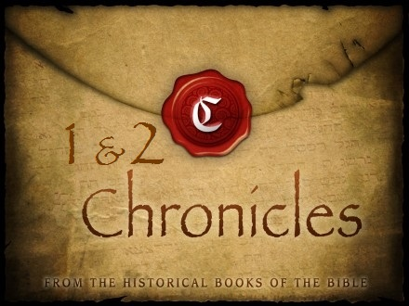
THE BOOKS OF CHRONICLES
EVENTS OF THE YEARS - HEBREW
theme
“ISRAEL’S SPIRITUAL HISTORY & HERITAGE”

Slide 2
THE BOOKS OF CHRONICLES
EVENTS OF THE YEARS - HEBREW
Are so called as being the record made by the appointed historiographers of the kingdoms of Judah and Israel;
they are the official histories of those kingdoms.
Narrates David and Solomon’s kingship as well as a selection of southern kings and Judah’s judgment into exile.
Kings - from man’s viewpoint. Concentrated on bad things the kings did. (author: Jeremiah?)
Chronicles - from God's viewpoint. Sin not mentioned. Revivals mentioned. Concentrated on good things the kings did. (author: Ezra?)
Like the gospels - same events but different accounts

Slide 3
THE BOOKS OF CHRONICLES
EVENTS OF THE YEARS - HEBREW
First and Second Chronicles is written for the people who returned from exile as a way to encourage them in their faith.
They were spiritual heirs of David and Solomon and God would not forget the promises He made to David and to His people.
Thus, David and Solomon are portrayed in a more positive light, and only the southern kingdom (Judah) is highlighted.
Central theme: The Significance of The Davidic Covenant.
Time of incredible peace & prosperity. Prince of peace (Solomon’s reign). Picture of second coming.
Made possible because of the blood shed during David’s reign.

Slide 4
TABERNACLE | TEMPLE
Picture of the 1st coming (John 1:14) | Picture of the second coming
Suffering Saviour (David) | Conquering King

Slide 5
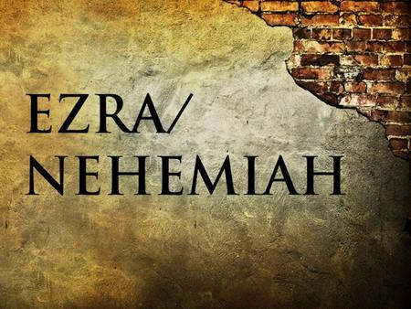
EZRA & NEHEMIAH
theme
“RESTORATION & RECONSTRUCTION”

Slide 6
EZRA & NEHEMIAH
These two books should be seen as one volume. They narrate the return of the exiles from Babylon in three different groups. (3 deportations)
                One was led by Zerubbabel, who began to rebuild the temple.
              Another was led by Nehemiah, who rebuilt the walls of Jerusalem.
              A third was led by Ezra the scribe, who taught God’s people the law and reestablished the worship of God and Israel’s festivals.
Ezra's religious reforms vs Nehemiah's political/social reforms

Slide 7
EZRA & NEHEMIAH
EZRA
The story of the return of the Jews from the Babylonian captivity, and of the rebuilding of the temple, re-establishing them again in their land.
Covers 1st return and 2nd return from exile.
Part in Hebrew and part in Aramaic.
NEHEMIAH
(Yahweh has comforted)
Covers the 3rd return.
An account of the rebuilding of the walls of the city, and of the obstacles encountered and overcome.
Leadership and revival.
Man of action but few words.
Position of trust, wielding considerable influence.
Picture of the ministry of the Holy Spirit (comforter)

Slide 8
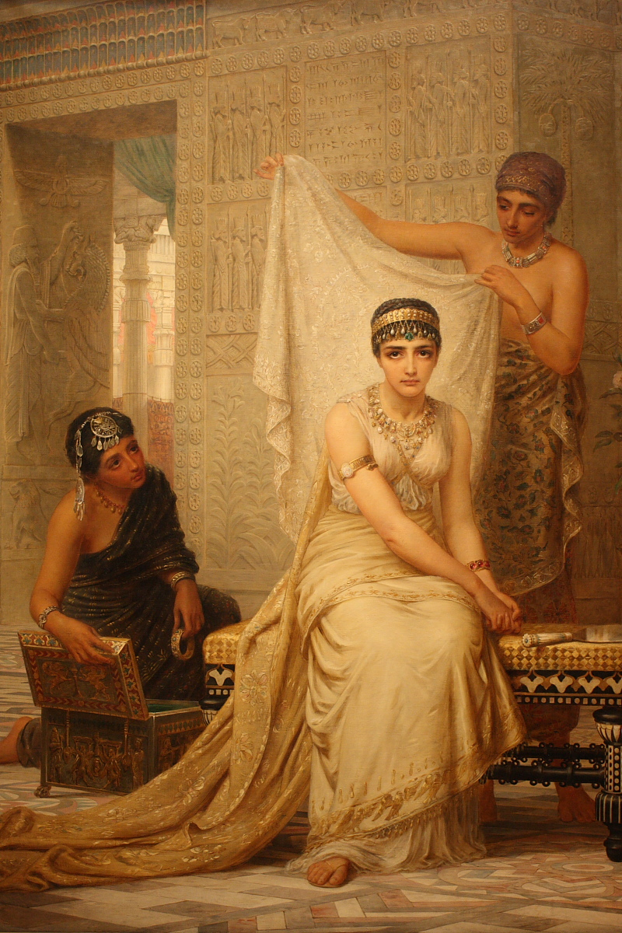
ESTHER
theme
“PRESERVATION”
Notes:
Photo: queen esther

Slide 9
ESTHER
Second book to be named after a woman.
God is not mentioned. Almost excluded from the Bible.
Prayer is not mentioned too.
Not quoted in New Testament.
But God stood in the shadows & watched over His own. Even when God is silent, He is at work.
Like Ezekiel & Daniel, it was set outside the Promised Land.
Notes:
Photo: queen esther

Slide 10
ESTHER
How Jews behaved in a gentile society.
Satan's attempt to destroy the Jews & Jesus.
The story of a Jewess who became queen of Persia and saved the Jewish people from destruction.
“For if you remain completely silent at this time, relief and deliverance will arise for the Jews from another place, but you and your father’s house will perish. Yet who knows whether you have come to the kingdom for such a time as this?” Esther 4:14
The providence of God for His people.
Even when His people are faithless, God remains faithful.
Notes:
Photo: queen esther

Slide 11
POETICAL / WISDOM BOOKS
Insight into daily living & address troubling questions about faith in God.
The foundation of wisdom - The fear of the Lord.

Slide 12
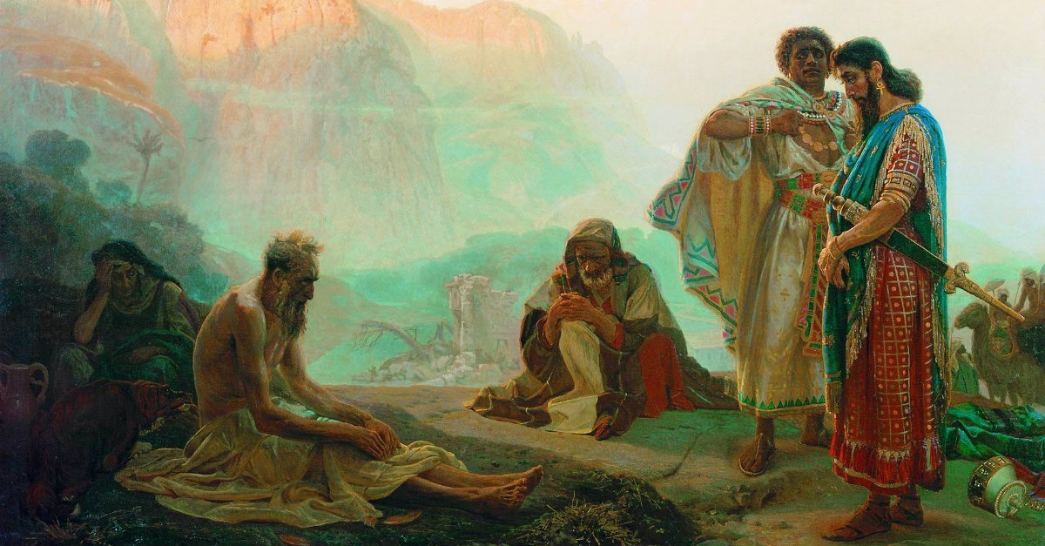
JOB
theme
“BLESSINGS THROUGH SUFFERING”
Notes:
Photo: job with his 3 friends

Slide 13
JOB
Probably the oldest book.
No mention of Law, Israel & Tabernacle.
The story of the trials and patience of a holy man of Edom.
The setting of the story is a test of Job’s faith by removing everything that is of value to him (wealth, family and health).
Notes:
Photo: job with his 3 friends

Slide 14
JOB
The bulk of the story was a conversation between Job and his three friends, Eliphaz, Bildad and Zophar, who argued about why Job was suffering and concluded that it was due to a sin in Job’s life. Job defended his innocence before his friends.
Elihu entered the picture and suggested to Job that he needed to be more humble since God is not required to explain Himself.
God finally answered Job but offered no explanation for the suffering. Instead God humbled Job and sought to remove any sense of self-righteousness in order that he might find his purpose in God.
The book ended with God restoring everything that Job had lost.
Troubles & misfortune do not mean that God has forsaken you.
God didn’t answer Job. He is the answer for his situation.
Notes:
Photo: job with his 3 friends

Slide 15
PSALMS | PROVERBS
Workbook on worship | Workshop in wisdom
Takes your heart to heaven | Keeps your feet on the ground
A songbook | A guidebook
A book you take to prayer closet | A book you take to office at work
What you bring to the sanctuary | What you take to the streets
Complement each other like love & marriage.

Slide 16
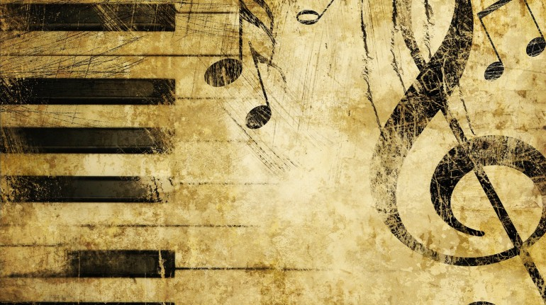
PSALMS
theme
“PRAISE”
Notes:
Photo: piano / musical notes

Slide 17
PSALMS
The hymn or "Him" book of the Bible.
Not just a book of praise but exhortation to praise.
Keyword "Hallelujah"
Only book that contains every human experience - deep devotion, intense feeling, exalted emotion & dark rejection.
Not only speaks to us but also for us.
A collection of sacred poems intended for use in the worship of Jehovah. Chiefly the productions of David.
The Book of Psalms is essentially a hymnbook for the Hebrew nation.
Man’s chief end is to glorify God and enjoy Him forever.
Notes:
Photo: piano / musical notes

Slide 18
PSALMS
The 5 sections correspond to the 5 books of Moses. (Pentateuch).
It contains 150 songs and prayers that focus on Israel’s religious life.
There are 70 Psalms attributed to King David, many of which detailed Saul’s vengeful pursuit of the would-be King David.
Other authors include Asaph, sons of Korah, Moses...
There are different types of Psalms: Laments; praises; royal Psalms (where God’s kingship is celebrated); thanksgiving Psalms; imprecatory Psalms and messianic Psalms that the New Testament writers used in speaking about Jesus (for example Psalm 22).
One of the most beloved parts of Scripture is Psalm 23 while Psalm 119 celebrates the goodness of God’s word.
It is also the longest Psalm.
Notes:
Photo: piano / musical notes

Slide 19
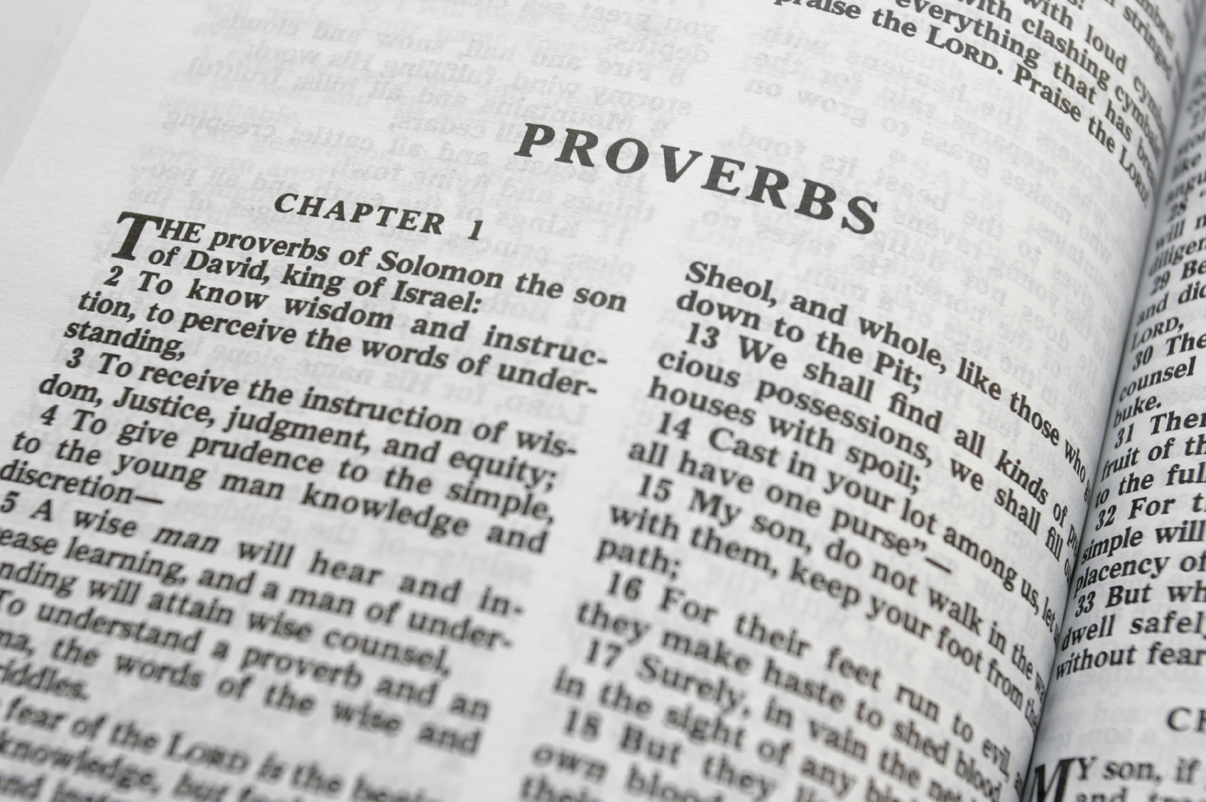
PROVERBS
theme
“PRACTICAL WISDOM”

Slide 20
PROVERBS
Short sentence drawn from long experience. Simple truth. Easy to remember.
Keys to a good life.
Not religious. No priests. No worship.
Living a sacred life in a secular world.
Generally true. Not always true.
900 proverbs (general observations of life). Not promises.
31 chapters.

Slide 21
PROVERBS
The wise sayings of Solomon.
Other authors include Agur, King Lemuel...
Proverbs are short sayings that communicate a moral truth or principle.
The goal of the Book of Proverbs is to communicate wisdom for godly living, a wisdom that originates and comes from God.
Wisdom is more precious than gold and only a fool is not interested in receiving its instructions.

Slide 22
SONG OF SOLOMON | Love of Solomon | Written by young Solomon | Romance
PROVERBS | Wisdom of Solomon | Written by middle-aged Solomon | Morality
ECCLESIASTES | Foolishness of Solomon | Written by old Solomon | Nature

Slide 23
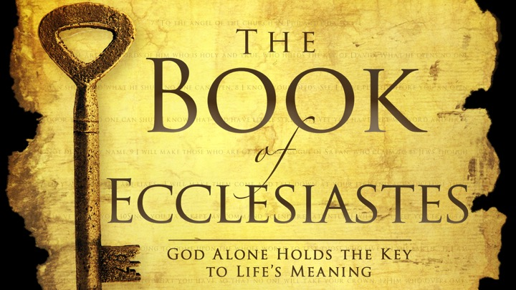
ECCLESIASTES
theme
“ALL IS VANITY APART FROM GOD”

Slide 24
ECCLESIASTES
A poem respecting the vanity of earthly things. "LORD" not mentioned.
Favourite book of atheists, cynics, critics & cults.
The Book of Ecclesiastes is attributed to Solomon and is a biography that examines the meaning of life.
Solomon reflected over a backslidden period away from God. No relationship with Him.

Slide 25
ECCLESIASTES
Journal of his journey into carnality. Life without God.
The second wisest man played the fool.
One of his conclusions is that all of men’s actions are essentially transitory and meaningless. Vanity of vanities.
Therefore one should enjoy life’s simple pleasures including work which is God’s gift to humans.
The author’s final conclusion on life’s meaning however is the most noteworthy:
“Fear God and keep His commandments for that is the whole duty of everyone” (Eccl 12:13).

