Slide 1
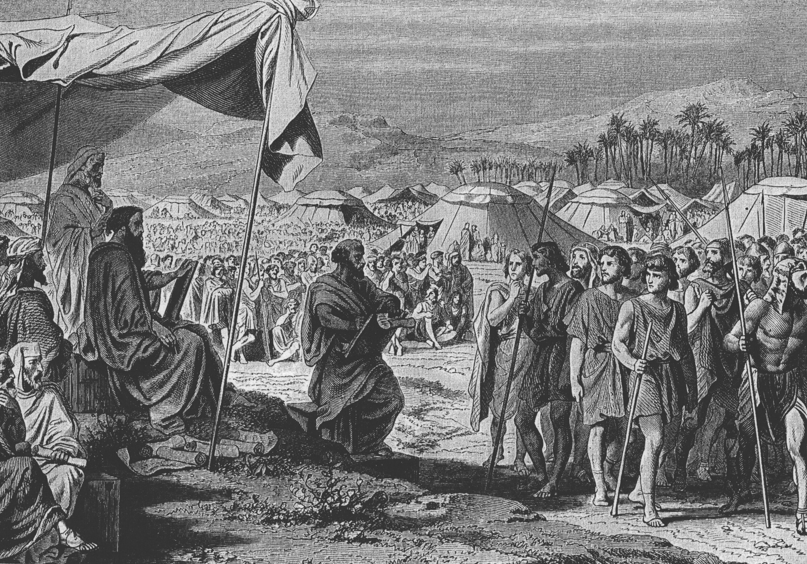
NUMBERS
theme
“JOURNEYS”
Notes:
Photo: counting the number of men to promised land

Slide 2
NUMBERS
Organization of God's people in preparation to take the Promised Land (mobilisation)
The census of the people; the story of the wanderings in the wilderness.
Israel lacks faith in entering the Promised Land.
Notes:
Photo: counting the number of men to promised land

Slide 3
NUMBERS
God punishes Israel by making them wander in the desert for forty years until all of the adult generation that came out of Egypt has died.
The book of Numbers takes its name from the census that is conducted at the beginning of the book to count the number of men in order to determine the size of God’s army that would have conquered the Promised Land.
Making your life count.
Notes:
Photo: counting the number of men to promised land

Slide 4
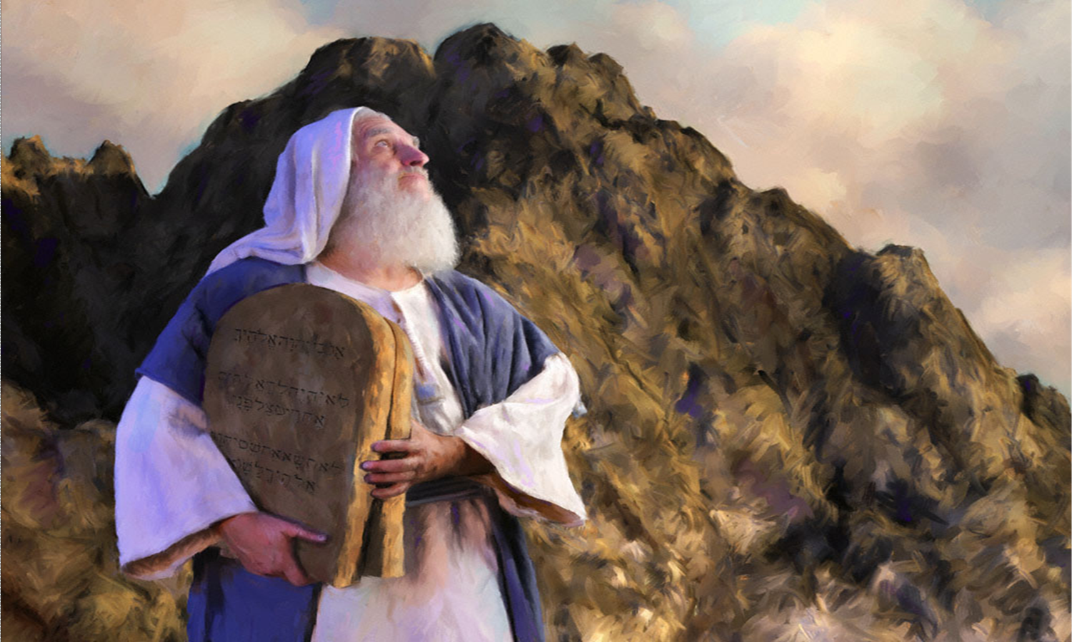
DEUTERONOMY
theme
“OBEDIENCE”
Notes:
Photo: moses holding the tablet (10 commandments)

Slide 5
DEUTERONOMY
The law rehearsed, second giving of the Law; the death of Moses.
Moses's farewell sermon.
Need not have been written if God’s people were obedient.
“Deuteronomy” means “the second law” and basically, it is a recounting of the laws that God previously gave to His people at Mount Sinai.
Notes:
Photo: moses holding the tablet (10 commandments)

Slide 6
DEUTERONOMY
The reason the laws are repeated is because the adult generation that came out of Egypt has passed away and a new generation must renew their covenant with God.
Keyword - “obey”
To be read publicly every sabbatical year at Feast of Tabernacles, Deut 31:9-13.
Most quoted book by Jesus.
To be worshipper of God & student of the Word.
Notes:
Photo: moses holding the tablet (10 commandments)

Slide 7
HISTORICAL BOOKS

Slide 8
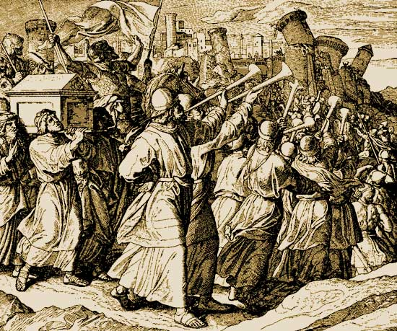
JOSHUA
theme
“CONQUEST”
Notes:
Photo: the fall of jericho

Slide 9
JOSHUA
The story of the conquest and partition of Canaan.
Exodus: book of redemption out of Egypt.
Joshua: book of redemption into the Promised Land.
Parallel with Revelation.
Notes:
Photo: the fall of jericho

Slide 10
JOSHUA
After Israel’s renewal of the covenant in Deuteronomy (at the foot of the promised land), the Book of Joshua narrates the conquest of this land and the division of the land among the twelve tribes of Israel.
Keyword - “possession”
Notes:
Photo: the fall of jericho

Slide 11
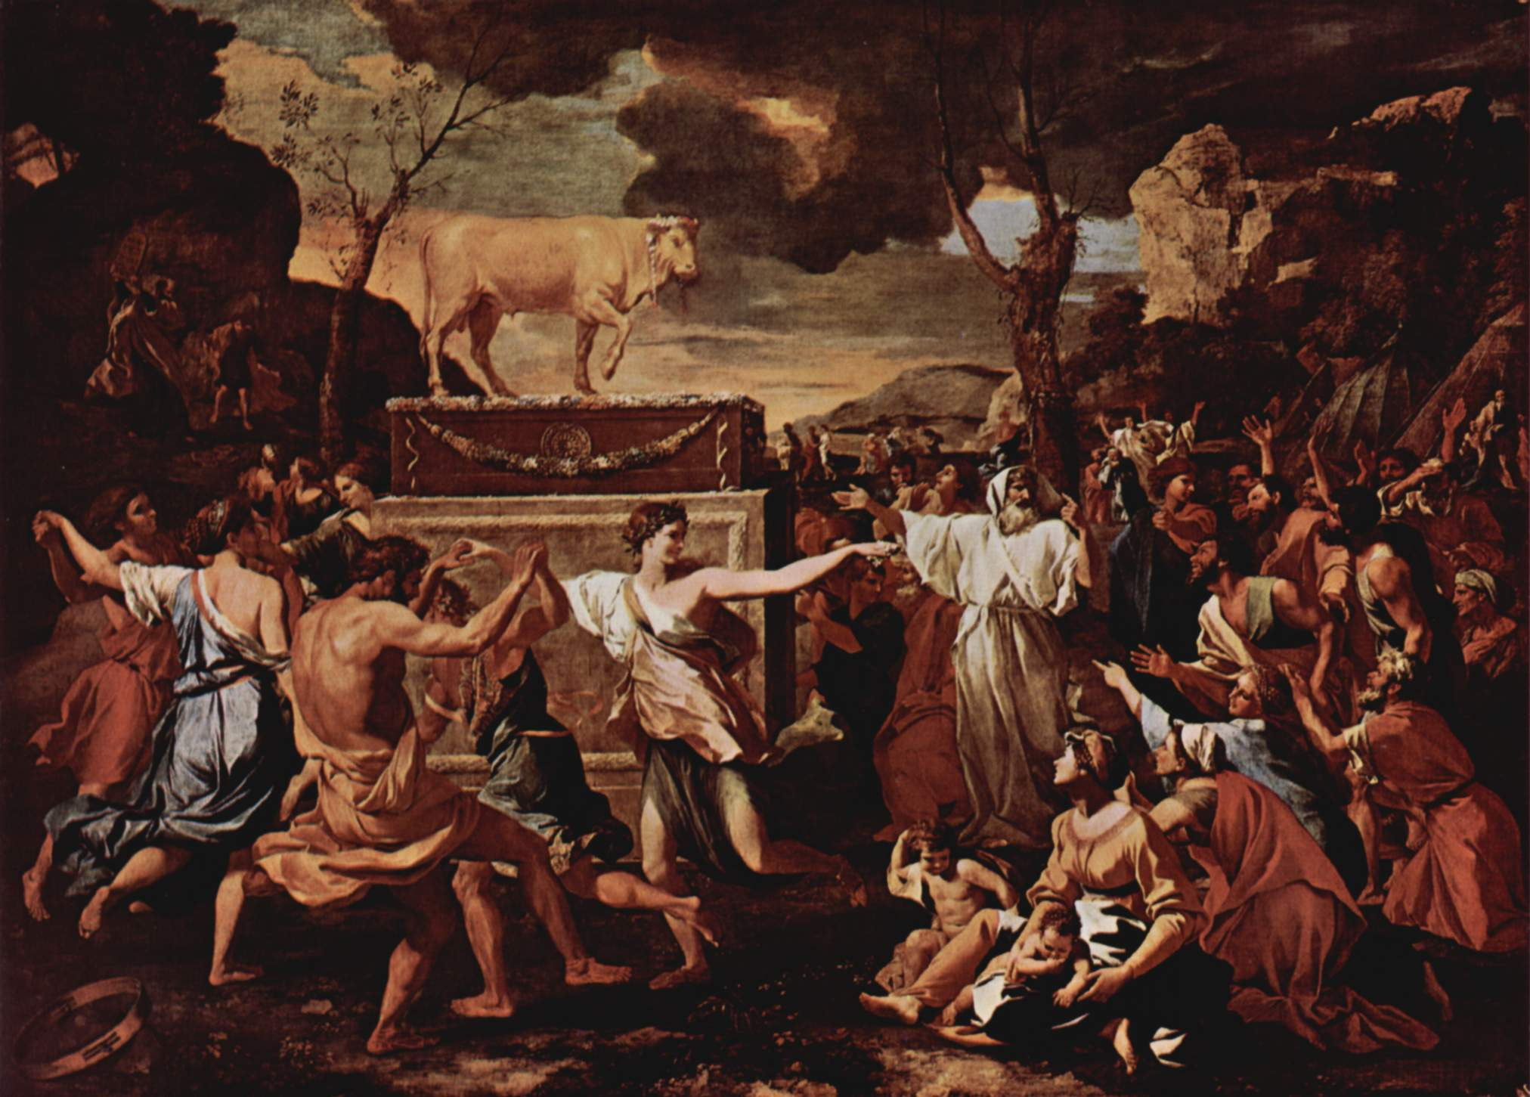
JUDGES
theme
“DETERIORATION AND DELIVERANCE”
Notes:
Photo: idolatry

Slide 12
JUDGES
The history of the nation from Joshua’s death to time of Samuel (last judge & first prophet).
Raised by God to mete out judgments against Israel's enemies.
12 , including 1 woman.
Notes:
Photo: idolatry

Slide 13
JUDGES
After Joshua’s death, the people of God began a cycle of sin which included: idolatry, judgment of God by an invading army, the people’s repentance and clamour for deliverance, raising of a judge and the peace of God’s people.
This cycle repeats itself twelve times in the Book of Judges.
Notes:
Photo: idolatry

Slide 14
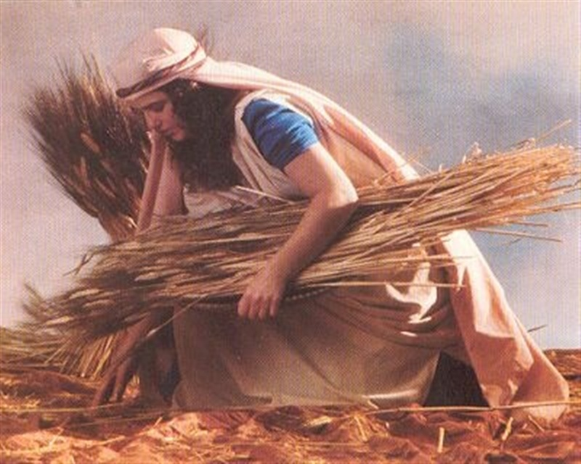
RUTH
theme
“REDEMPTION”
Notes:
Photo: ruth

Slide 15
RUTH
In Hebrew bible, Judges and Ruth as one book.
Placed together with books of prophecy.
Read at Feast of Pentecost
The story of the ancestors of the royal family of Judah.
Occurring during the time of the judges, this book tells the story of a foreigner called Ruth, who became part of God’s people through marriage.
Notes:
Photo: ruth

Slide 16
RUTH
Theme - “redemption”
Possible only through a kinsman-redeemer.
God could not redeem apart from a mediator.
Notes:
Photo: ruth

Slide 17
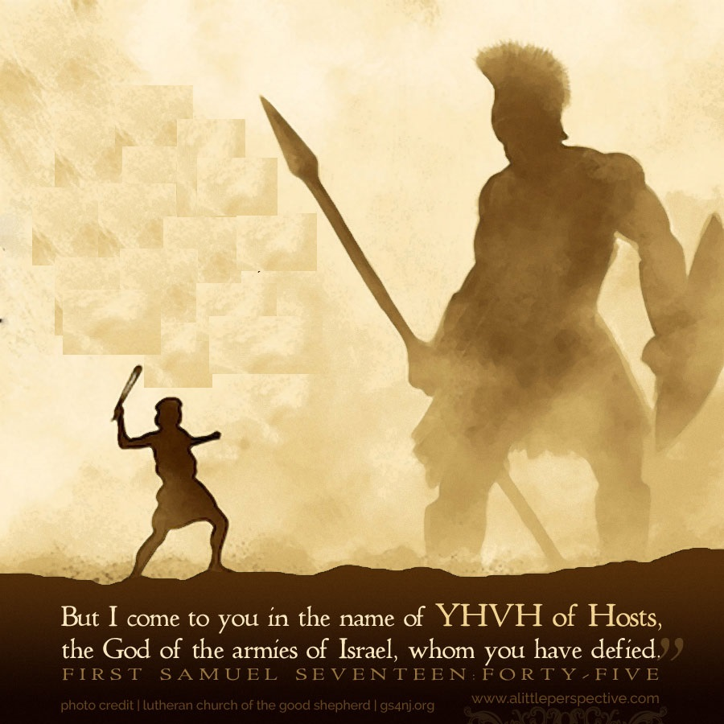
1 & 2 SAMUEL
theme
“TRANSITION & UNIFICATION”
Notes:
Photo: david & goliath

Slide 18
1 & 2 SAMUEL
1 SAMUEL
The story of the nation during the judgeship of Samuel and the reign of Saul.
A. Samuel - last judge, first prophet & kingmaker. (Chaps 1-12)
When Israel was under theocracy, God moved through the
priesthood.
When the priests failed & king appointed, God used
prophets.
B. Saul - first king (Chaps 13-31)
Saul’s rebellion against God
David slayed Goliath
Death of Samuel
Death of Saul
Notes:
Photo: david & goliath

Slide 19
1 & 2 SAMUEL
2 SAMUEL
Story of the reign of David.
C. David - best king
David extends the Kingdom
David’s sin with Bathsheba
Absalom’s revolt against David
David regains the Kingdom
Notes:
Photo: david & goliath

Slide 20
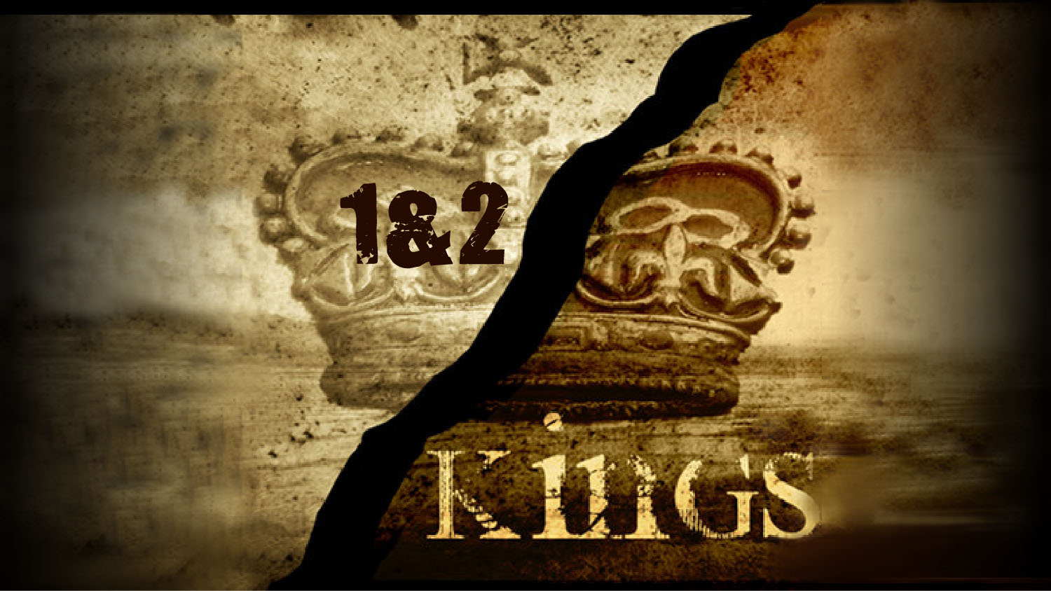
1 & 2 KINGS
theme
“DISRUPTION & DISPERSION”
Notes:
Photo: divided kingdom

Slide 21
1 & 2 KINGS
The books of Kings form only one book in the Hebrew manuscript.
They contain the history of the nation from David's death and Solomon's accession to the destruction of the kingdom of Judah and the desolation of Jerusalem.
Narrates Solomon’s kingship, the divided kingdom of Israel and Judah, and God’s judgment of His disobedient people into exile.
Author: Jeremiah?
Notes:
Photo: divided kingdom

Slide 22
1 & 2 KINGS
THE KINGS HAD:
Absolute power
Made the rules
Commanded the armed forces
Ruled by decree
Representative of the nation before God & vice versa
His character & conduct decided nation’s fate
PATTERN:
Good king - average reign 33 years
Bad king - average reign 11 years
David was the yardstick (human standard)
Notes:
Photo: divided kingdom

Slide 23
1 & 2 KINGS
From United kingdom to Divided kingdom to Single kingdom.
Started well. Finished badly.
Not about history but lessons from history.
History repeats because no one learns.
Notes:
Photo: divided kingdom

