Slide 1
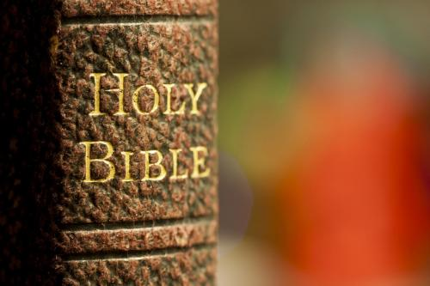
AN
OVERVIEW

Slide 2

A LOVE LETTER FROM GOD
THE FATHER TO HIS CHILDREN.
A love story of the Father looking for a Bride for His Son. They found each other, married and lived happily ever after.
It’s God’s truth about Himself and how we should relate to Him.
It’s the vibrant story of God’s redeeming work in the lives of His people.

Slide 3

BIBLIO
A Library of Books
66 books written by more than 40 persons over 1600 years
39 books in the Old Testament
27 books in the New Testament
The Old enfolds the New
The New unfolds the Old
The Bible starts earlier & finishes later than any other book
It’s history written from God’s point of view

Slide 4
THEMES
What has gone wrong with our world? (Genesis)
How can it be put right? (the rest of the Bible)

Slide 5
HIM-MERNEUTICS
And beginning at Moses and all the Prophets,
He expounded to them in all the Scriptures the things concerning Himself .
~ LUKE 24:27
Now it came to pass, as He sat at the table with them, that He took bread, blessed and broke it, and gave it to them. Then their eyes were opened and they knew Him; and He vanished from their sight.
~ LUKE 24:30-31

Slide 6
BOOK | JESUS
Genesis | King Of Salem & Priest Melchizedek
Exodus | The Tabernacle
Leviticus | The Lamb
Numbers | The Rock
Deuteronomy | The Year Of Jubilee
Isaiah | Emmanuel & Prince Of Peace
Jeremiah | Branch Of Righteousness
Ezekiel | Plant Of Renown

Slide 7
BOOK | JESUS
Daniel | The Stone Cut Without Hands
Hosea | The Dew Of Israel
Joel | The Hope Of Israel
Amos | The Ploughman
Jonah | One Greater Than Jonah
Haggai | The True Zerubbabel
Zechariah | The Purity Of Truth
Malachi | The Son Of Righteousness

Slide 8
OUR RESPONSIBILITY
Your words were found, and I ate them,
And Your word was to me the joy and
rejoicing of my heart;
For I am called by Your name,
O Lord God of hosts.
~ JEREMIAH 15:16

Slide 9
WHAT DO I NEED?
A Study Bible (NKJV)
Dictionary
Commentary
(John Vernon McGee, Warren Wiersbe, William Barclay, Matthew Henry, Josephus, David Pawson)
Concordance
Maps
Blue Letter Bible (https://www.blueletterbible.org/)
The Bible Project
Google

Slide 10
THE BOOKS
Order | Book Title(s) | Book Title(s) | Chapters | Chapters | Verses | Verses
I. Law
1. | The First Book of Moses Called Genesis |  |  | 50 |  | 1,533
2. | The Second Book of Moses Called Exodus |  |  | 40 |  | 1,213
3. | The Third Book of Moses Called Leviticus |  |  | 27 |  | 859
4 | The Fourth Book of Moses Called Numbers |  |  | 36 |  | 1,288
5 | The Fifth Book of Moses Called Deuteronomy |  |  | 34 |  | 959

Slide 11
TORAH (TO BE READ ONCE A YEAR) | WHO? | WHEN? | GOD'S PEOPLE
GENESIS (BEGINNINGS) | Universal | Centuries (Past) | Waiting (Gen 15)
EXODUS (GOING OUT) | National | Years (300) | Watching (For deliverer-Moses)
LEVITICUS (LEVITES) | One tribe | Month (1) | Worshipping
NUMBERS (STATISTICS) | National | Years (40) | Warring (Mobilisation)
DEUTERONOMY (2ND LAW) | Universal | Centuries (Future) | Wandering

Slide 12
THE BOOKS
Order | Book Title(s) | Book Title(s) | Chapters | Chapters | Verses
II. Old Testament Narrative
6. | The Book of Joshua |  |  | 24 | 658
7. | The Book of Judges |  |  | 21 | 618
8. | Book of Ruth |  |  | 4 | 85
9. | First Book of Samuel |  |  | 31 | 810
10. | The Second Book of Samuel |  |  | 24 | 695
11. | The First Book of Kings |  |  | 22 | 816
12. | The Second Book of Kings |  |  | 25 | 719
13. | The First Book of Chronicles |  |  | 29 | 942
14. | The Second Book of Chronicles |  |  | 36 | 822
15. | The Book of Ezra |  |  | 10 | 280
16. | The Book of Nehemiah |  |  | 13 | 406
17. | The Book of Esther |  |  | 10 | 167

Slide 13
THE BOOKS
Order | Book Title(s) | Book Title(s) | Chapters | Chapters | Verses
III. Wisdom Literature
18. | The Book of Job |  |  | 42 | 1,070
19. | The Book of Psalms |  |  | 150 | 2,461
20. | The Book of Proverbs |  |  | 31 | 915
21. | The Book of Ecclesiastes |  |  | 12 | 222
22. | The Song of Songs (or Song of Solomon) |  |  | 8 | 117
IV. Major Prophets
23. | The Book of Isaiah |  |  | 66 | 1,292
24. | The Book of Jeremiah |  |  | 52 | 1,364
25. | The Book of Lamentations |  |  | 5 | 154
26. | The Book of Ezekiel |  |  | 48 | 1,273
27. | The Book of Daniel |  |  | 12 | 357

Slide 14
THE BOOKS
Order | Book Title(s) | Book Title(s) | Chapters | Chapters | Verses | Verses
V. Minor Prophets
28. | The Book of Hosea |  |  | 14 |  | 197
29. | The Book of Joel |  |  | 3 |  | 73
30. | The Book of Amos |  |  | 9 |  | 146
31. | The Book of Obadiah |  |  | 1 |  | 21
32. | The Book of Jonah |  |  | 4 |  | 48
33. | The Book of Micah |  |  | 7 |  | 105
34. | The Book of Nahum |  |  | 3 |  | 47
35. | The Book of Habakkuk |  |  | 3 |  | 56
36. | The Book of Zephaniah |  |  | 3 |  | 53
37. | The Book of Haggai |  |  | 2 |  | 38
38. | The Book of Zechariah |  |  | 14 |  | 211
39. | The Book of Malachi |  |  | 4 |  | 55

Slide 15
THE BOOKS
Order |  | Book Title(s) | Chapters | Verses | Verses
VI. New Testament Narrative
40. | The Gospel According to Matthew | The Gospel According to Matthew | 28 |  | 1,071
41. | The Gospel According to Mark | The Gospel According to Mark | 16 |  | 678
42. | The Gospel According to Luke | The Gospel According to Luke | 24 |  | 1,151
43. | The Gospel According to John | The Gospel According to John | 21 |  | 879
44. | The Acts of the Apostles | The Acts of the Apostles | 28 |  | 1,007

Slide 16
THE BOOKS
Order | Book Title(s) | Chapters | Verses | Verses
VII. Pauline Epistles
45. | The Epistle of Paul to the Romans | 16 | 433
46. | The First Epistle of Paul to the Corinthians | 16 | 437
47. | The Second Epistle of Paul to the Corinthians | 13 | 257
48. | The Epistle of Paul to the Galatians | 6 | 149
49. | The Epistle of Paul to the Ephesians | 6 | 155
50. | The Epistle of Paul to the Philippians | 4 | 104
51. | The Epistle of Paul to the Colossians | 4 | 95
52. | The First Epistle of Paul to the Thessalonians | 5 | 89
53. | The Second Epistle of Paul to the Thessalonians | 3 | 47
54. | The First Epistle of Paul to Timothy | 6 | 113
55. | The Second Epistle of Paul to Timothy | 4 | 83
56. | The Epistle of Paul to Titus | 3 | 46
57. | The Epistle of Paul to Philemon | 1 | 25

Slide 17
THE BOOKS
Order | Book Title(s) | Chapters | Chapters | Verses
VIII. General Epistles
58. | The Epistle to the Hebrews |  | 13 | 303
59. | The General Epistle of James |  | 5 | 108
60. | The First Epistle of Peter |  | 5 | 105
61. | The Second Epistle of Peter |  | 3 | 61
62. | The First Epistle of John |  | 5 | 105
63. | The Second Epistle of John |  | 1 | 13
64. | The Third Epistle of John |  | 1 | 14
65. | The Epistle of Jude |  | 1 | 25
IX. Apocalyptic Epistle
66. | The Book of Revelation (or The Apocalypse of John) |  | 22 | 404
TOTAL NUMBER OF CHAPTERS AND VERSES | 1,189 | 31,102

Slide 18
HOW TO READ THE BIBLE
The verse-centred approach (self)
The passage-centred approach (others)
The book-centred approach (God)

Slide 19
OLD TESTAMENT

Slide 20
BOOKS OF THE LAW
Pentateuch – “penta = 5”
Torah – “instruction”

Slide 21
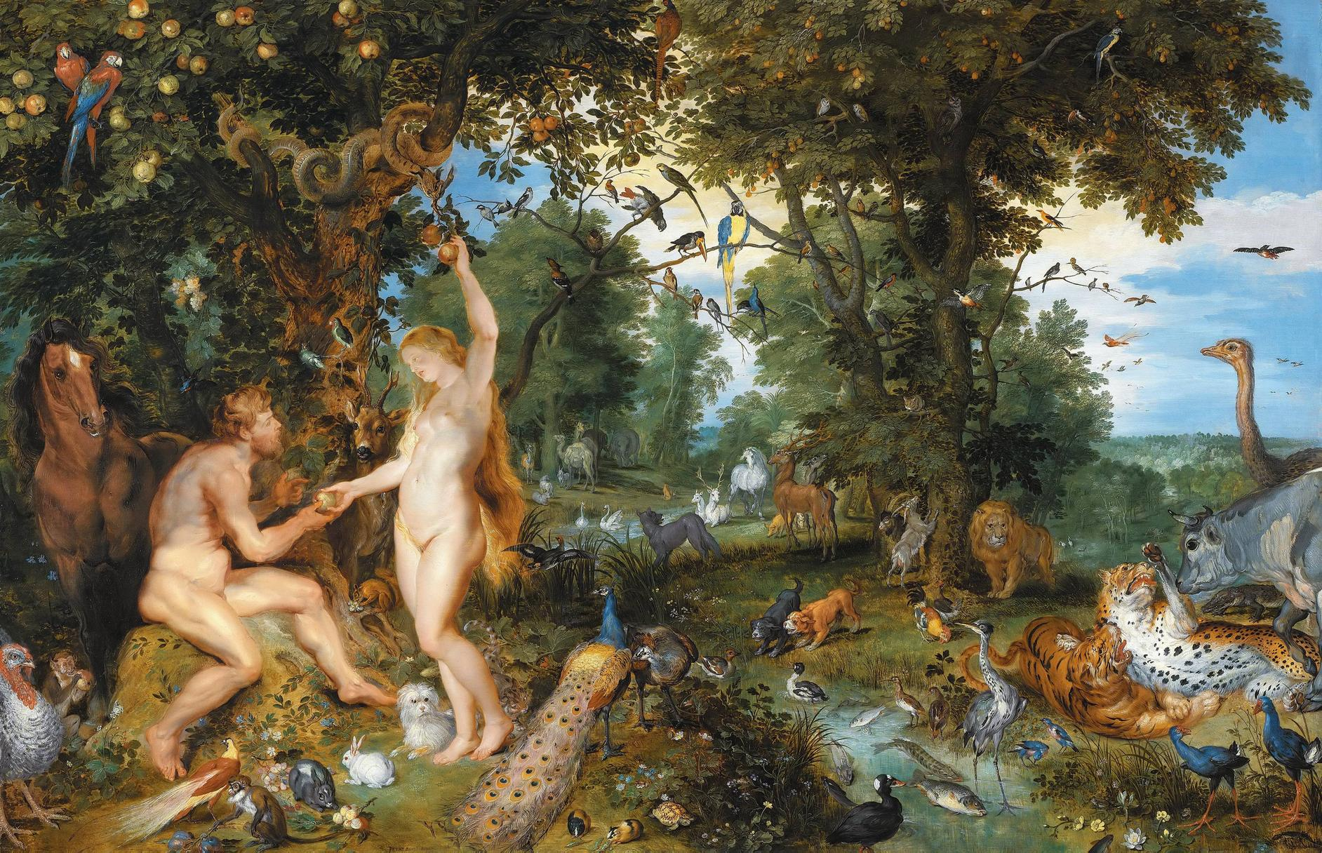
GENESIS
THE BOOK OF
“BEGINNINGS”
Notes:
Photo: adam & eve in the garden of eden

Slide 22
GENESIS
Genesis is the book of origins or beginnings - foundational. The key that unlocks the rest of the Bible.
2 books the devil hates most: Genesis – his entrance; Revelation – his exit.
Sin & condemnation (man ruined)
Not a book of science but is infallible on every issue of science.
Notes:
Photo: adam & eve in the garden of eden

Slide 23
GENESIS
It is a record of creation (the universe, earth and man), humanity’s fall from grace, the story of Noah’s flood and the tower of Babel.
The second part relates the story of God’s plan to redeem both man and the world beginning with a covenant with Abraham.
The rest of Genesis relates the lives of the patriarchs Abraham, Isaac, Jacob and Joseph, ending with the people of God living in Egypt.
Notes:
Photo: adam & eve in the garden of eden

Slide 24
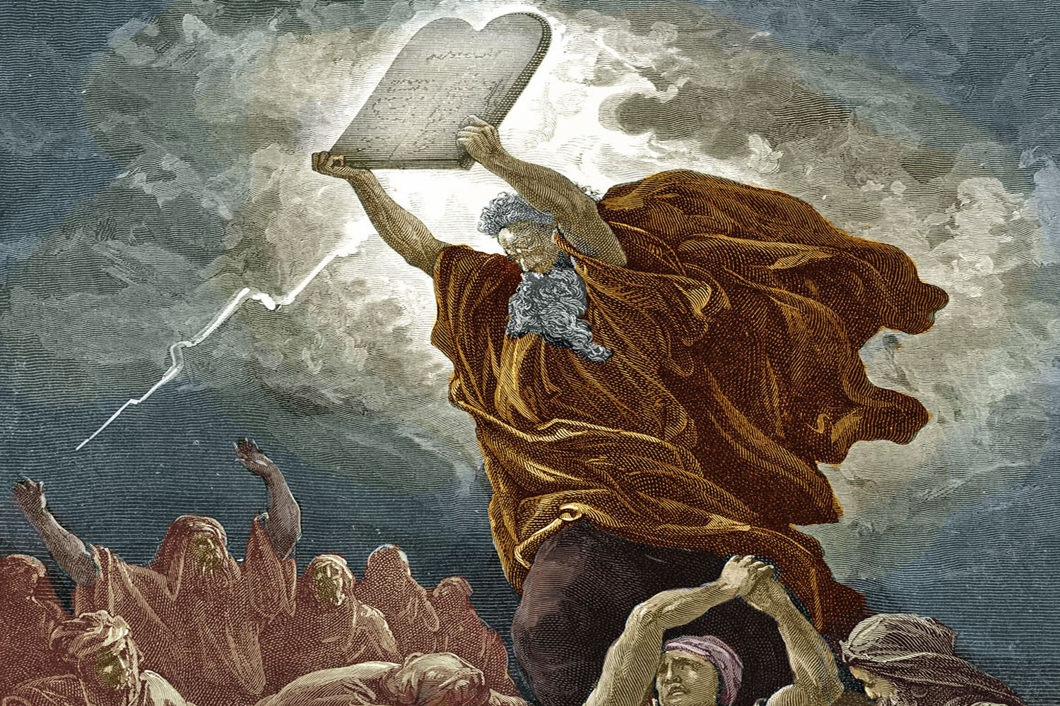
EXODUS
THE BOOK OF
“DELIVERANCE”
Notes:
Photo: moses at mt. sinai with the tablet (10 commandments)

Slide 25
EXODUS
God's redemptive plan unfolded - story of redemption by blood & power.
Redemption & salvation (man redeemed)
A new Pharaoh enslaves the people of God, who cry out for deliverance.
God raises up Moses through whom he delivers his people from Pharaoh through a series of plagues.
Notes:
Photo: moses at mt. sinai with the tablet (10 commandments)

Slide 26
EXODUS
God then guides his people to Mount Sinai where he gives them a set of laws, a constitution by which to live.
The people of God become the nation of God.
The 10 commandments are part of that law and represent the law’s essence.
God orders the building of his tabernacle so that he can dwell amongst His people.
Notes:
Photo: moses at mt. sinai with the tablet (10 commandments)

Slide 27
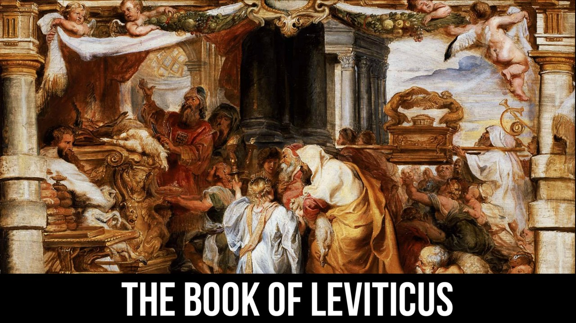
LEVITICUS
THE BOOK OF
“INSTRUCTION”
Notes:
Photo: giving offerings

Slide 28
LEVITICUS
More of God's words than any book in Bible. No narratives.
Separation, consecration & holiness (man worshipping God)
Common reactions - boring, unfamiliar & irrelevant.
Notes:
Photo: giving offerings

Slide 29
LEVITICUS
The law of the priests.
The book of worship.
God gives laws to his people, governing their sacrifices and festivals. In addition, God gives a set of purity laws to his people, including dietary restrictions to keep them holy.
Notes:
Photo: giving offerings

